Slide 1

Risk
Toxicology
Hazardous Waste

Slide 2
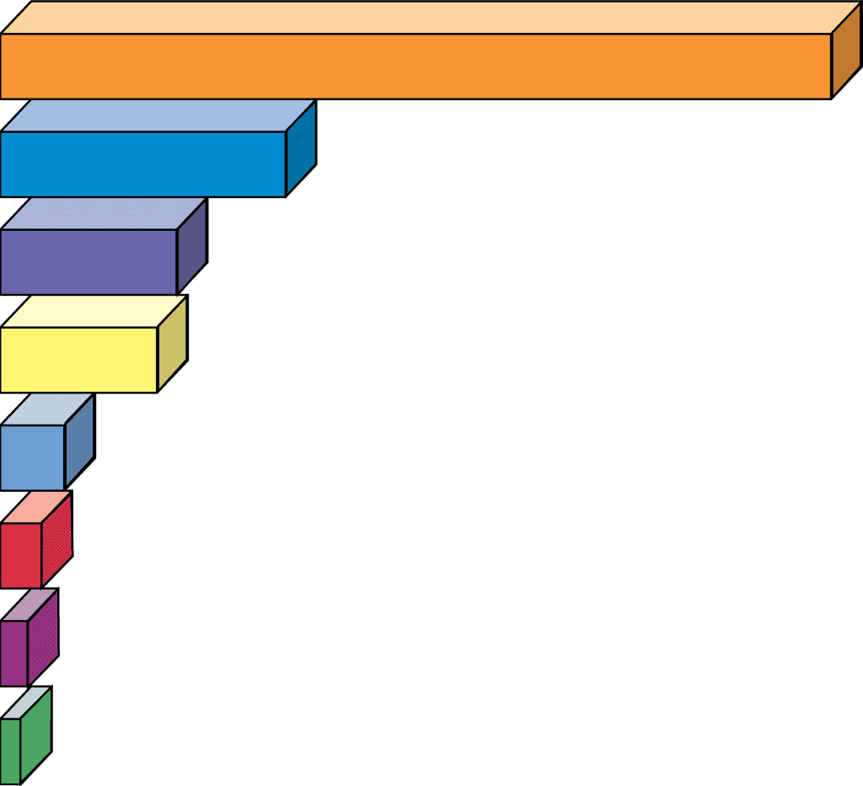
Cause of Death
Deaths
Tobacco use
440,000
Alcohol use
150,000
Accidents
95,600 (41,800 auto)
Pneumonia and
influenza
67,000
Suicides
28,300
Annually in US
Homicides
16,100
Hard drug use
15,600
AIDS
14,400
© 2004 Brooks/Cole – Thomson Learning

Slide 3
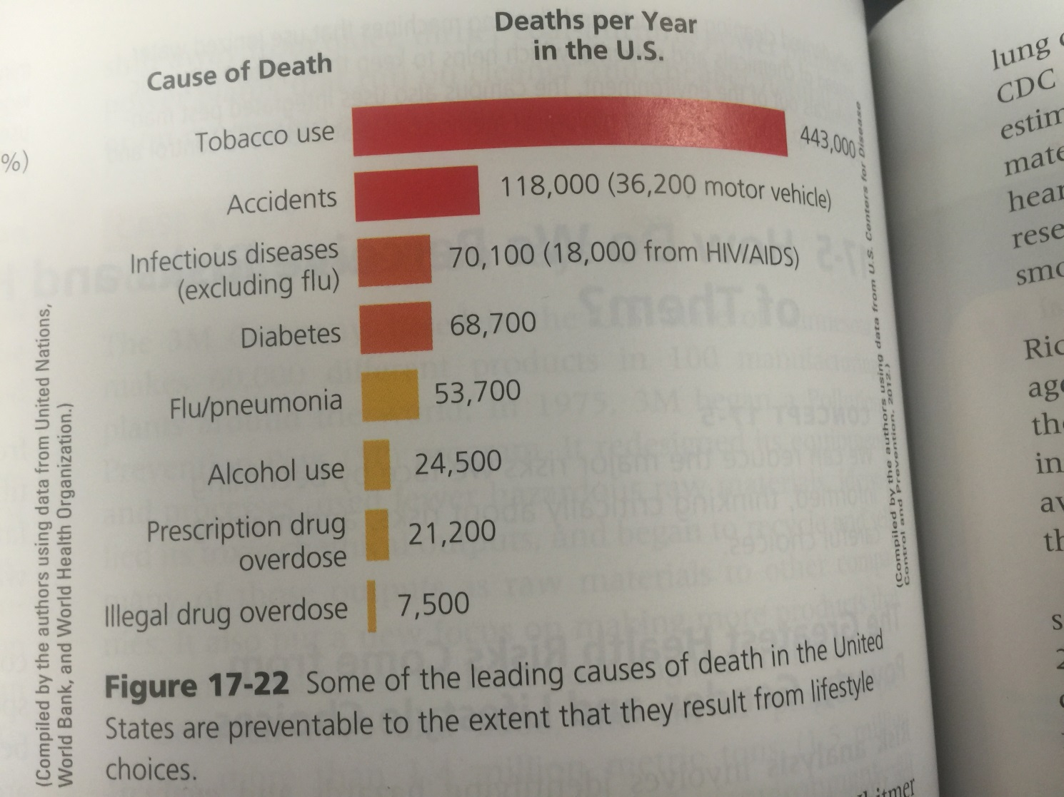

Slide 4
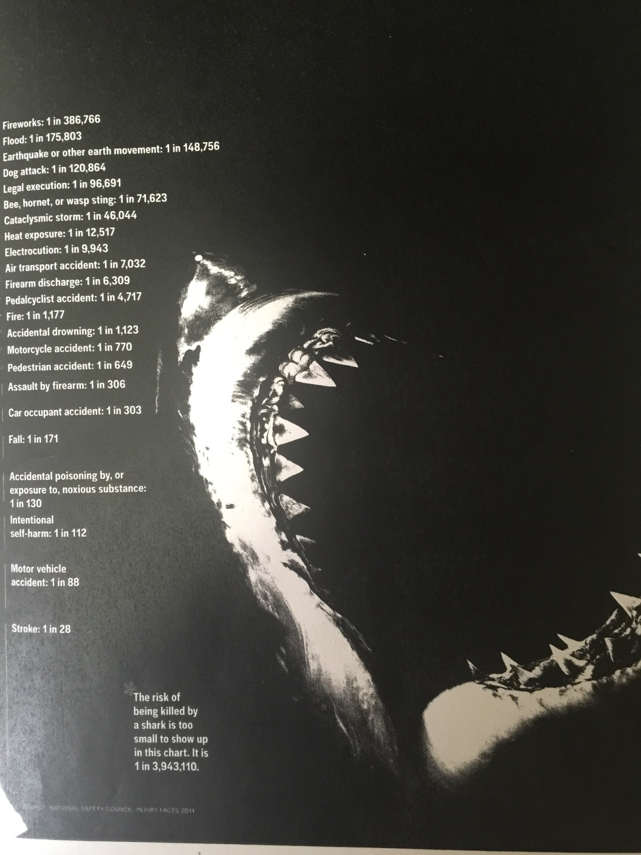

Slide 5
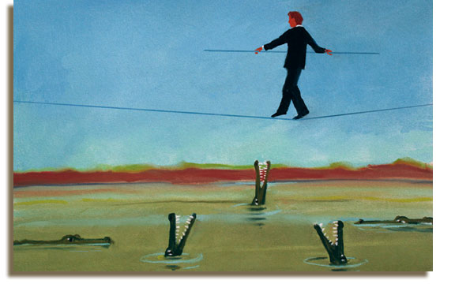
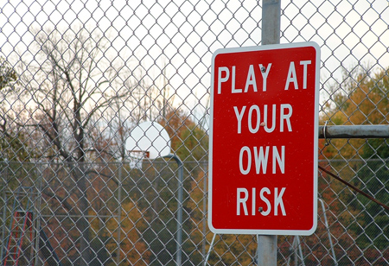
Risk, Toxicology, and Human Health
Risk – possibility of loss or injury
Hazard – a source of danger
Risk assessment/management
4 types of Hazards:
1) Cultural Hazards – unsafe working conditions, smoking, poor diet, drugs
2) Chemical Hazards – air, water, soil, and food
3) Physical Hazards – fires, earthquakes, volcanoes, hurricanes
4) Biological Hazards – pathogens, pollens, animals

Slide 6
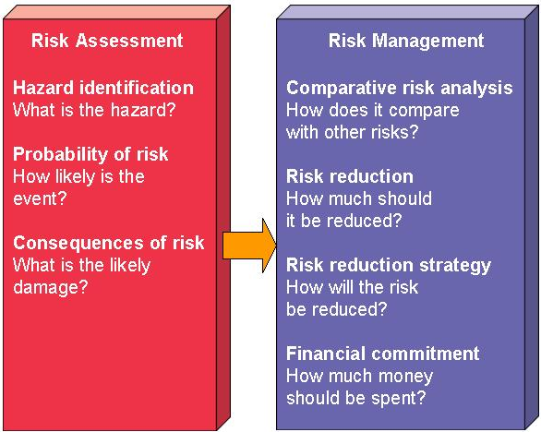
Risk and Probability
Risk
Probability
Risk
assessment
Risk
management
Fig. 11-2 p. 229

Slide 7
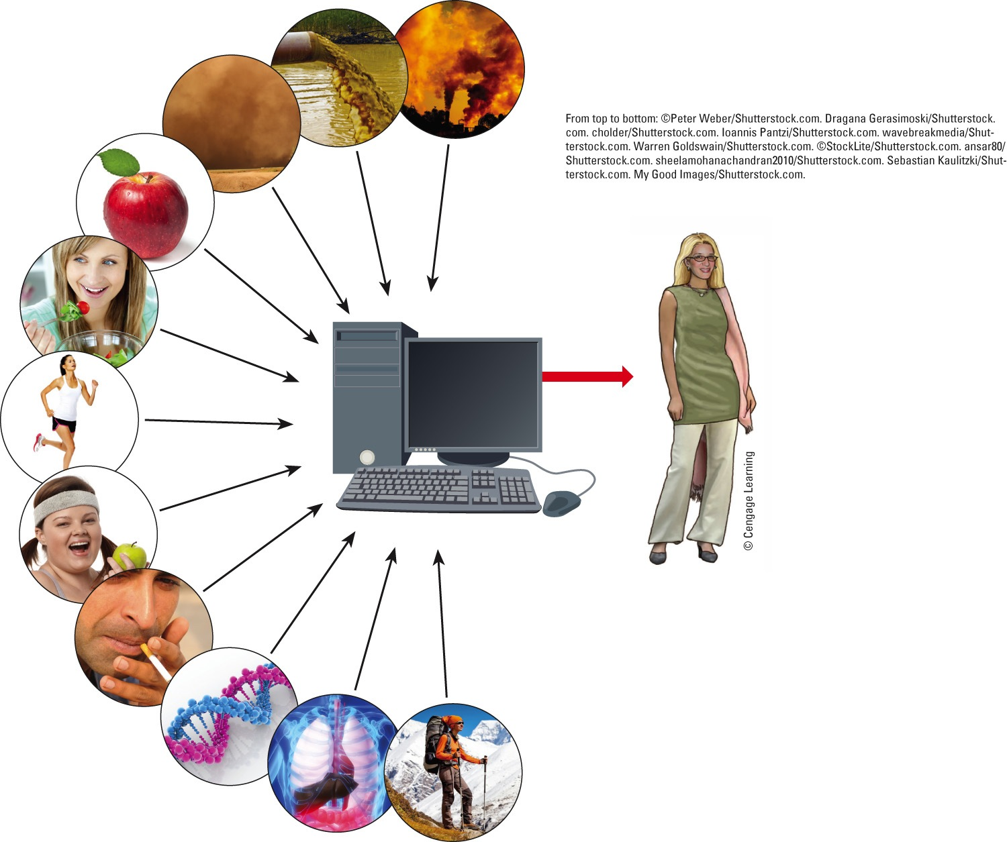
Water pollutant levels
Air pollutant levels
Soil/dust levels
Food pesticide levels
Nutritional health
Scientific measurements and modeling
?
Overall health
Lifestyle
Predicted level of toxicant in people
Personal habits
Genetic predisposition
Metabolism
Accumulation
Lung, intestine,
and skin absorption rates
Excretion
Fig. 17.16, p. 459
Notes:
Figure 17-16: Toxicology. Estimating human exposure to chemicals and measuring the effects of that exposure are very difficult because of the many and often poorly understood variables involved. Question: What are three of these factors that might make you more vulnerable to the harmful effects of chemicals?

Slide 8
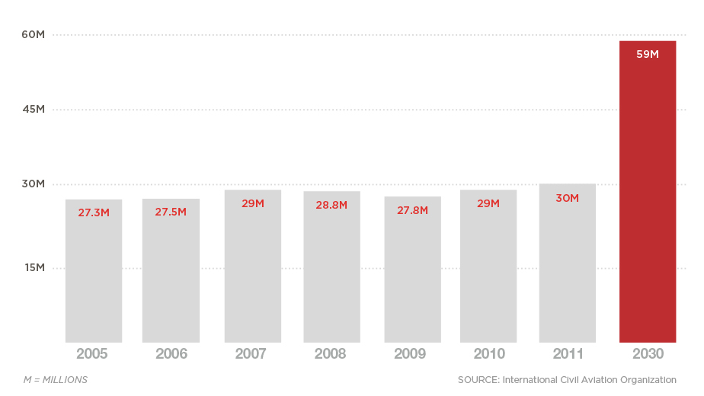
Annual Worldwide Commercial Departures

Slide 9
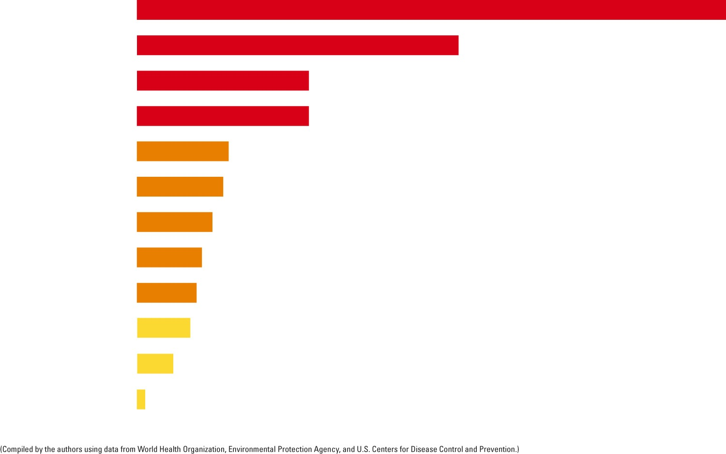
Cause of death
Annual deaths
Poverty/malnutrition/ disease cycle
11 million (150)
Tobacco
6.0 million (82)
Pneumonia and ﬂu
3.2 million (44)
Air pollution
3.2 million (44)
HIV/AIDS
1.7 million (23)
Number of deaths per year in the world. Numbers in parenthesis give these deaths in terms of the # of fully loaded jumbo (200 passenger) jets crashing accidentally every day of the year with no survivors
Diarrhea
1.6 million (22)
Tuberculosis
1.4 million (19)
Automobile accidents
1.2 million (16)
Work-related
injury and disease
1.1 million (15)
Malaria
1.0 million (14)
Hepatitis B
655,000 (9)
Measles
139,000 (2)
Fig. 17-20, p. 465
Notes:
Figure 17-20: Global outlook: Scientists have estimated the number of deaths per year in the world from various causes. Numbers in parentheses represent these death tolls in terms of numbers of fully loaded 200-passenger jet airplanes crashing every day of the year with no survivors. Question: Which three of these causes are the most threatening to you?

Slide 10
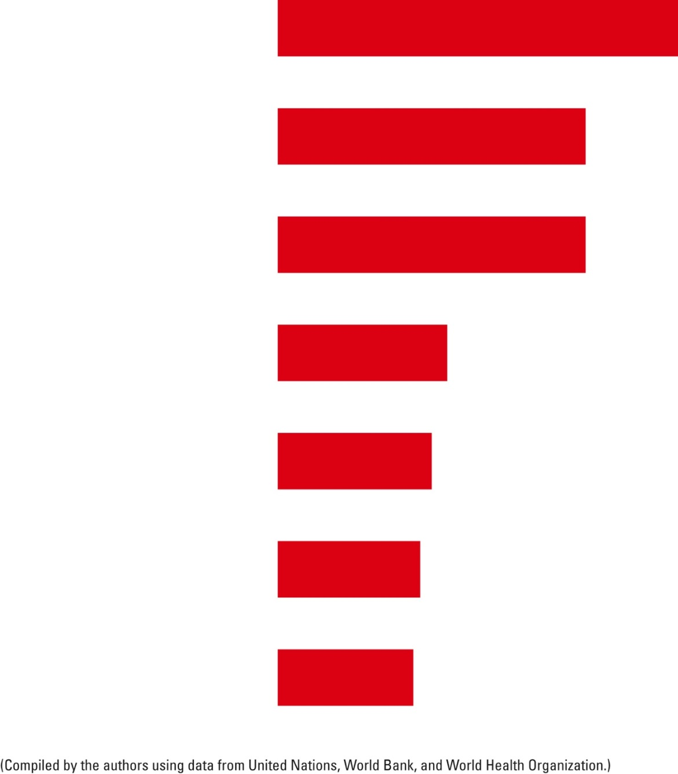
Lack of access to
Number of people
(% of world’s population)
Adequate
sanitation facilities
2.6 billion (37%)
Enough fuel for
heating and cooking
2 billion (28%)
Electricity
2 billion (28%)
Adequate health care
1.1 billion (15%)
Adequate housing
1 billion (14%)
Enough food for good health
925 million (13%)
Clean
drinking water
880 million (12%)
Fig. 17-21, p. 466
Notes:
Figure 17-21: These are some of the harmful effects that result from living in poverty. Questions: Which two of these effects would be the most harmful for you? Why?

Slide 11



Toxicology
Toxicity – measure how harmful a substance is
DEPENDS ON:
1)dose – amount person ingested
2) Frequency of exposure
Ex – Asbestos?
3) Victim – child or adult
4) Body’s Defense
5) Genetic Makeup
A basic concept in toxicology:
“Any chemical can be harmful if ingested in a large enough quantity”
EX- 100 cups of coffee in a row can be lethal
***Anything in moderation is okay
safe/threshold level
http://storyofstuff.org/electronics/
Story of Stuff - toxicity
Notes:
1)Dose – amount person ingested – first thing poison control asks
2)Frequency of exposure – Ex – How much exposure to asbestos
3)Victim – child or adult
4)Body’s defense – how well can our lungs, liver, and kidney work
5)Genetic makeup – each individual sensitiity different

Slide 12
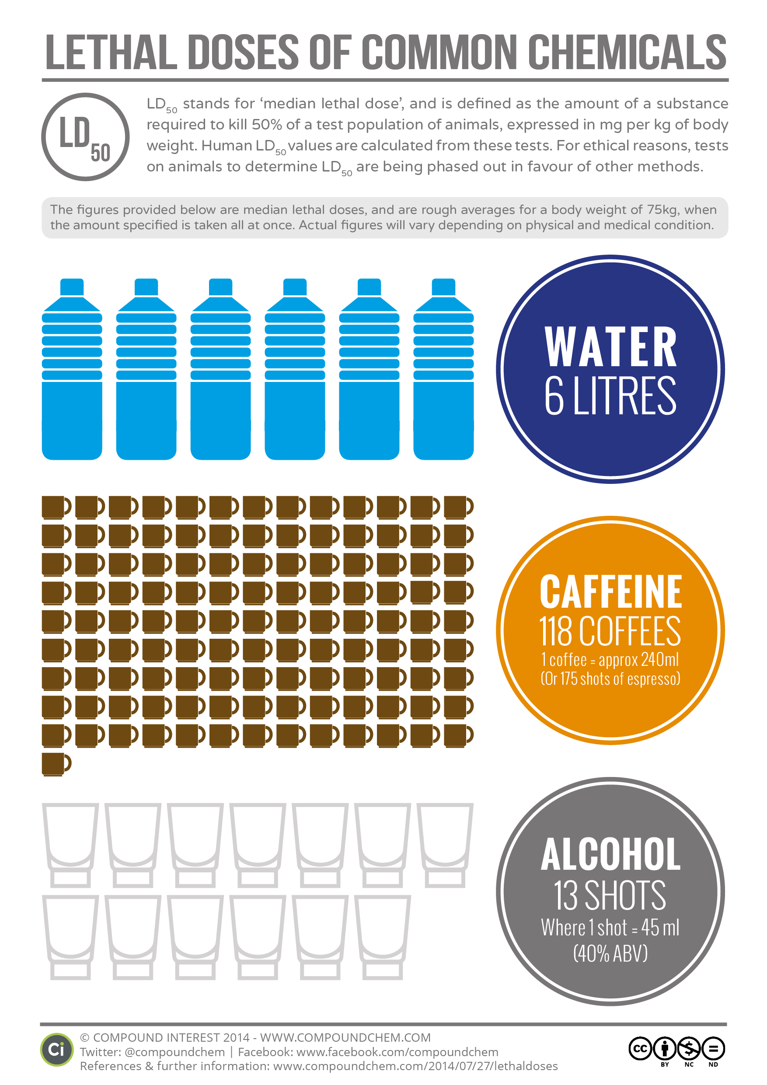

Slide 13
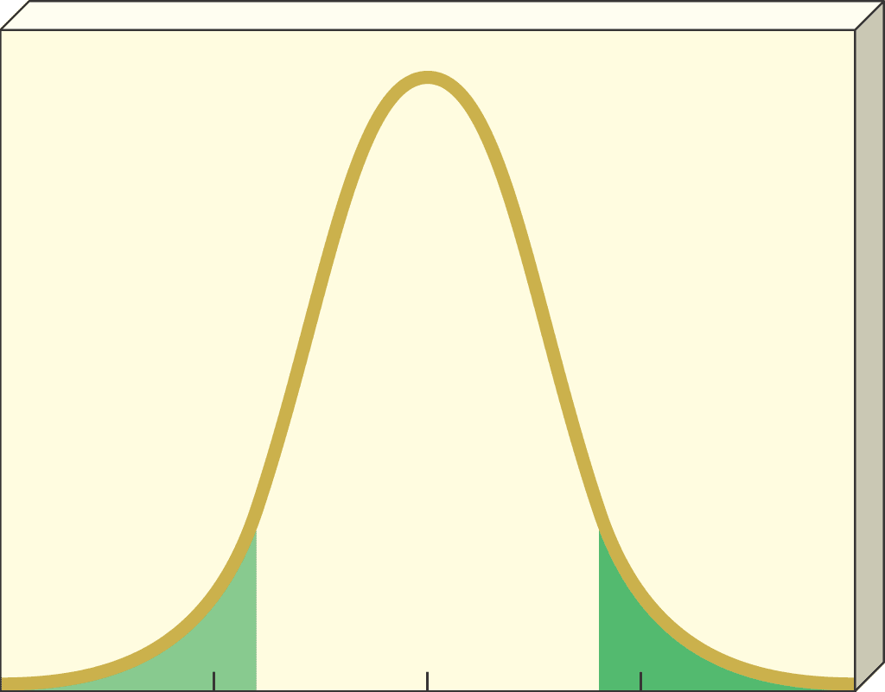
© 2004 Brooks/Cole – Thomson Learning
Number of individuals affected
Very
sensitive
Majority
of population
Very
insensitive
0
20
40
60
80
Dose (hypothetical units)

Slide 14

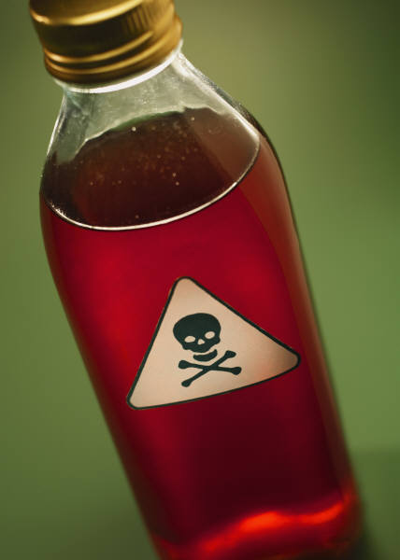
Poison
LD50 – median lethal dose –
Ex - administering to mice a substance with an LD50 for mice of 10 mg/kg would kill 50 percent of a population of mice.
What’s the world’s most powerful animal poison?
http://worldtop10.net/top-10-deadliest-poisons-in-the-world/
Notes:
Toxicity is usually measured by the LD50: the amount needed to kill half the creatures (usually mice) to whom a poison is given. Amusingly, the worst found so far is the bacterial protein botulin – Botox. Based on mice, its LD50 when injected into humans is less than 0.1 micrograms. For poisons from animals, batrachotoxin is often mentioned. Various estimates of its equivalent LD50 give somewhat under 100 micrograms:

Slide 15
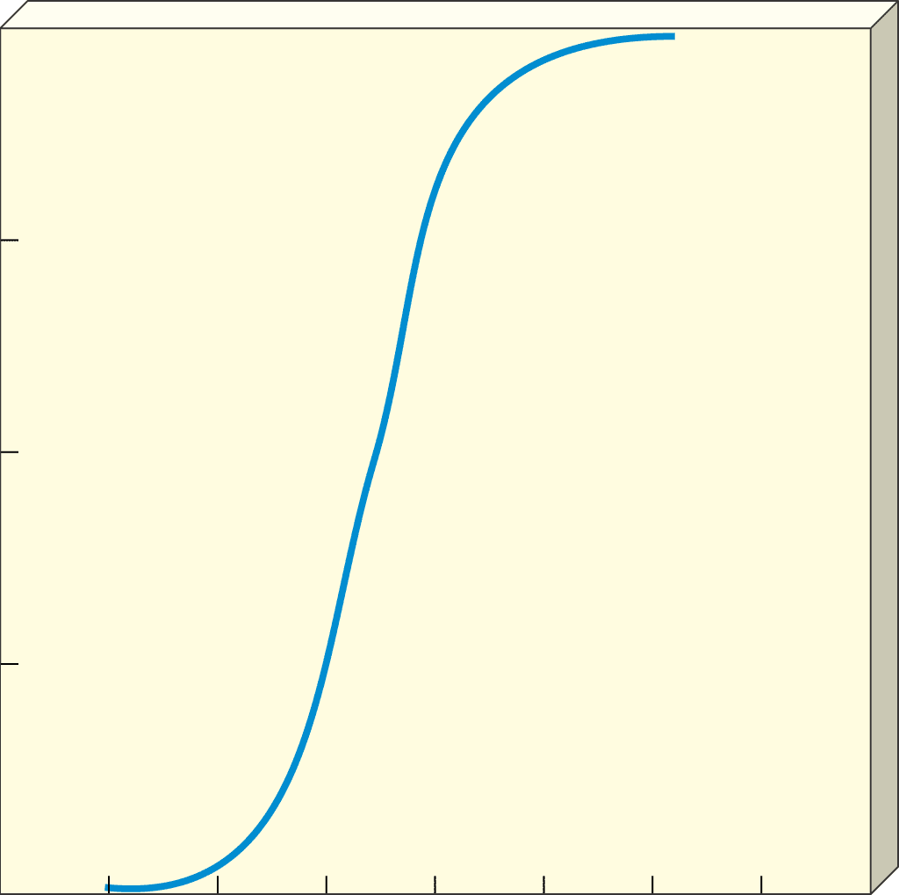
100
© 2004 Brooks/Cole – Thomson Learning
Dose Response Curve
75
Percentage of population killed by a given dose
50
Threshold of toxicity – ADD NEXT YEAR
25
LD
50
0
8
2
4
6
10
12
14
16
Dose (hypothetical units)

Slide 16
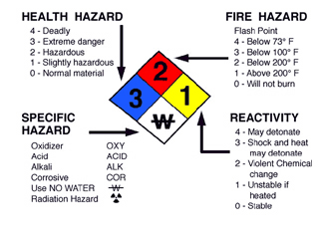
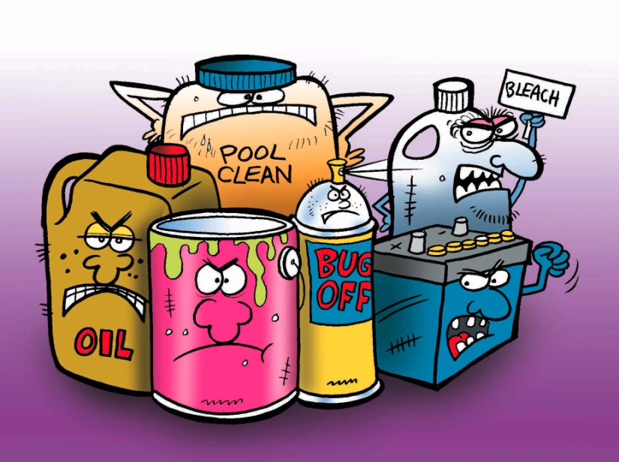
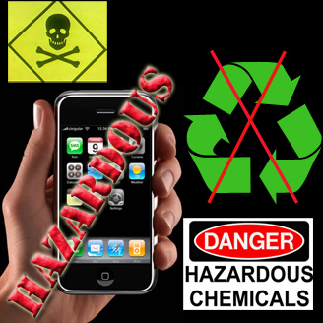
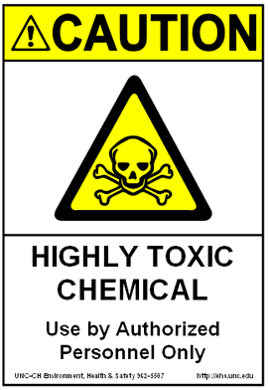
Chemical Hazards
Toxic chemicals – fatal to more than 50% of test animals
**HAZMAT chemical
Toxic, ignitable, corrosive, reactive
Notes:
toxic, ignitable, corrosive, reactive
T-solvents, pesticides, paint strippers
I-gasoline, paints, solvents)
C-industrial cleaning agents and oven, drain cleaners
R-acids, bases, ammonia, chlorine bleach

Slide 17
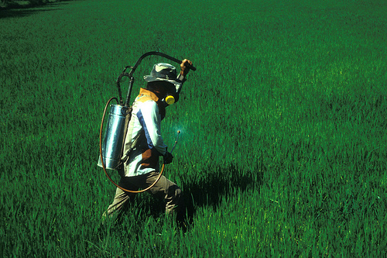
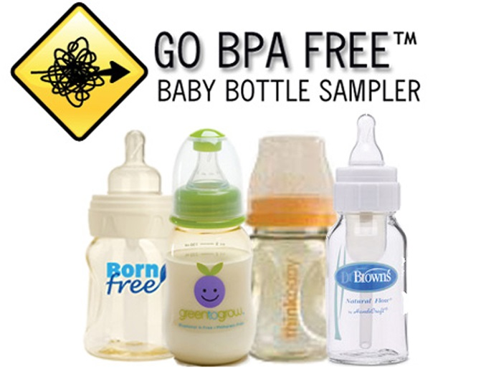
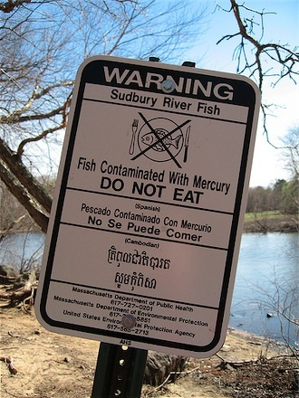
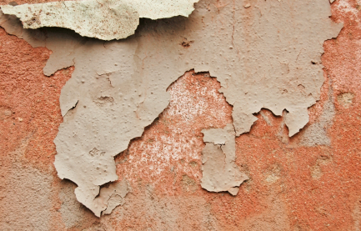
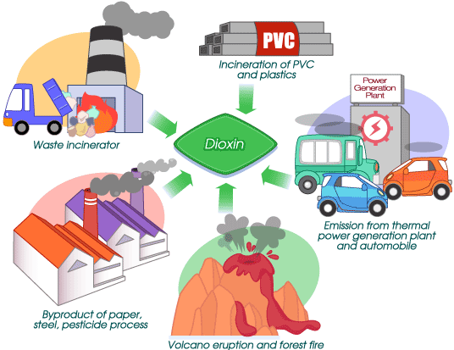
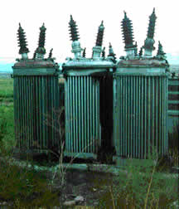
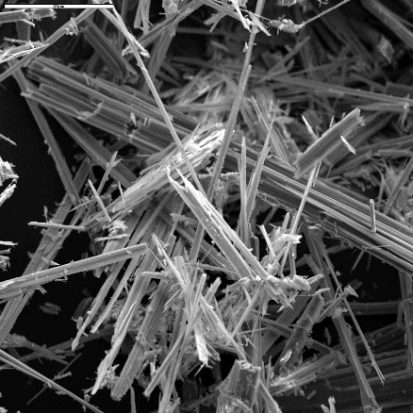
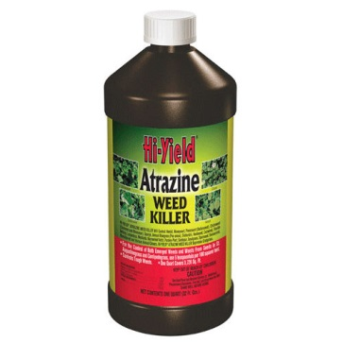
Notable Toxins
Lead
Mercury
Dioxins
Asbestos
PCBs
Biophenol-A (BPA)
Aldicarb
Atrazine
Notes:
Lead – oil pipes, paint and gasoline, batteries, causes brain damage and kidney problems
Mercury – coal burning, same as lead
Dioxins – burning of waste and industrial processes – causes cancer, disrupts reproductive and endocrine and immune
Asbestos – insulation in old buildings – lung cancer and mesothelioma
PCB – industrial chemical & now banned but persists a long time, neurotoxin
Biophenol-A – found in plastics, receipt tape – endocrine disruptor
Aldicarb – pesticide, possible teratogen
Atrazine – herbicide – endocrine disruptor, causes amphibians to become hermoprodites or sexually impaired

Slide 18
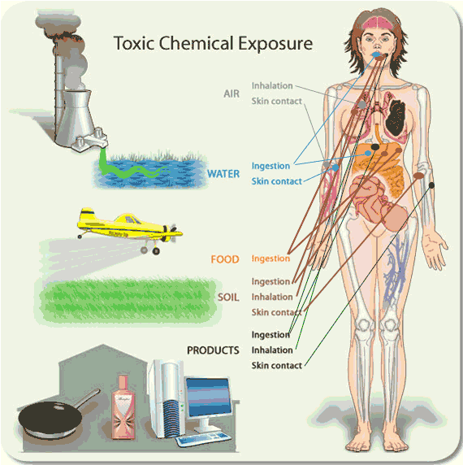
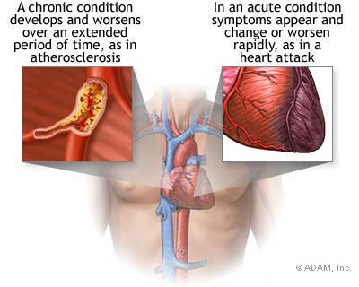
Exposure
Response – reaction to toxin
Allergic Reaction
Mutagens,Teratogens
Carcinogens
HEALTH DAMAGE:
Acute – immediate
Chronic -long-lasting
Notes:
Mutagens – cause mutations in cells
Teratogens – birth defects
Carcinogens – cause growth of malignant tumors, cells multiply uncontrollably

Slide 19
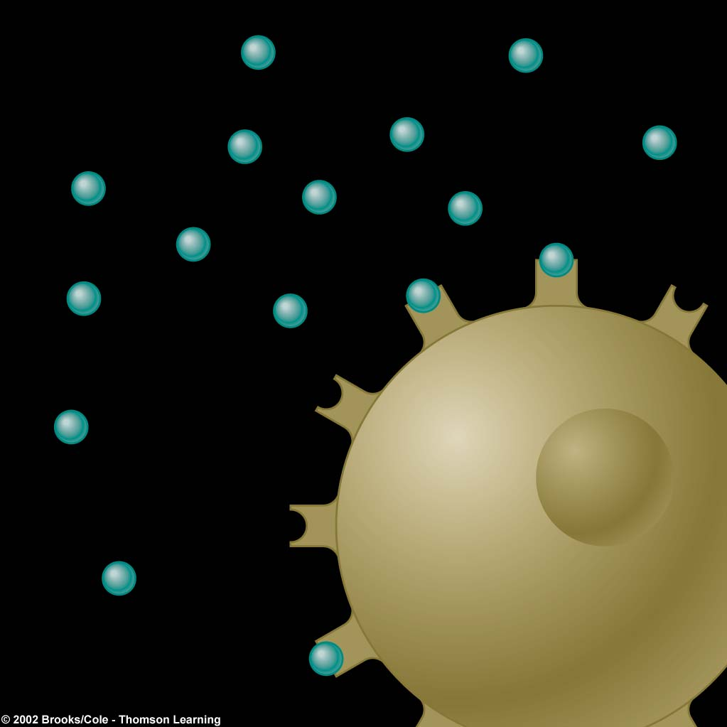
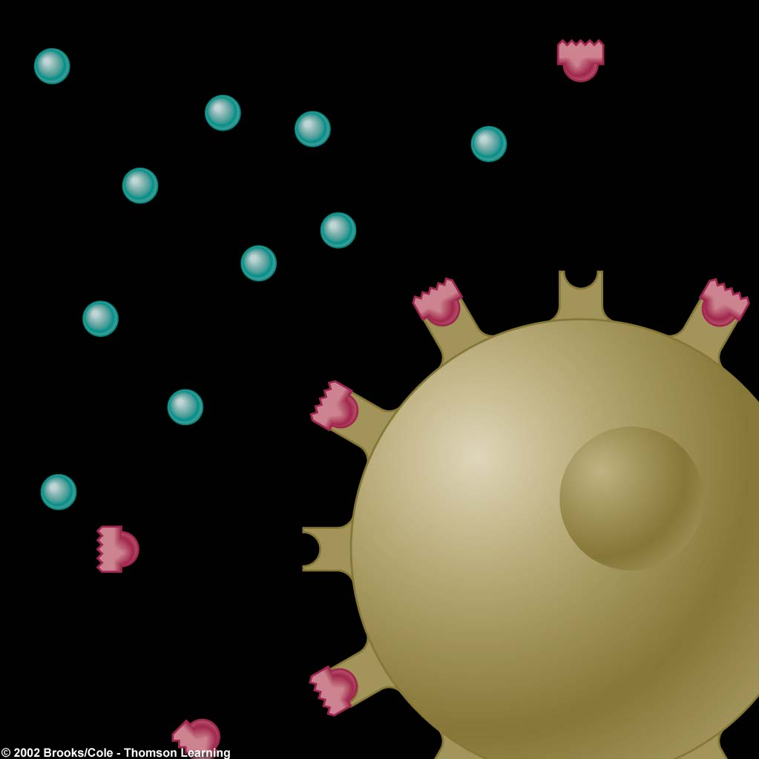
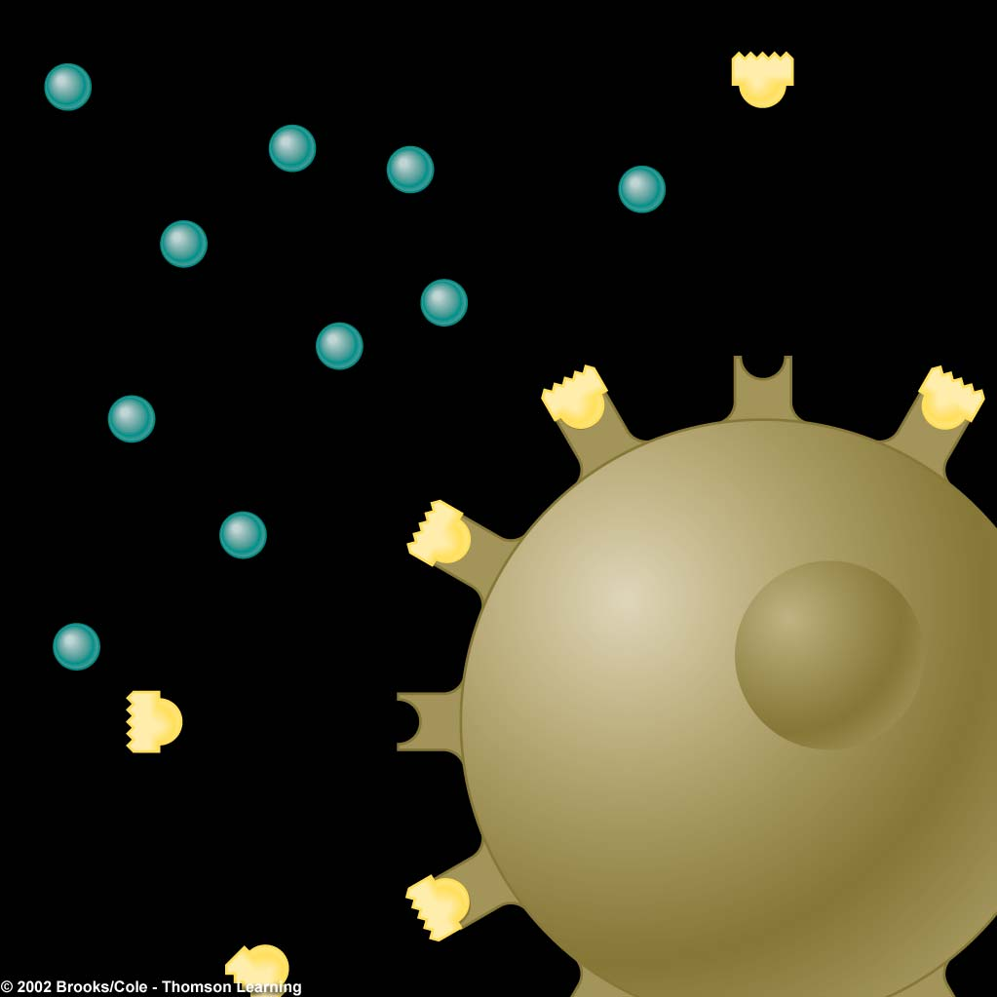
Hormone
Estrogen-like chemical
Antiandrogen chemical
Receptor
Cell
Normal Hormone Process
Hormone Mimic
Hormone Blocker
Endocrine Disrupter
Act as “hormone imposters” and attach to hormones and interfere with them (called hormonally active agents) HAA

Slide 20
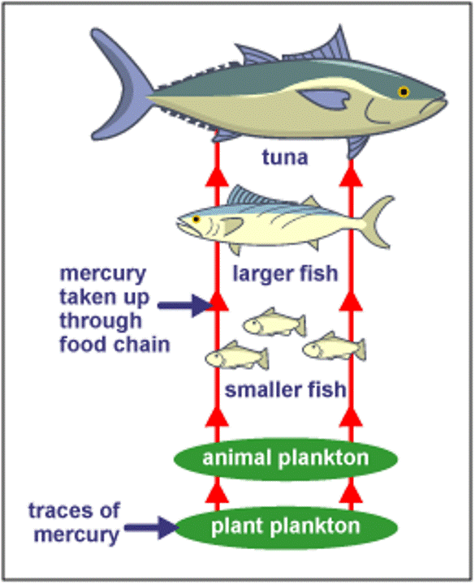
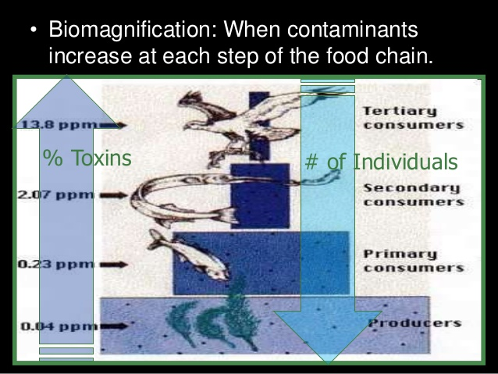
Bioaccumulation – accumulate in body in high levels
Biomagnification – toxic levels can be magnified
Ex – passed on to offspring as it goes through food chain
http://www.youtube.com/watch?v=E5P-UoKLxlA
Fig. 11-4
p. 231

Slide 21
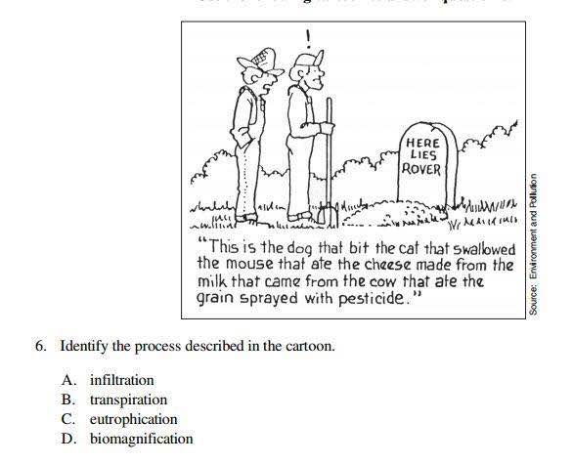

Slide 22
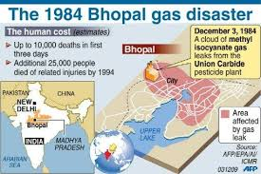
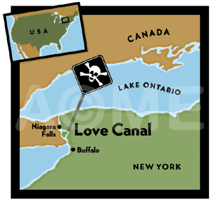
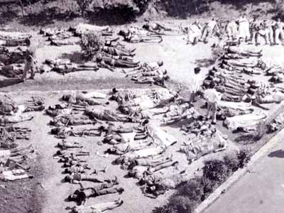
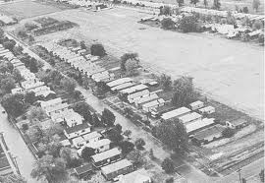
Love Canal
Bhopal Disaster
1978
http://www.nytimes.com/2013/11/25/booming/love-canal-and-its-mixed-legacy.html?_r=0
Notes:
http://www2.epa.gov/aboutepa/love-canal-tragedy

Slide 23
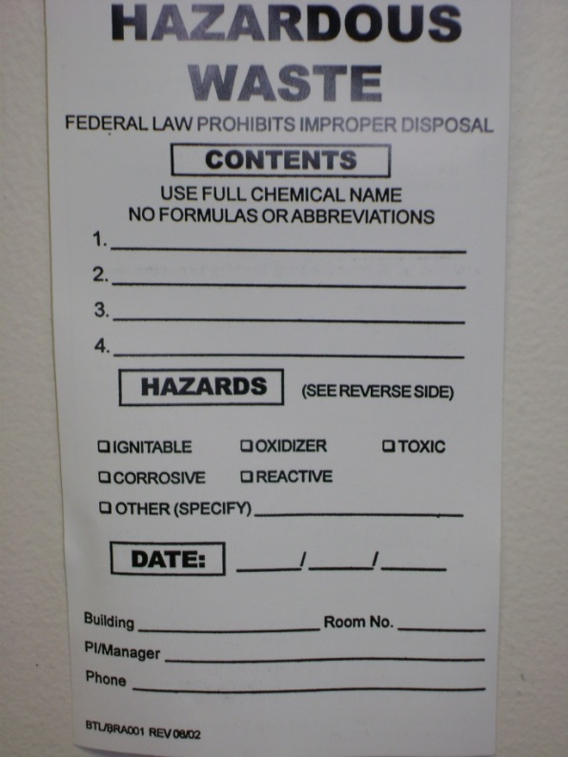
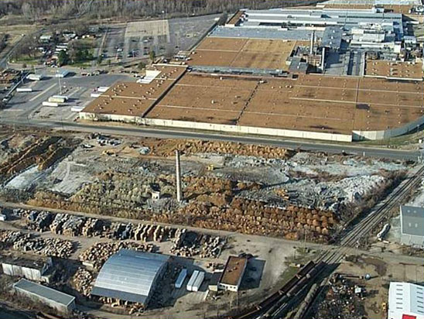
Legislation
1)RCRA 1976
“cradle to grave”
“prevention”
2)CERCLA/Superfund
“cleanup”
Brownfields
abandoned areas
contaminated (not as much as a superfund site)
Ex – factories, junkyards
POPs treaty
Dirty Dozen
http://www.pops.int/documents/pops/default.htm
Notes:
`RCRA – Resource Conservation & Recovery Act - requires EPA to identify hazardous wastes and set standards
CERCLA – Comprehensive Environmental Response Compensation and Liability Act - clean up abandoned hazardous waste dump sites
POPS – 12 persistent organic pollutants – most dangerous chemicals, most banned in US http://www.epa.gov/international/toxics/pop.html

Slide 24
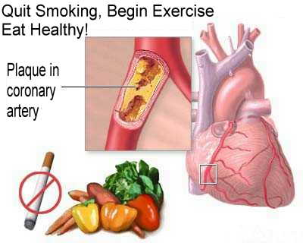
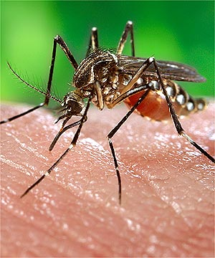
Biological Hazards
Nontransmissable disease
Ex-heart disease, cancer, asthma
Transmissible disease –Infectious agents – pathogens EX – AIDS, malaria
Ex Malaria
mosquito
protozoan-genus Plasmodium
What are some Deadly Diseases?
Notes:
Nontransmissable - multiple causes, not transmitted from person to person
Ex – heart disease, cancer, asthma
Transmissable - caused by a living organism like a bacteria, virus, protozoa, can be spread from person to person - (spread by air, water, food, body fluids, vectors (insects)

Slide 25







Disease
(type of agent)
Deaths per year
Pneumonia and flu
(bacteria and viruses)
3.2 million
HIV/AIDS (virus)
2.1 million
Diarrheal diseases (bacteria and viruses)
1.9 million
Tuberculosis (bacteria)
1.7 million
Malaria
(protozoa)
1 million
Hepatitis B
(virus)
1 million
Measles
(virus)
© Cengage Learning 2015
800,000
Stepped Art
Fig. 17-4, p. 445
Notes:
Figure 17-4: Global outlook: The World Health Organization has estimated that the world’s seven deadliest infectious diseases killed about 10 million people per year—most of them poor people in less-developed countries (Concept 17-2). This averages about 27,400 mostly preventable deaths every day. Question: How many people, on average, die prematurely from these diseases every hour?

Slide 26
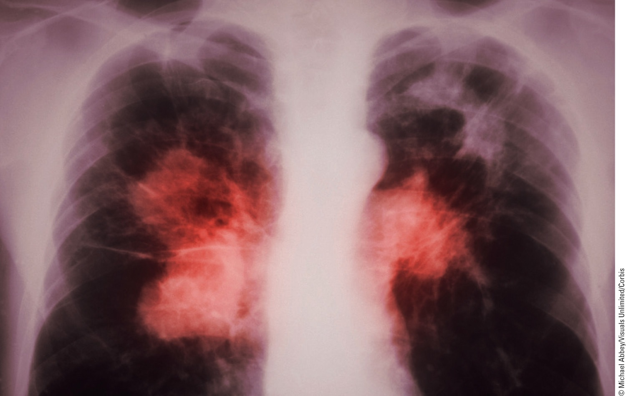
Fig. 17-5, p. 445
Notes:
Figure 17-5: The colorized red areas in this chest X-ray show where TB bacteria have destroyed lung tissue.

Slide 27
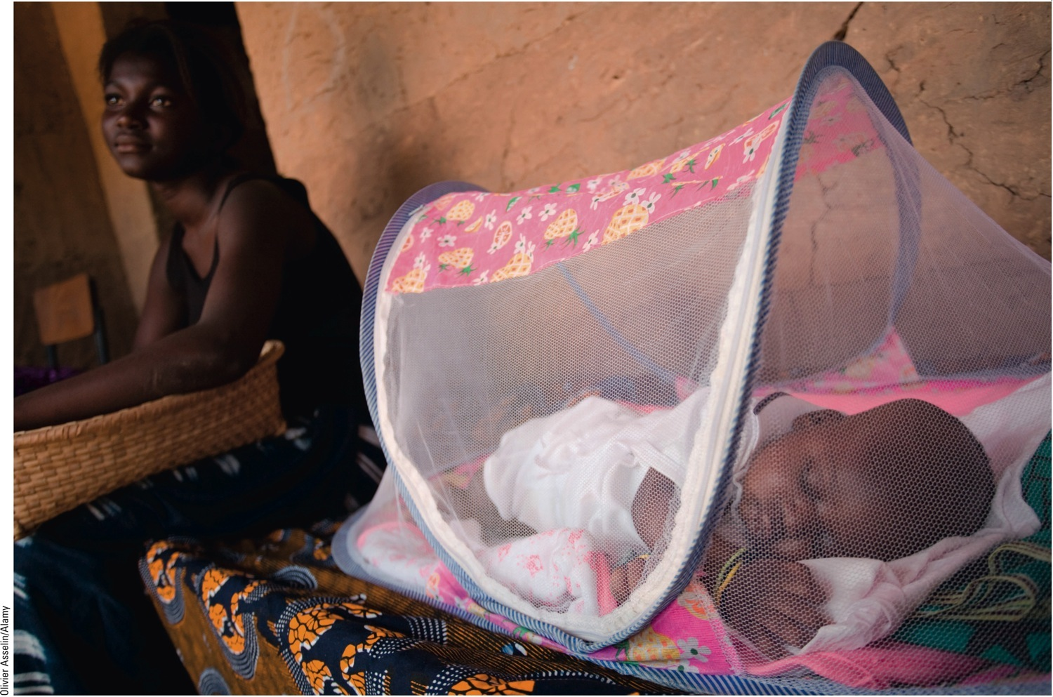
© Cengage Learning 2015
Fig. 17.8, p. 452
Notes:
Figure 17-8: This baby in Senegal, Africa, is sleeping under an insecticide-treated mosquito net to reduce the risk of being bitten by malaria-carrying mosquitoes.

Slide 28
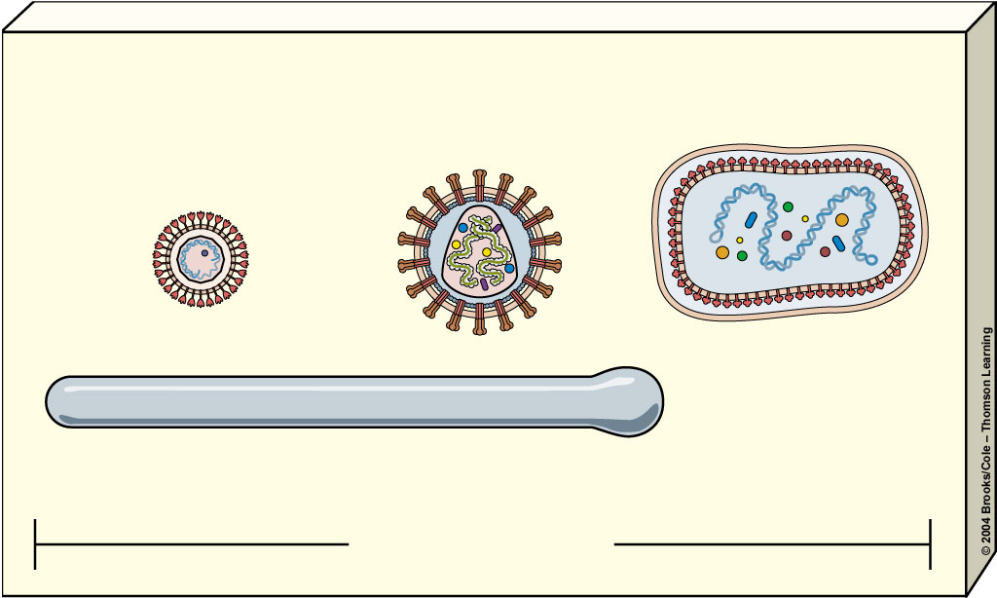
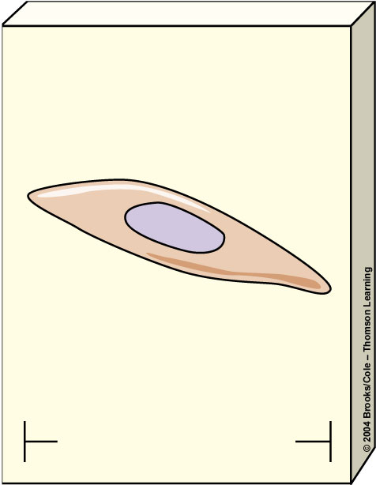
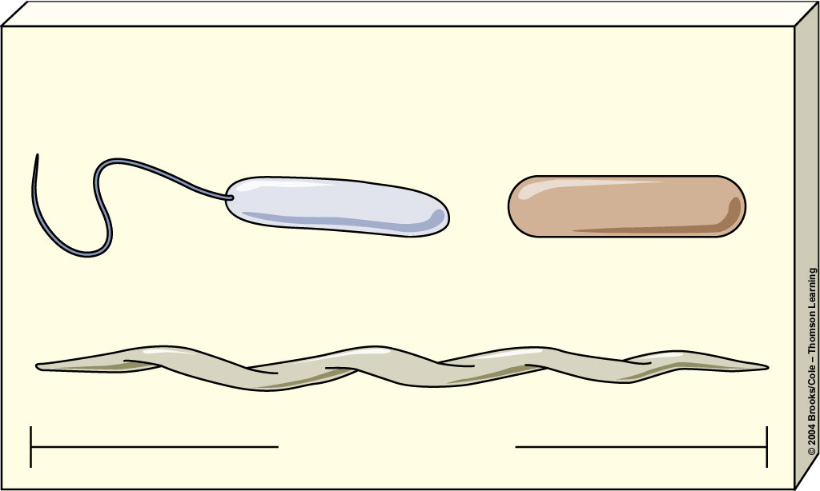
Viruses
HIV
(AIDS)
Smallpox
Hepatitis B
Protozoa
Ebola
On this scale, a human hair would be 6 meters (20 feet) wide
1 micrometer
Plasmodium
(malaria)
Bacteria
Vibrio cholerae
(cholera)
Myobacterium
tuberculosis
(tuberculosis)
10 micrometers
Treponema pallidum (syphilis)
6 micrometers

Slide 29

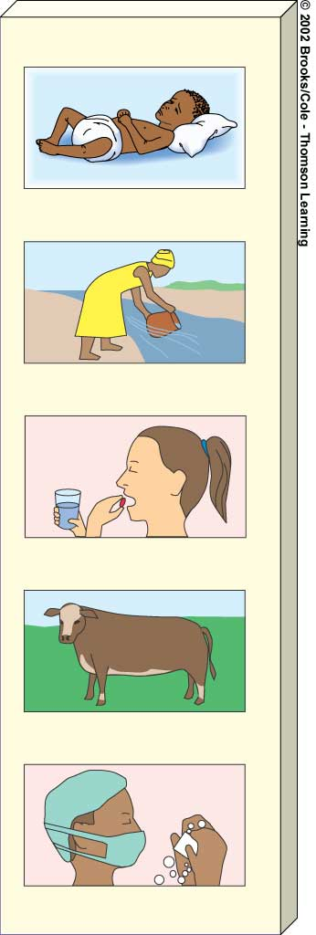
Increase research on
tropical diseases and
vaccines
Reduce poverty
Decrease malnutrition
Improve drinking
water quality
Reduce unnecessary
use of antibiotics
Educate people to
take all of an
antibiotic prescription
Reduce antibiotic use
to promote livestock
growth
Careful hand washing
by all medical
personnel
Slow global warming
to reduce spread of
tropical diseases to
temperate areas
Increase preventative
health care

Slide 30
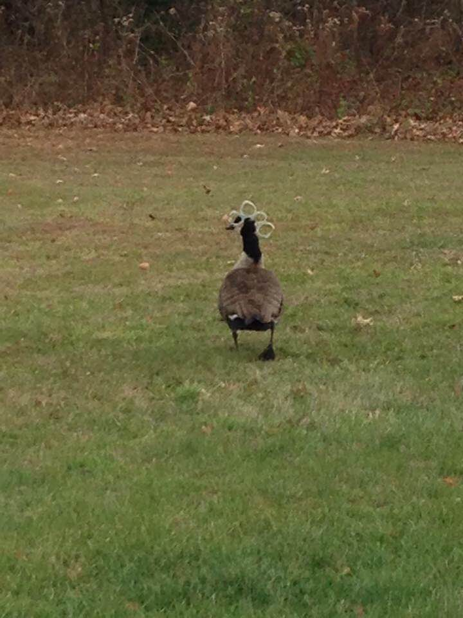

Slide 31
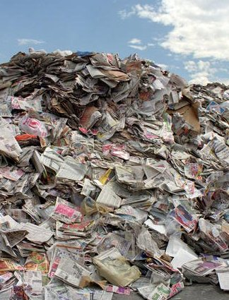
Chapter 21 Solid and Hazardous Waste
US – 4.6% of world’s population, produces 33% of solid waste
Solid waste – unwanted/discarded material that is not a liquid or a gas
98.5% - mining, oil and natural gas production, agriculture, sewage sludge, industrial activity
1.5% - MSW (municipal solid waste)
homes and businesses
“GARBAGE”
506 billion pounds in US each year
Paper most
Each person in US/year produces – 1700 pounds (770kg)
54% of MSW – dumped into landfills
30% of MSW – recycled and composted
16% of MSW – burned in incinerators
E-waste – (electronic waste)
cell phones, computers, TV sets
toxic wastes given off (lead, mercury)

Slide 32



Landfills
http://techalive.mtu.edu/meec/module15/Landfills.htm
Interactive diagram of Landfill
Sanitary Landfill
cover with clay,spread out
have liner with clay and plastic to prevent leakage into groundwater
LEACHATE – formed from mixture with rainwater
sent to sewage treatment plant

Slide 33



Recycling Center
A recycling center works by first separating all the materials that enter the center into one of three categories: paper, metal or plastic. Once the material has been categorized into its proper type, the plant can recycle
Primary recycling – produce same type of products
Ex newspaper, aluminum
Secondary recycling – produce something different – lower quality
Does cost of recycling benefit us? Is it worth it?
MRFs (Materials Recovery Facilities) – separate mixed waste
Expensive, produce ash and pollutants
Paper – easiest to recycle
Plastics – oil and natural gas, more expensive, difficult to isolate
http://storyofstuff.org/bottledwater/

Slide 34


Slide 35




Composting
Naturally break down garbage
Recycling biodegradable wastes
kitchen scraps/leaves
turns back into soil.
“Add equal amounts of kitchen waste and leaves from the autumn leaf drop and... compost happens! “
Just put as much "green" stuff as "brown" stuff in your bin.
The stuff from your kitchen is the "green" stuff.
"Brown" stuff is autumn leaves, sawdust, or even shredded newspaper
Can even use worms
Can use compost as a soil fertilizer, topsoil, landfill cover
Can have odor
Cannot Remove toxic materials from

Slide 36


Incinerators
Combustion of organic materials
Thermal
converted into ash, flue gases, particulates, and heat,
used to generate electric power.
flue gases cleaned of pollutants before dispersed into atmosphere
http://www.youtube.com/watch?v=fwikqijnftQ

Slide 37


How else to Deal with Waste?
Plasma torch – use high temperatures to change waste into gas - syn gas
deep wells,
ponds (above ground)
Pits and landfills (not sanitary)
above ground storage facilities
**All have problem with pollution/cost/etc
Bioremediation – microorganisms convert toxic substances to harmless compounds
Phytoremediation – using plants to remove toxic waste

Slide 38





Waste Management:
“Ecoindustrial revolution” (Industrial ecology)
mimic chemical cycles
Material flow economy
buy and use
Service flow economy
lease or rent services
Ex – Xerox
Increase resource productivity Ex – cars, plastic bags, phones,reduce bulk

Slide 39

Hazardous Waste Disposal
http://www.epa.gov/recyclecity/dropoff.htm

