Slide 1
Chapter 12 The Human Population: Growth, Demography, and Carrying Capacity
http://www.youtube.com/watch?v=pdlKVfk7_iQ&feature=related
“The More the Merrier”
Notes:
http://www.youtube.com/watch?v=4BbkQiQyaYc IF HAVE TIME
7 minutes on population change

Slide 2
World Population Reached
1 billion in 1804
2 billion in 1927 (123 years later)
3 billion in 1960 (33 years later)
4 billion in 1974 (14 years later)
5 billion in 1987 (13 years later)
6 billion in 1999 (12 years later)
World Population May Reach
7 billion in 2013 (14 years later)
8 billion in 2028 (15 years later)
9 billion in 2050 (22 years later)

Slide 3
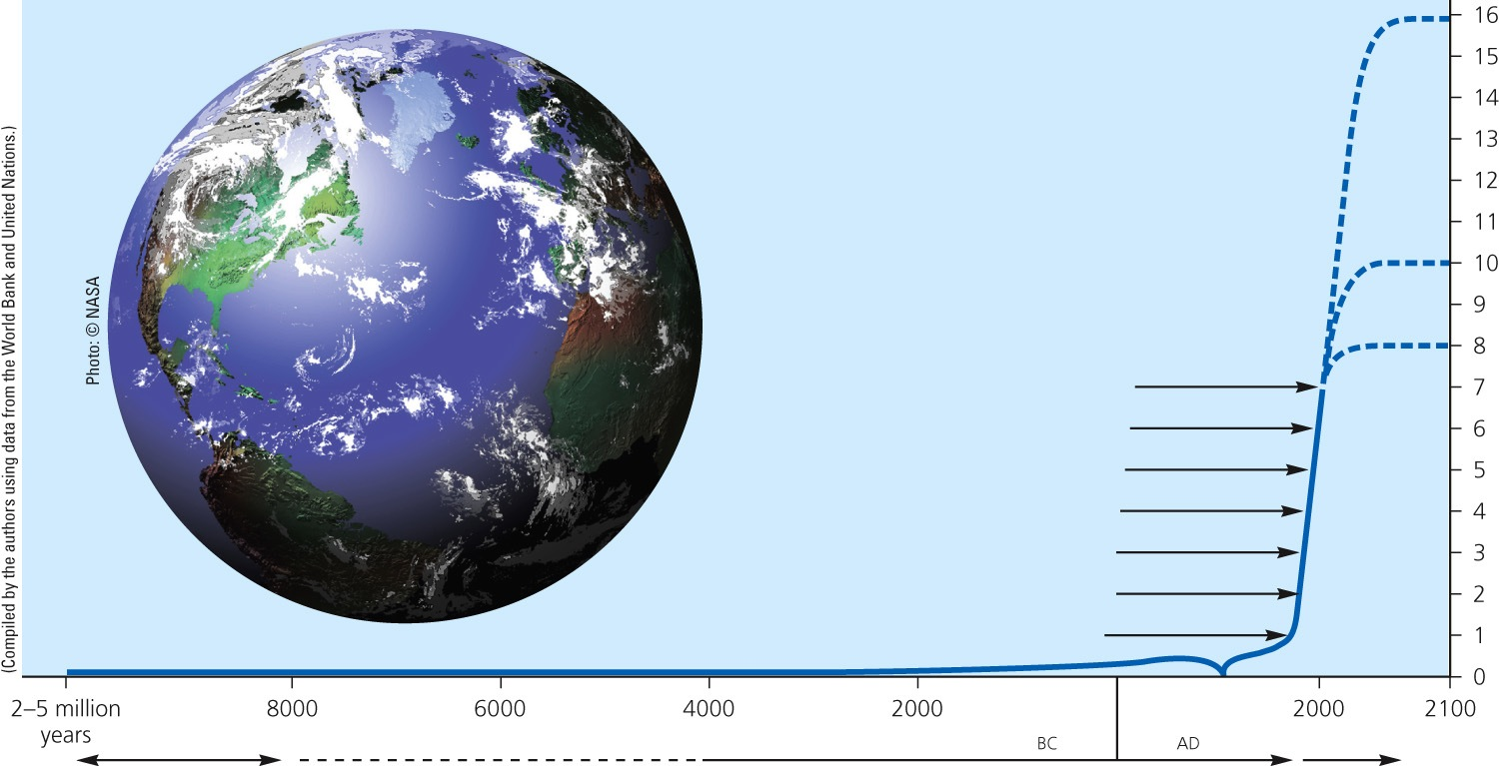
Core Case Study: Planet Earth: Population 7 Billion
2011 (7 billion)
Billions of people
1999 (6 billion)
1987 (5 billion)
1974 (4 billion)
1960 (3 billion)
1930 (2 billion)
1800 (1 billion)
Time
Hunting and gathering
Agricultural revolution
Industrial revolution
Fig. 6-1, p. 122
Notes:
Figure 6.1 The human population has grown exponentially—showing slow growth throughout most of history and shooting up at a rapid rate within the last 200 years. This graph also shows projections to 2100 that range from 8 billion to 16 billion. (This figure is not to scale.)

Slide 4
Annual Growth Rate of World Population, 1950-2010
Fig. 6-2, p. 123
Notes:
Figure 6-2: The annual growth rate of world population has generally dropped since the 1960s, but the population has continued to grow (Figure 6-1).

Slide 5
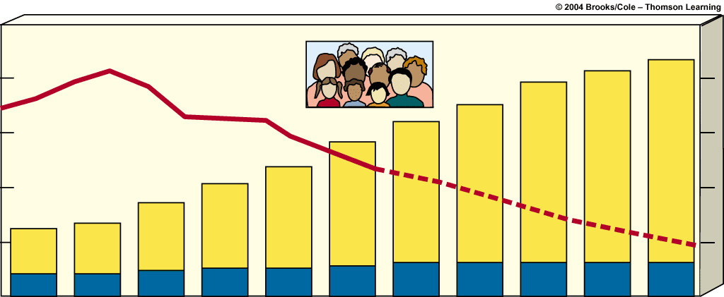
2.5
10
2.0
8
1.5
6
Growth rate (percent)
Population in billions
1.0
4
0.5
2
0.0
0
1950
1960
1970
1980
1990
2000
2010
2020
2030
2040
2050
Year
http://www.youtube.com/watch?v=EIZWX_AypNg 10 Most populous countries
Less developed countries
http://www.youtube.com/watch?v=oiIEz1D3It0 10 Least populated
More developed countries
http://www.nationsonline.org/oneworld/world_population.htm
World Population Stats
http://www.census.gov/population/international/data/idb/worldpoptotal.php
Population Growth Rates and People Added per year
Notes:
Bar graph – population in billions
Line graph – growth rate

Slide 6
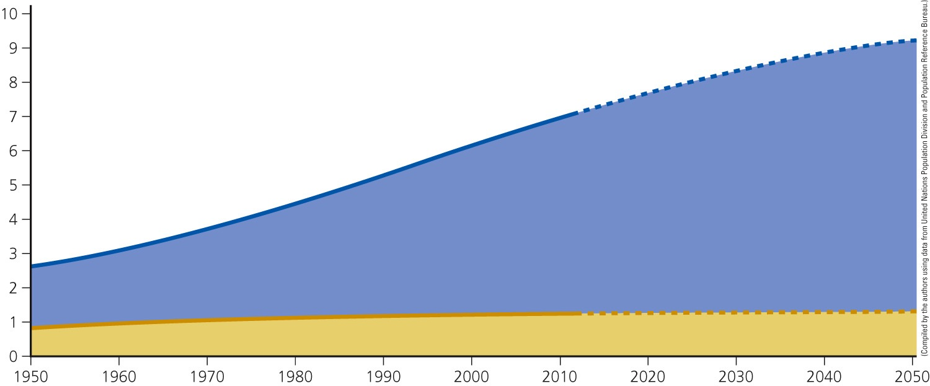
Where Population Growth Occurred, 1950-2010
World population (in billions)
Population in less-developed countries
Population in more-developed countries
Year
Fig. 6-3, p. 123
Notes:
Figure 6-3: Most of the world’s population growth between 1950 and 2012 took place in the world’s less-developed countries. This gap has been projected to increase between 2012 and 2050.

Slide 7
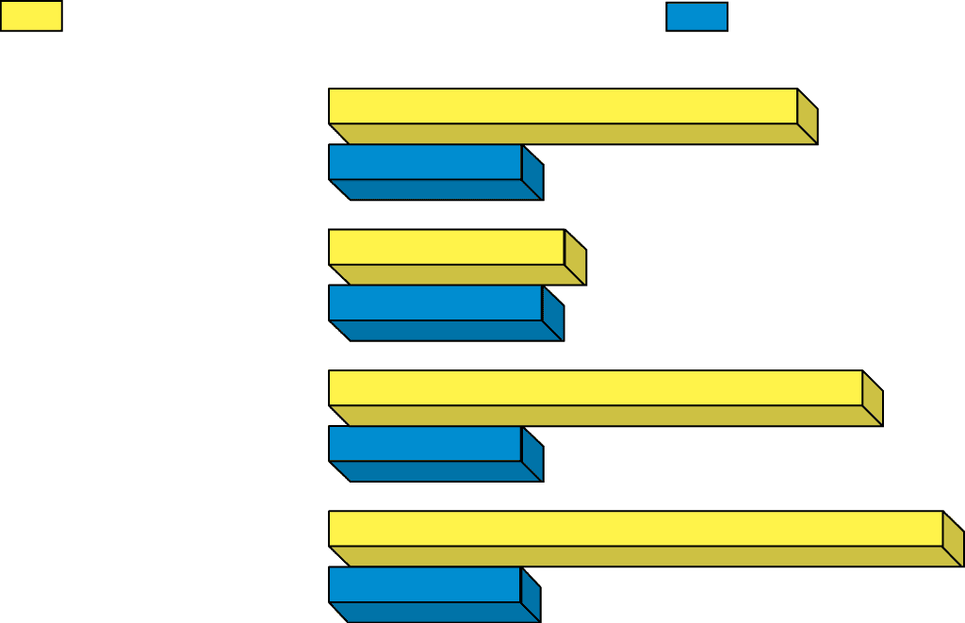
Average crude birth rate
Average crude death rate
World
21
9
All developed
countries
11
10
All developing
countries
24
8
Developing
countries
(w/o China)
29
9
© 2004 Brooks/Cole – Thomson Learning
Notes:
The number of deaths per 1000 people can be higher for developed nations than in less-developed countries, despite life expectancy being higher in developed countries due to standards of health being better. This happens because developed countries typically have a completely different population age distribution, with a much higher proportion of older people, due to both lower recent birth rates and lower mortality rates

Slide 8
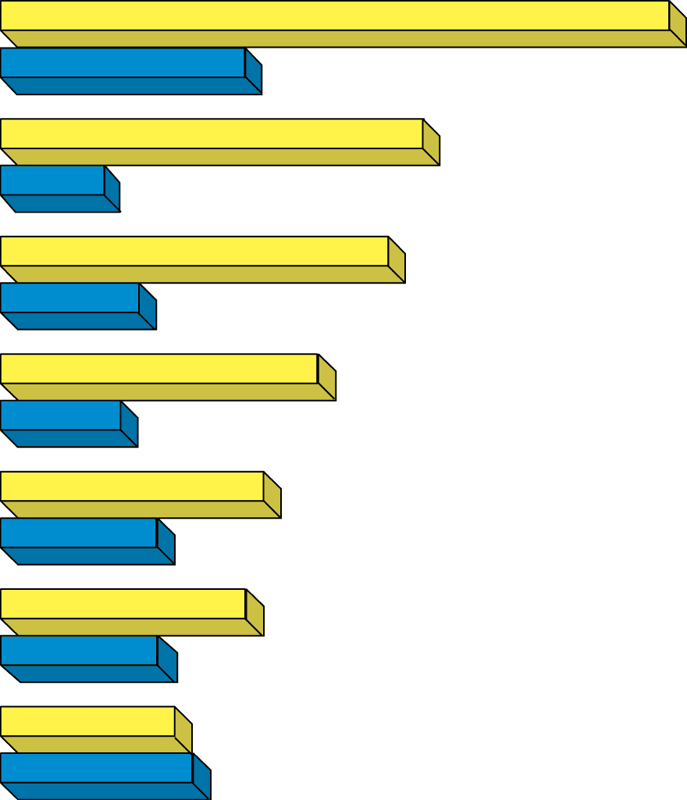
Africa
38
14
Latin
America
23
© 2004 Brooks/Cole – Thomson Learning
6
Asia
20
7
Oceania
18
7
United
States
15
9
North
America
14
9
Europe
10
11

Slide 9
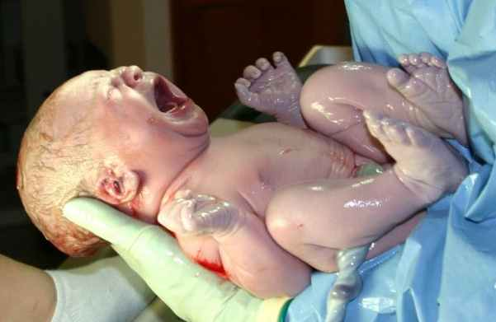
2 types of Fertility rates:
1)Replacement-level fertility (RLF)– number of children a couple has to replace themselves.
slightly higher than 2
2.1 DEVELOPED
2.5 DEVELOPING
1.9 US
Affected by infant mortality
2)total-fertility rate(TFR) – average number of children a woman will have during her childbearing years
Average Global 2.8 per woman
.6 developed countries
3.1 developing
Country of Niger in Africa – TFR – 7.46
https://www.cia.gov/library/publications/the-world-factbook/rankorder/2127rank.html
TOTAL FERTILITY RATE
Notes:
Replacement level fertility is the number of children each woman needs to have to maintain current population levels or what is known as zero population growth for her and her partner. The replacement level fertility for developed countries is about 2.1. Since replacement can not occur if a child does not grow to maturity and have their own offspring, the need for the extra .1 child (a 5% buffer) per woman is due to the potential for death and those who choose or are unable to have children.
http://www.prb.org/Publications/Datasheets/2012/world-population-data-sheet/fact-sheet-us-population.aspx
Replacement level fertility info for US

Slide 10
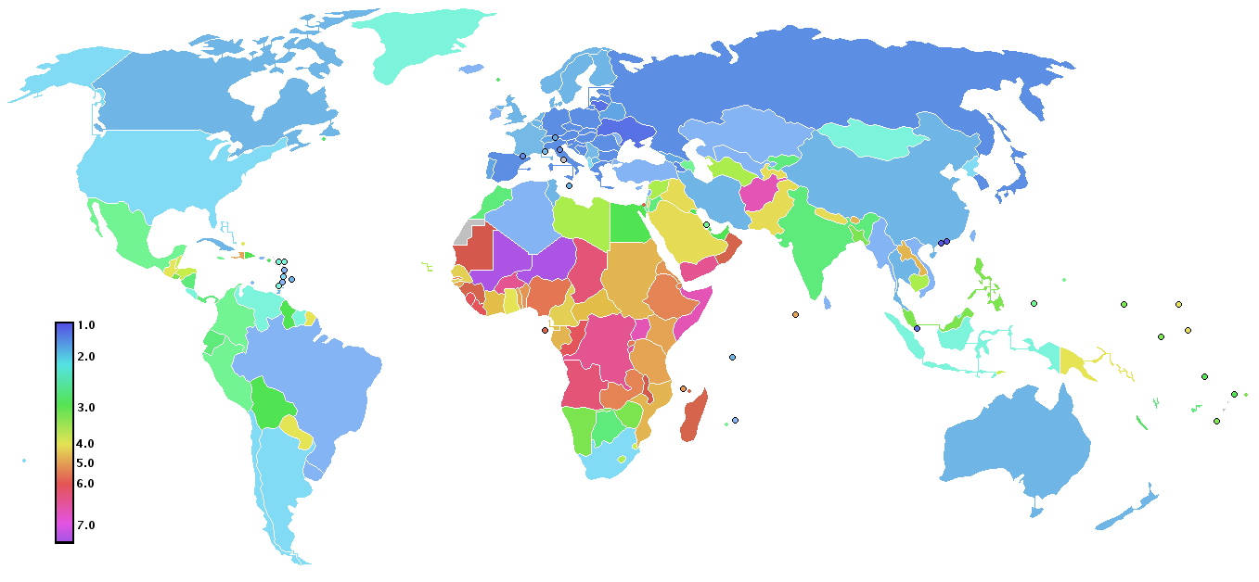
World Fertility Rates

Slide 11
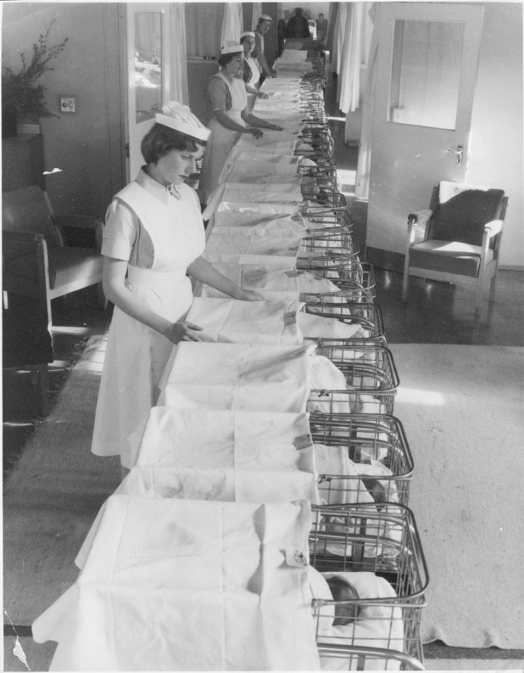
How have fertility rates changed in the United States?
76 million people - 1900
Exponential growth [faster than any other developed country]
US – 300 Million today
1946-1964
Baby boom period (79 million people added to US population) Generation x
1956-1976
Baby bust
decline (women working)
dropped from 4 to 2 (or zero!)
1977-2003
started having children – Generation y or Millenials
Notes:
Have had a drop in the TFR – high birth rates to low birth rates (demographic transition) More births to deaths thanks to medicine

Slide 13
Factors Affecting BR and TFR
32
30
28
26
24
Births per thousand population
22
20
18
End of World War II
16
Demographic
transition
14
Depression
Baby boom
Baby bust
Echo baby boom
0
1910
1920
1930
1940
1950
1960
1970
1980
1990
2000
2010
Year

Slide 14
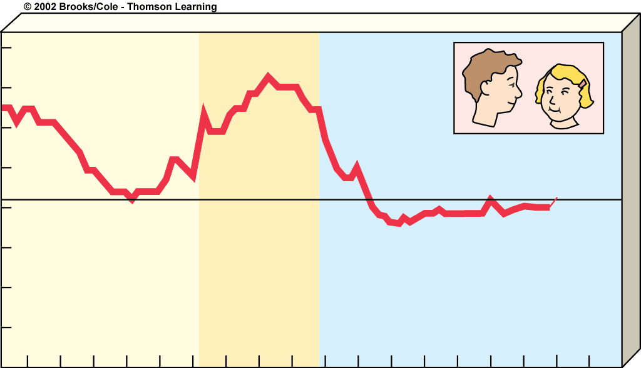
4.0
3.5
3.0
2.5
Births per woman
2.1
2.0
1.5
Baby boom
(1946-64)
1.0
0.5
0
1920
1930
1940
1950
1960
1970
1980
1990
2000
2010
Year

Slide 15
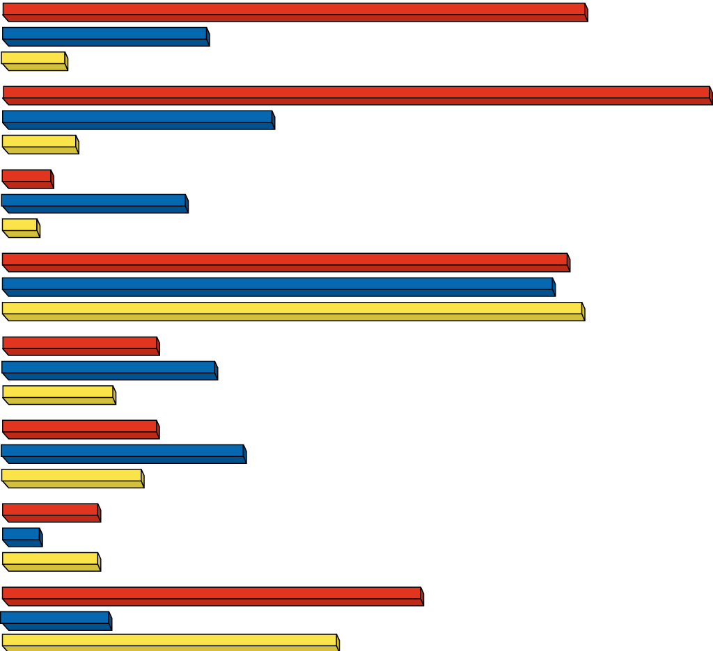
United States
Mexico
Canada
© 2004 Brooks/Cole – Thomson Learning
Population
(2002)
288 million
102 million
31 million
Projected
population
(2025)
346 million
132 million
36 million
Infant
mortality
rate
6.6
25
5.3
Life
expectancy
77 years
75 years
79 years
Total fertility
rate (TFR)
2.1
2.9
1.5
% population
under age 15
21%
33%
19%
% population
over age 65
13%
5%
13%
Per capita
GNI PPP
$34,110
$8,790
$27,170

Slide 16
Should the US Encourage or Discourage Immigration?
US admits twice as many immigrants than all other countries combined
US Commission on Immigration Reform recommends having immigration reduced. Most public surveys agree with them.
accounts for 45% of the country’s annual population growth
proponents say that this would allow the US to stabilize population
help reduce environmental impact
others state that historically, US is supposed to be a place of opportunity for the poor and oppressed
What’s Your Opinion?

Slide 17
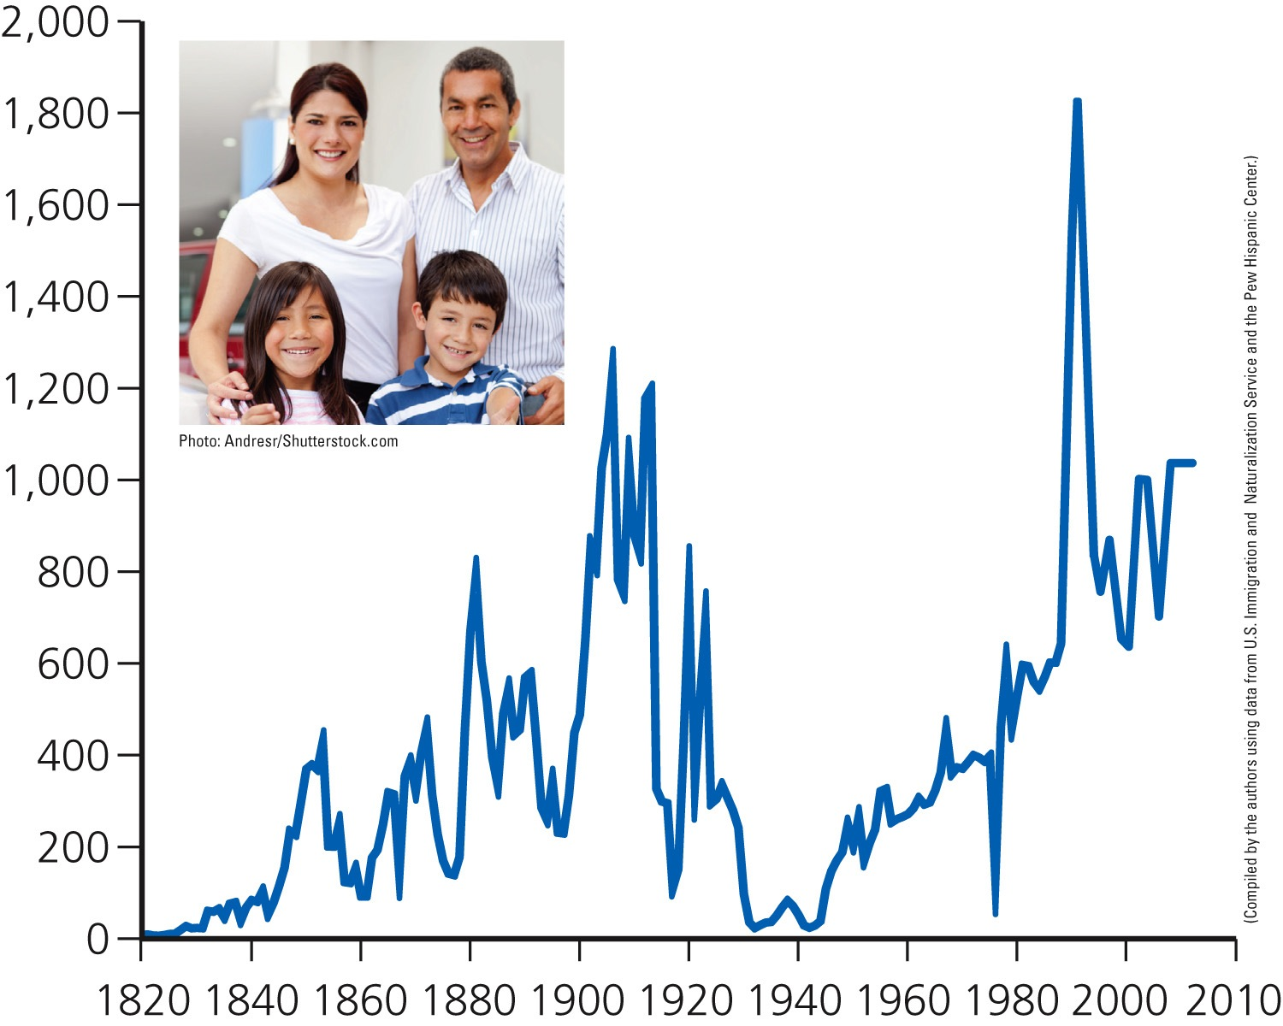
Legal Immigration to the United States
1907
1914 New laws restrict immigration
Number of legal immigrants (thousands)
Great Depression
Year
Fig. 6-6, p. 127
Notes:
Figure 6.6 Legal immigration to the United States, 1820–2006 (the last year for which data are available). The large increase in immigration since 1989 resulted mostly from the Immigration Reform and Control Act of 1986, which granted legal status to certain illegal immigrants who could show they had been living in the country before January 1, 1982.

Slide 18
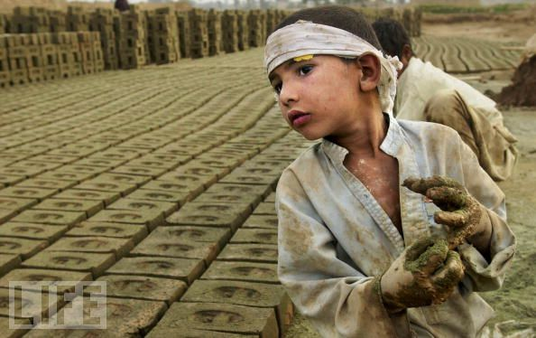
Factors that Affect Birth Rates
Factors that Affect Death Rates
1) children in the work force
2) cost of raising/educating children
3) pensions
4)Urbanization
better access to family planning, birth control
5) Opportunities for women
6) Infant Mortality Rate
7) Average Age of marriage
8) Abortions
rapid growth of the population not due to birth rate →due to decline in death rate
better medicine/health care/vaccines/nutrition
more food supplies
better sanitation and hygiene, safer water
Notes:
1)Want more children to work on the farms
2)Expensive to have kids
3)Don’t need as many kids to support you
4)Have less kids
5)Women want to get out and not just have kids
6)More of a shot baby will die, will have more
7)Younger you get married, more children
8)Abortion
9)

Slide 19
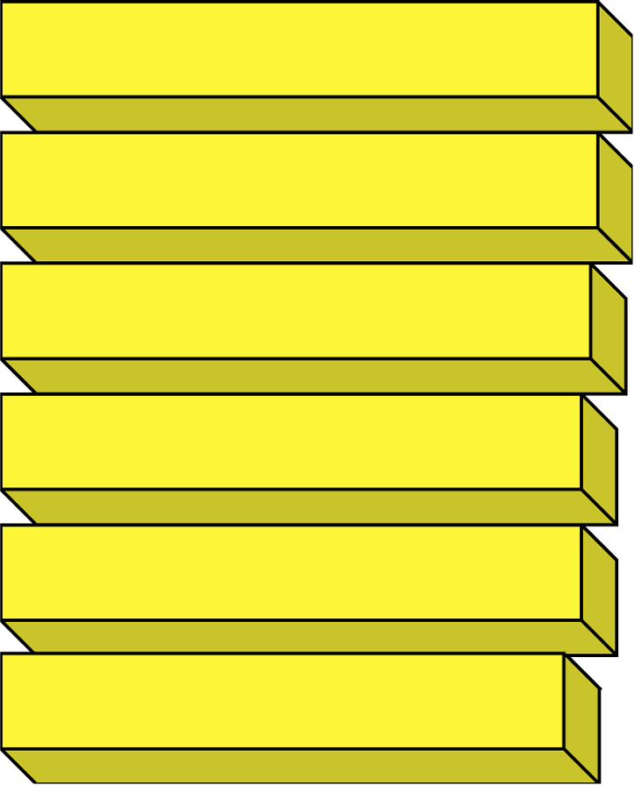
Extremely Effective
© 2004 Brooks/Cole – Thomson Learning
Total abstinence
100%
Sterilization
99.6%
Vaginal ring
98-99%
Hormonal implant
(Norplant)
96%
Highly Effective
IUD with slow-release
hormones
98%
IUD plus spermicide
98%
Vaginal pouch
(“female condom”)
97%
IUD
95%
Condom (good brand)
plus spermicide
95%
Oral contraceptive
93%

Slide 20
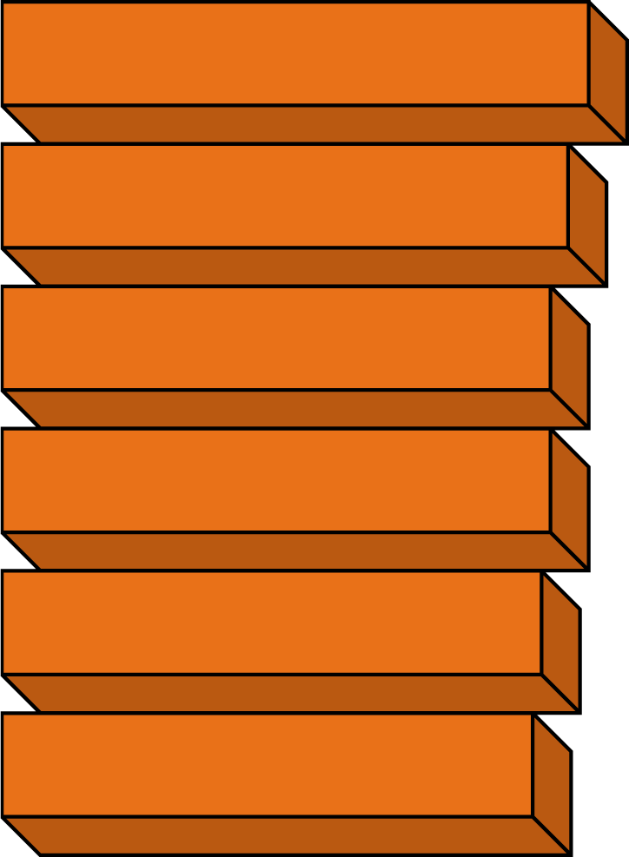
© 2004 Brooks/Cole – Thomson Learning
Effective
Cervical cap
89%
Condom (good brand)
86%
Diaphragm plus
spermicide
84%
Rhythm method (Billings,
Sympto-Thermal)
84%
Vaginal sponge impreg-
nated with spermicide
83%
Spermicide (foam)
82%

Slide 21
© 2004 Brooks/Cole – Thomson Learning
Moderately Effective
Spermicide (creams,
jellies, suppositories)
75%
Withdrawal
74%
Rhythm method (daily
temperature readings)
74%
Condom (cheap brand)
70%
Unreliable
Douche
40%
Chance (no method)
10%

Slide 22
2 Indicators of Overall Health of Country
http://en.wikipedia.org/wiki/List_of_countries_by_life_expectancy
Life Expectancy different countries
1)Life Expectancy – average number of years we will live
76 years – developed countries
65 years – developing countries
poorest countries – 55 years
2)Infant mortality rate – number of babies out of 1000 that die before 1st Birthday
**Is the single most important measure of a society’s quality of life
reflects nutrition and health care
7 deaths/1000 in developed countries
61/1000 developing countries
https://www.cia.gov/library/publications/the-world-factbook/rankorder/2091rank.html
Infant mortality rates

Slide 23
Demographic Transition:
As industrialization takes place, 1st death rates and them birth rates decrease
Transition takes place in 4 stages:
1)Preindustrial stage
harsh living conditions, high birth rate, high death
2)Transitional stage
industrialization begins
birth rate still high, death rate drops
population growth still high
developing countries still in Ex - Kenya
3)Industrial stage
population growth slowing down
birth rate drops and approaches death rate
developed countries in this stage and some developing
4)Postindustrial stage – birth rate = death rate →zero population growth.
Birth rate below death, population decreases slowly – negative
US – slow population (between 3 & 4)
http://geography.about.com/od/populationgeography/a/zero.htm 20 countries with zero or negative

Slide 24
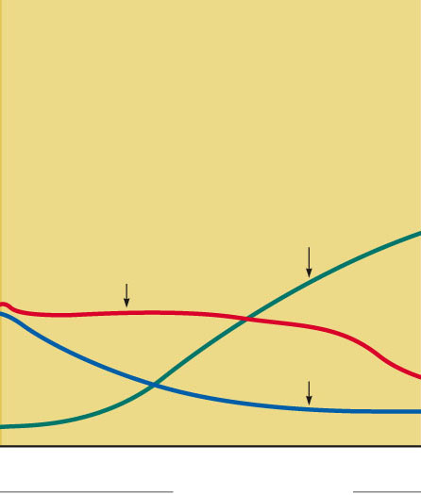
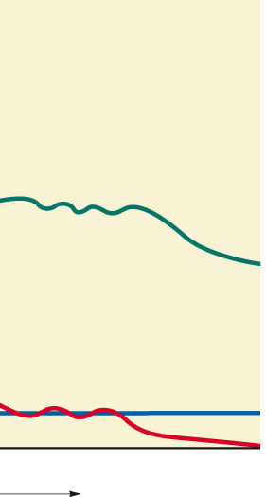
Stage 1
Preindustrial
Stage 2
Transitional
Stage 3
Industrial
Stage 4
Postindustrial
Population
grows very
slowly because
of a high
birth rate
(to compensate
for high infant
mortality) and a
high death rate
Population grows rapidly because birth rates are high and death rates drop because of improved food production and health
Population growth slows as both birth
and death rates drop because of improved food production, health, and education
Population growth levels off and then declines as birth rates equal and then fall below death rates
80
70
60
50
40
30
20
10
0
Total population
Birth rate and death rate
(number per 1,000 per year)
Birth rate
Death rate
Low
Increasing
Very high
Decreasing
Low
Zero
Negative
Growth rate over time
Stepped Art
Fig. 6-16, p. 135
Notes:
Animated Figure 6-16 The demographic transition, which a country can experience as it becomes industrialized and more economically developed, can take place in four stages. Question: At what stage is the country where you live?

Slide 25
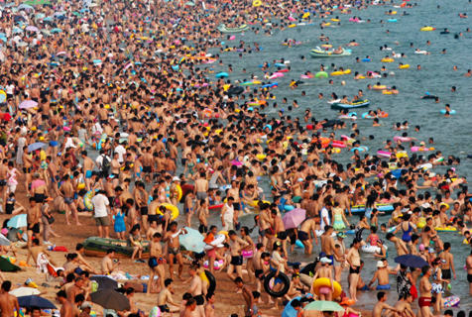
Solutions
“optimum sustainable population”
What is the planet’s cultural carrying capacity?
Is our earth overpopulated? What do you think??
Should we limit # of children? What about freedom?
Economic Rewards and Penalties (Ex-China)
1 out of 6 people on earth today don’t have what they need - Poverty!!
http://www.youtube.com/watch?v=YJ8wdHWv6kA
China Population Control
Notes:
Known to many as the one-child policy, China's actual rules are more complicated. The government limits most urban couples to one child, and allows two children for rural families if their firstborn is a girl. Numerous other exceptions include looser rules for minority families and a two-child limit for parents who are themselves both singletons.

Slide 26
Population Age Structure
different age groups
prereproductive, reproductive, and postreproductive
Population momentum
Continued growth of a population after fertility drops to RL
Due to Large portion of population in reproductive years
“Today's fertility generates tomorrow's population in the absence of high mortality”.
Notes:
Population momentum occurs in stage 3 of demographic transition

Slide 27
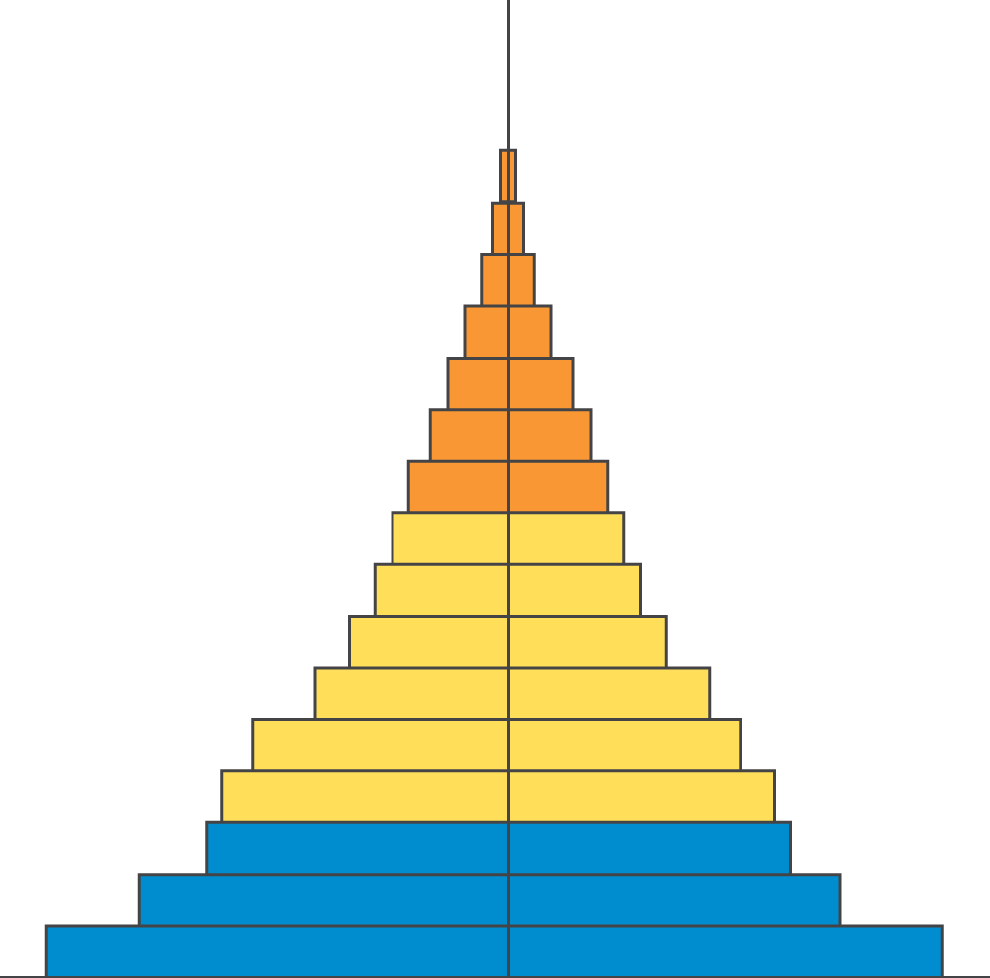
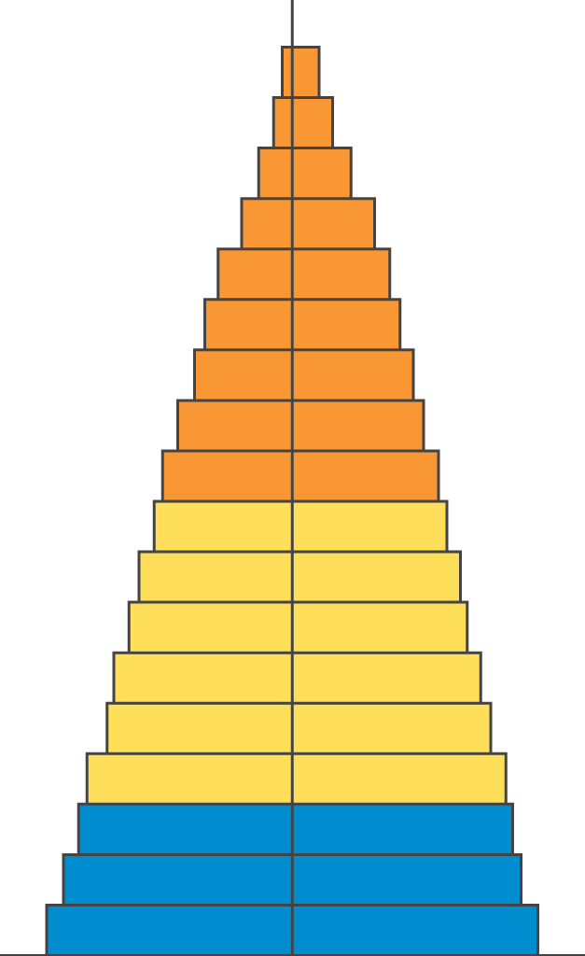
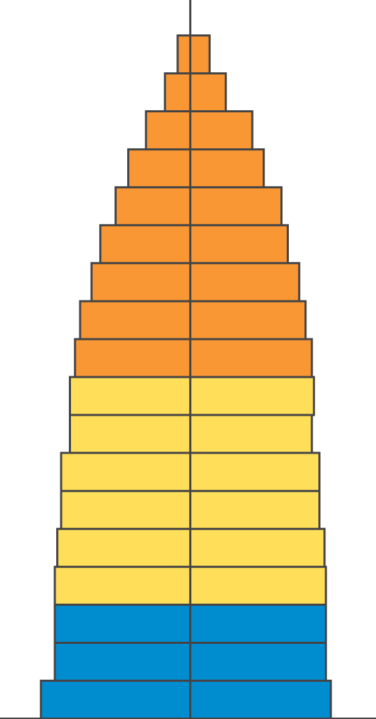
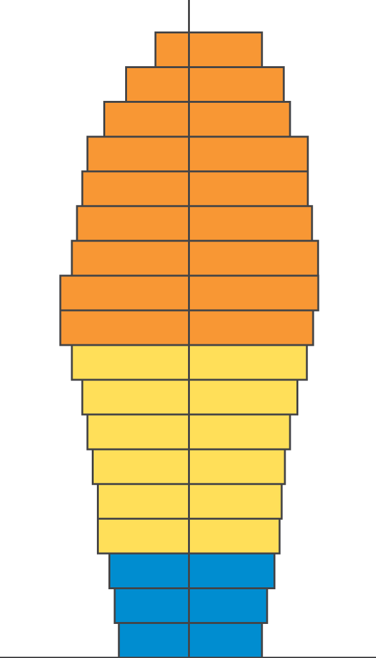
Population Age Structure
http://www.prb.org/Educators/TeachersGuides/HumanPopulation/Change.aspx
Fig. 12-19
p. 263
Male
Female
Rapid Growth
Guatemala
Nigeria
Saudi Arabia
Slow Growth
United States
Australia
Canada
Zero Growth
Spain
Austria
Greece
Negative Growth
Germany
Bulgaria
Sweden
Ages 0-14
Ages 15-44
Ages 45-85+

Slide 28
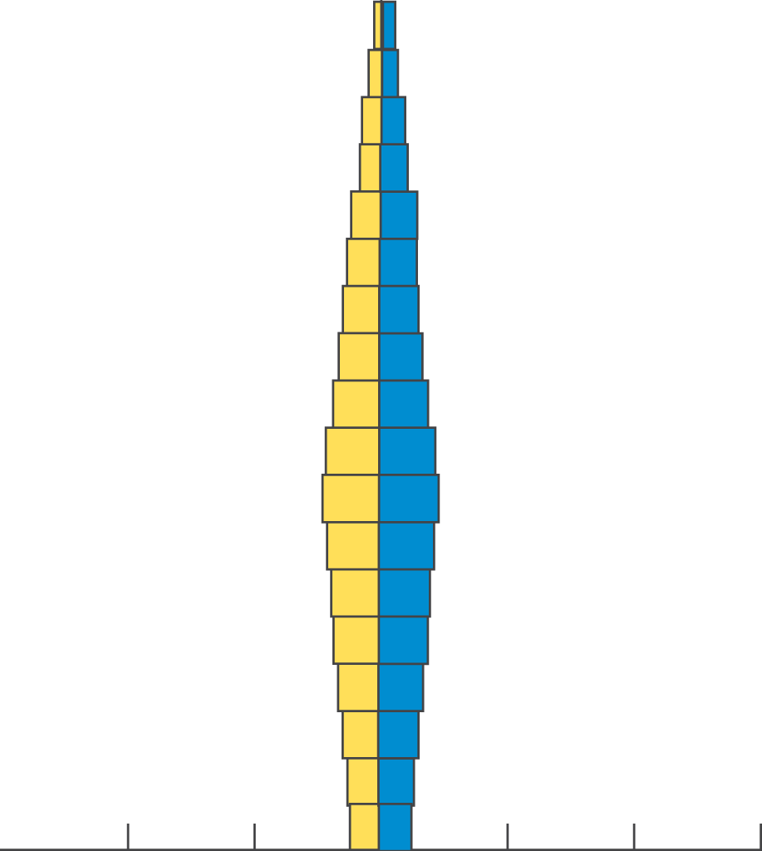
Developed Countries
85+
80-85
75-79
70-74
65-69
60-64
55-59
50-54
45-49
40-44
35-39
30-34
25-29
20-24
15-19
10-14
5-9
0-4
Male
Female
Age
300
200
100
0
100
200
300
Population (millions)
© 2004 Brooks/Cole – Thomson Learning

Slide 29
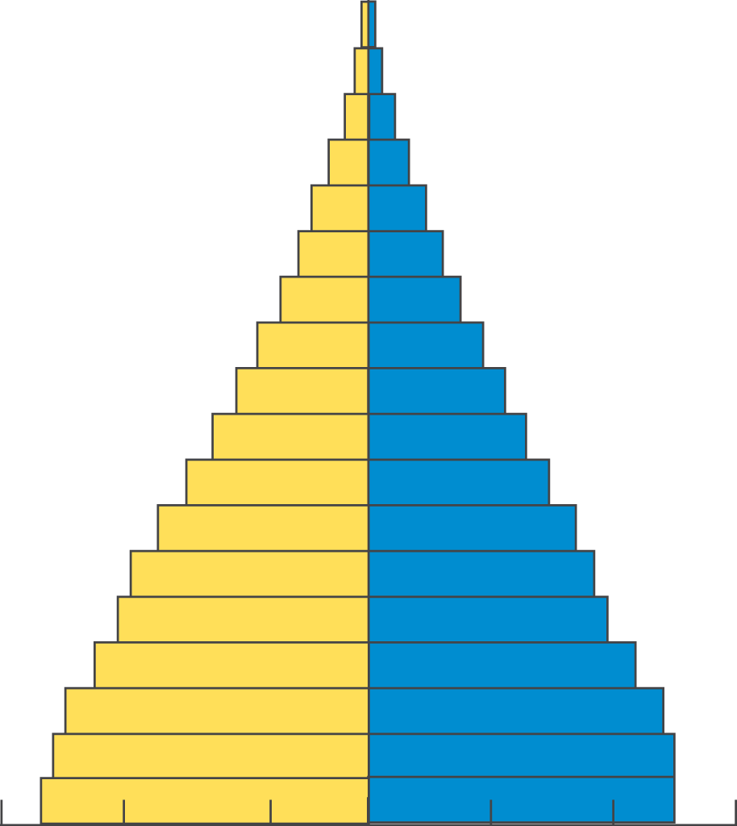
Developing Countries
85+
80-85
75-79
70-74
65-69
60-64
55-59
50-54
45-49
40-44
35-39
30-34
25-29
20-24
15-19
10-14
5-9
0-4
Male
Female
Age
300
200
100
0
100
200
300
Population (millions)
© 2004 Brooks/Cole – Thomson Learning

Slide 30
Some Problems with Rapid Population Decline
Can threaten economic growth
Labor shortages
Less government revenues with fewer workers
Less entrepreneurship and new business formation
Less likelihood for new technology development
Increasing public deficits to fund higher pension and health-care costs
Pensions may be cut and retirement age increased
Fig. 6-14, p. 133
Notes:
Figure 6-14: Rapid population decline can cause several problems. Question: Which two of these problems do you think are the most important?

