Slide 1
EVOLUTION & BIODIVERSITY

Slide 2
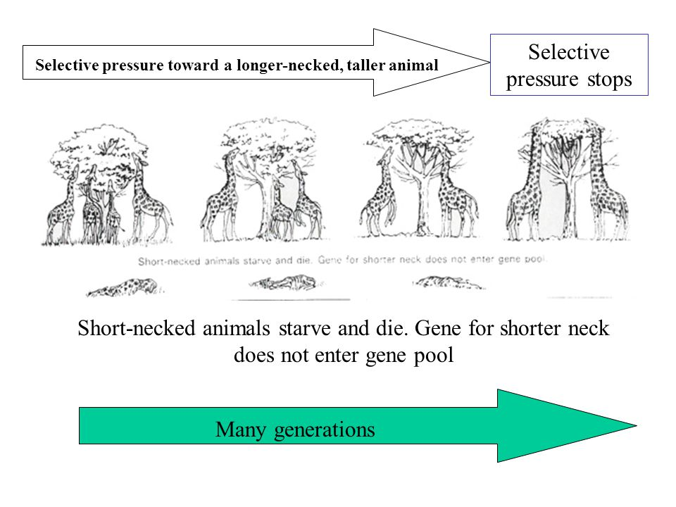
Theory of Evolution
Change
all species descended from earlier species
Diversity in world
Darwin – Natural Selection
Selective pressure
environmental factors that lessen reproduction in a species Ex competition for food
1)Variation
2)Overproduction
3)Struggle for existence
4) Differential Survival and Reproduction
Notes:
https://antonl-evolution.weebly.com/selective-pressure.html selective pressure would be against the short necked because long necks can receive food. Selective pressure is against more susceptible bacteria who cannot withstand antibiotic

Slide 3
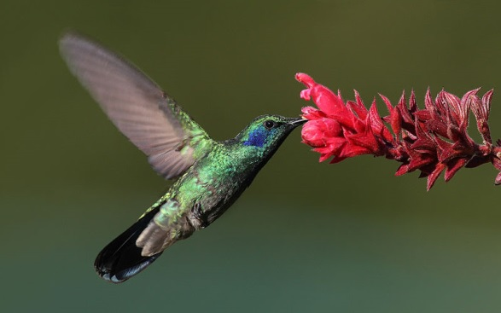
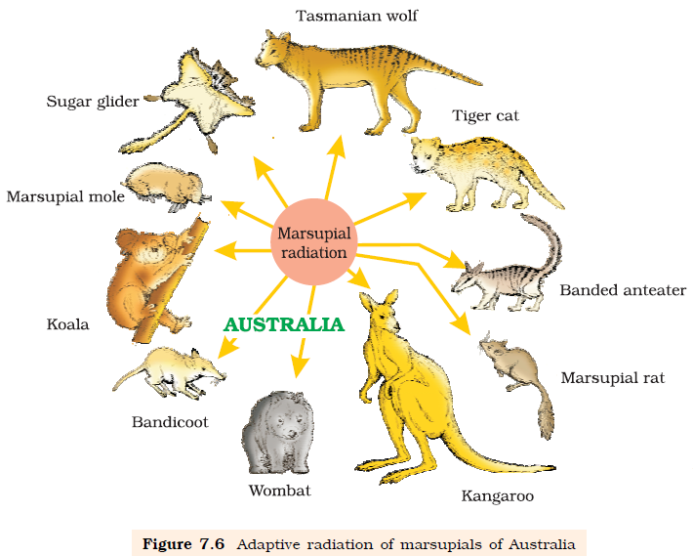
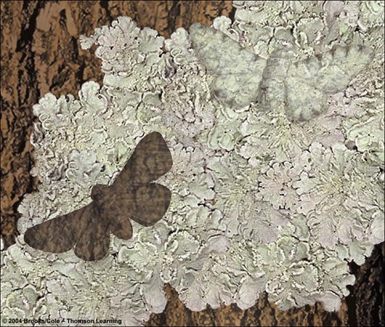
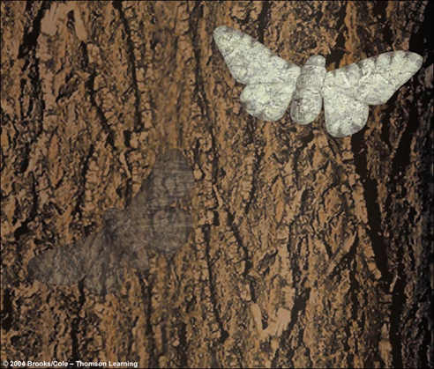
Are species evolving today?
Why do species evolve?
Adaptation
heritable trait
better survive and reproduce
Pass to offspring
**The existence of species today means that speciation has kept ahead of extinction.
Our current BIODIVERSITY is basically all the years of speciation minus extinction
Case Study
Peppered Moth

Slide 4
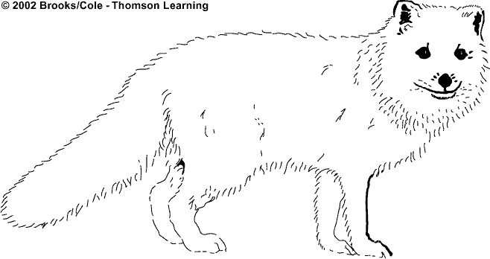
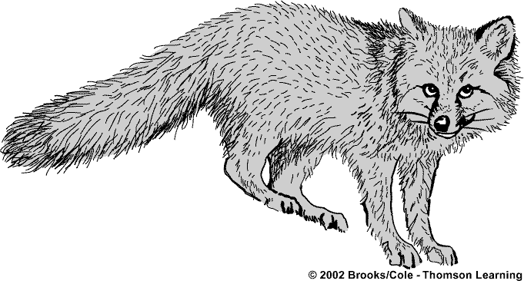
Northern population
Adapted to cold
through heavier
fur, short ears,
short legs, short
nose. White fur
matches snow
for camouflage.
Arctic Fox
Spreads
northward
and
southward
and
separates
Different environmental
conditions lead to different
selective pressures and evolution
into two different species.
Early fox
population
Southern population
Adapted to heat
through lightweight
fur and long ears,
legs, and nose, which
give off more heat.
Gray Fox

