Slide 1
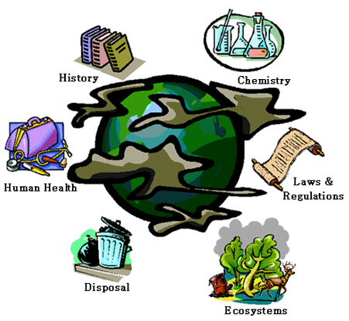
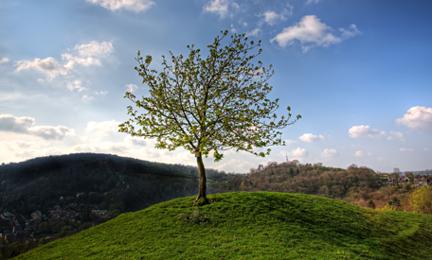
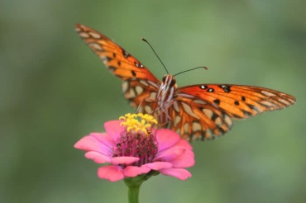
Introduction Environmental Problems, Causes, and Sustainability

Slide 2
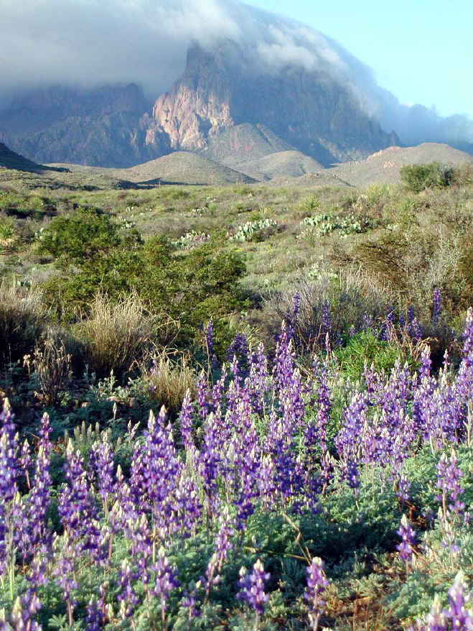
Why study Environmental Science?
Interdisciplinary course
how the earth works
Ecology (big part)
living organisms and their environment
humans & environmental problems
Ecology – “household/house”
Household = all aspects of environmental science
What is an Environmentally Sustainable Society?
Maintain the balance of ecosystems for future generations.
Be responsible when using resources
Take only what we need
Notes:
Introduce environmental science - Pose the following questions: Why study environmental science? - interdisciplinary, ecology main branch (organisms and their environment), humans and environmental problem as well. Explain to students that ecology comes from greek word for "household" or "house" - Think of a household = all aspects of environmental science. Describe components of your household and house, what makes it work, function. etc.
We will see how household relates to env science

Slide 3
Everything is interconnected

Slide 4
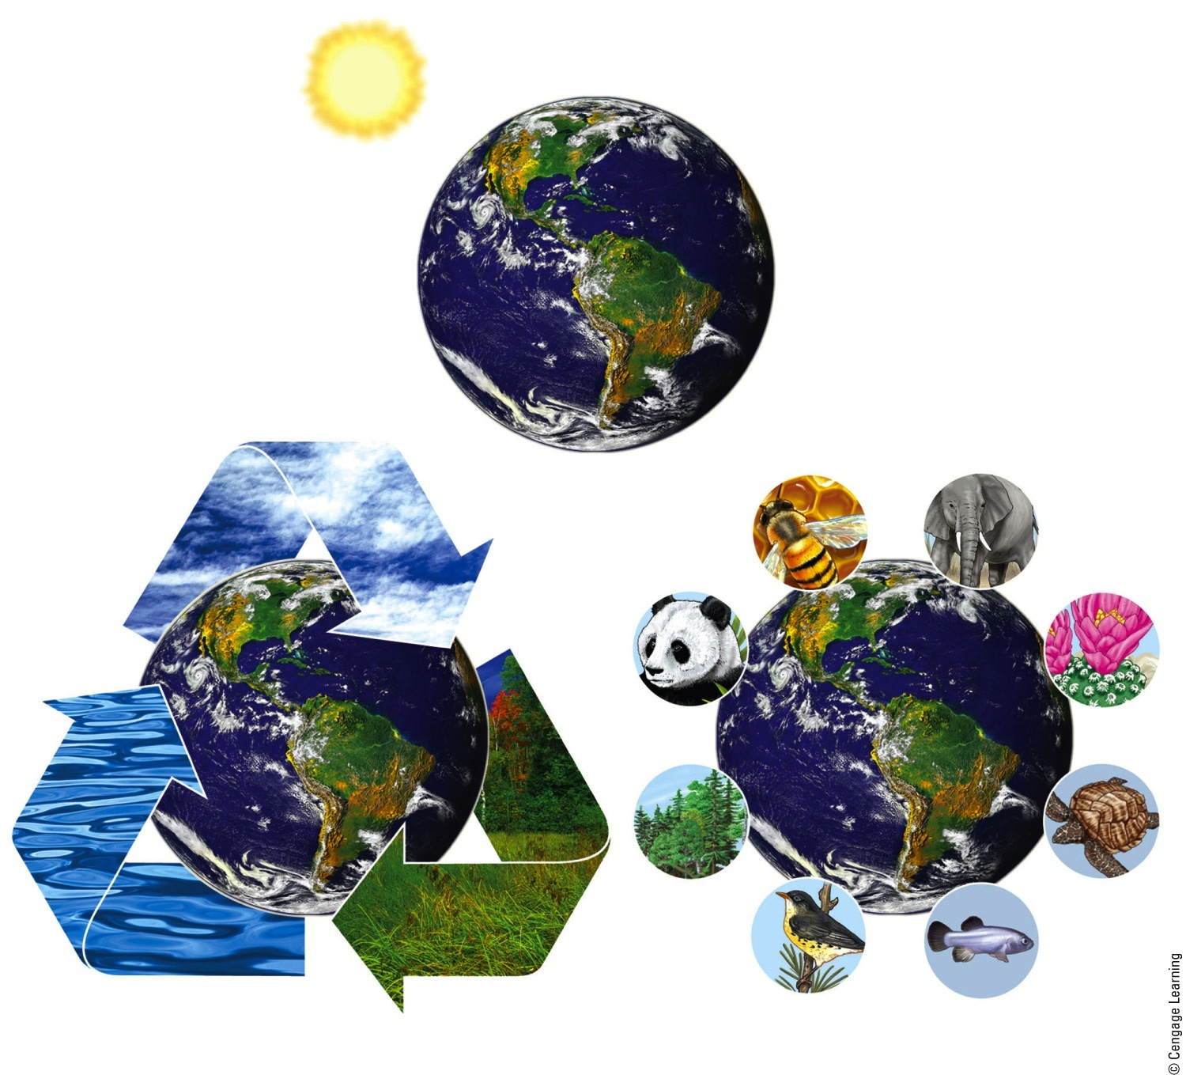
Three Principles of Sustainability
Solar Energy
Chemical Cycling
Biodiversity
Fig. 1-3, p. 8
Notes:
Figure 1.2 Three scientific principles of sustainability based on how nature has sustained a huge variety of life on the earth for 3.5 billion years, despite drastic changes in environmental conditions

Slide 5
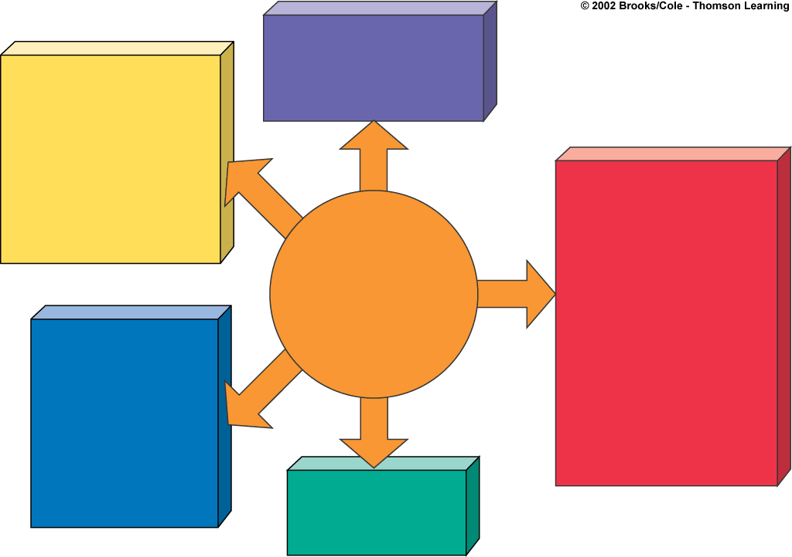
Biodiversity Depletion
Habitat destruction
Habitat degradation
Extinction
Air Pollution
Global climate change
Stratospheric ozone depletion
Urban air pollution
Acid deposition
Outdoor pollutants
Indoor pollutants
Noise
Food Supply Problems
Overgrazing
Farmland loss
and degradation
Wetlands loss
and degradation
Overfishing
Coastal pollution
Soil erosion
Soil salinization
Soil waterlogging
Water shortages
Groundwater depletion
Loss of biodiversity
Poor nutrition
Major
Environmental
Problems
Water Pollution
Sediment
Nutrient overload
Toxic chemicals
Infectious agents
Oxygen depletion
Pesticides
Oil spills
Excess heat
Waste Production
Solid waste
Hazardous waste

Slide 6
6 Important Environmental issues
1)Population Growth
2) Wasteful resource use
3)Poverty
4)Global Climate Change
5)Pollution
6)Extinction of Plants & Animals

Slide 7
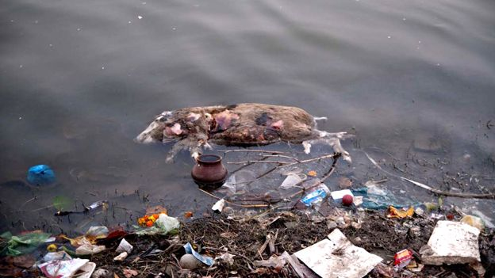
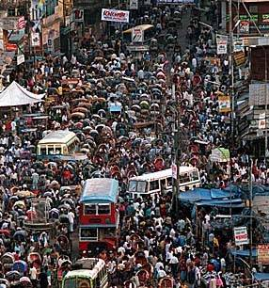
WOULD YOU RATHER?
1)Would you rather stop poverty or stop pollution? (Discuss # 3 & #5)
2)Would you rather enforce a vegan diet on everyone or limit the amount of children the world can have? (Discuss #1 & # 2)
3)Would you rather have a job paying $25,000 helping the environment or $150,000 dumping toxic waste into ocean (Discuss # 5 & #6)
4)Would you rather use coal for energy or sun for energy? (Discuss #2 & #4)
5)Would you rather live in a big city or the country? (Discuss # 1 & #3)
6)Would you rather swim in water near a nuclear power plant or swim in water near a sewage treatment plant? (Discuss #5 & #6)

Slide 8
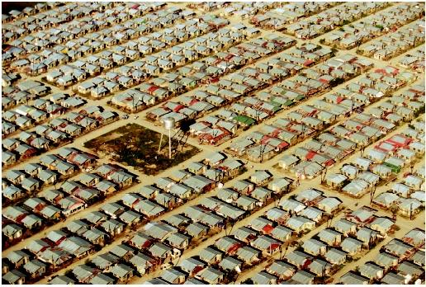
1) Population growth

Slide 9
2) Wasteful resource use

Slide 10
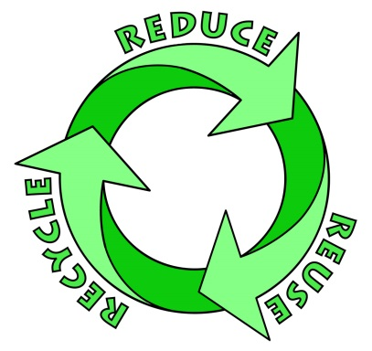
Resources
1)Perpetual resource-solar energy
2)Renewable resource
Ex-forests, animals, fresh air and water
3)Nonrenewable resource
Ex-energy resources, metals, nonmetals
Notes:
Nonrenewable can be renewed but takes millions of years
Metals-iron, copper, aluminum
Nonmetals-slate, clay, sand, phosphates

Slide 11
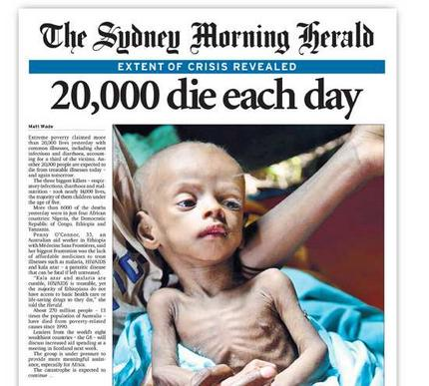
3) Poverty

Slide 12
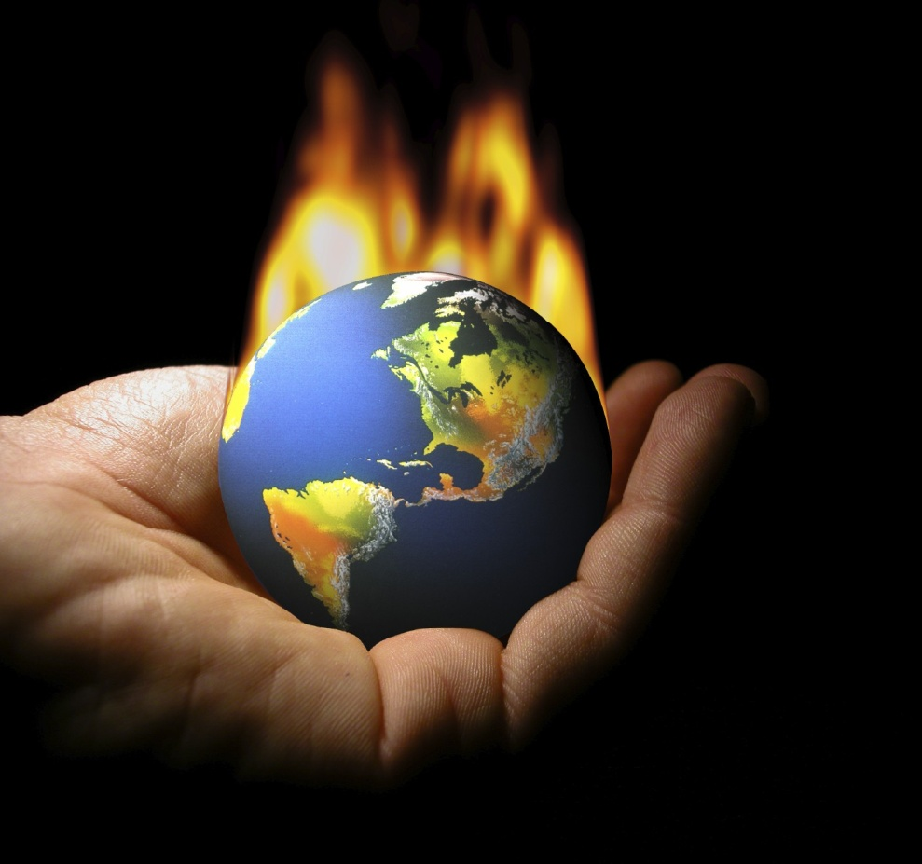
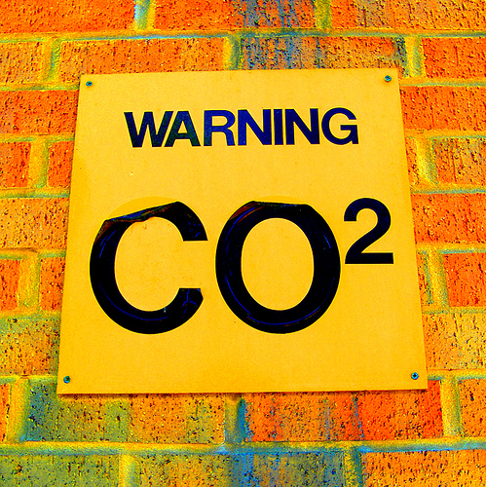
4) Global climate change

Slide 13
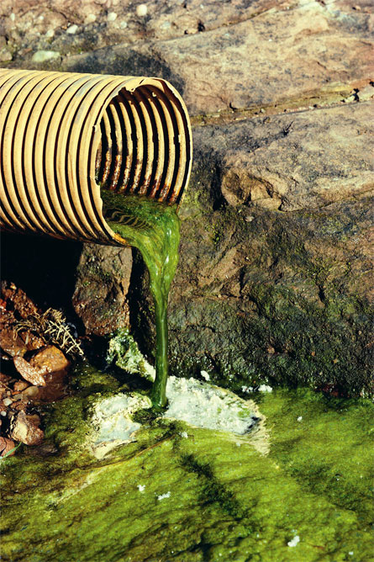
5) Pollution
Point vs Nonpoint
Human activity-ANTHROPOGENIC
Natural (volcanic eruptions)

Slide 14
Point-Source Air Pollution
Fig. 1-8, p. 11
Notes:
Figure 1-8: Point-source air pollution from smokestacks in a coal burning industrial plant.

Slide 15
Nonpoint Source Water Pollution
Fig. 1-9, p. 11
Notes:
Figure 1-9: The trash in this river came from a large area of land and is an example of nonpoint water pollution.

Slide 16
6) Extinction of plants and animals ( biodiversity crisis)

Slide 17
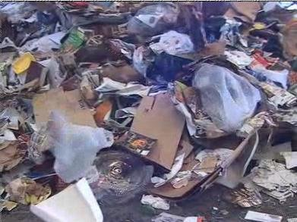
Environmentalists use a simple model
P x A x T =Environmental Impact (I)
Environmental impact(I)
Number of people(P)
Average resource use per person
(Affluence A)
Beneficial and Harmful environmental effects of technologies (T)

Slide 18
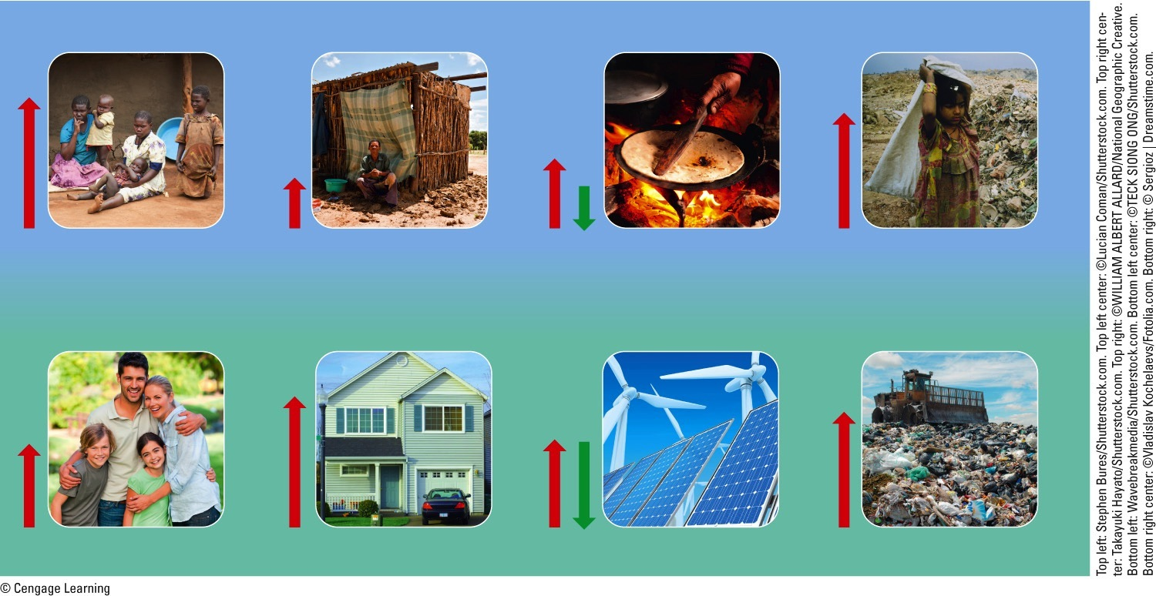
IPAT
Less-Developed Countries
Consumption per person (affluence, A)
Technological impact per unit of consumption (T)
Environmental impact of population (I)
Population (P)
X
X
=
More-Developed Countries
Fig. 1-14, p. 17
Notes:
Figure 1.14 This simple model demonstrates how three factors—population size, affluence (resource use per person), and technology—help to determine the environmental impacts of populations in lessdeveloped countries (top) and more-developed countries (bottom). Red arrows show generalized harmful impacts and green arrows show generalized beneficial impacts.

Slide 19
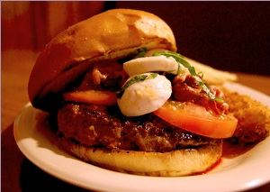
1 American =
3 Japanese
6 Mexicans
12 Chinese
33 Indians (i.e. from India)
147 Bangladeshis
281 Tanzanians
422 Ethiopians
Environmental Impact

Slide 20
Population Growth
biggest strain on environment
Exponential growth
J shaped curve
Human Population 1 %/year.
6.3 Billion in 2003
Today?
7.24 Billion in 2015
7.32 Billion in 2016
http://www.census.gov/population/international/data/idb/worldpoptotal.php
World Population,Population Growth Rates and People Added per year
http://www.census.gov/popclock/
Clock with with population increases
http://www.worldometers.info/world-population/
World Population Clock & 20 countries with largest

Slide 21
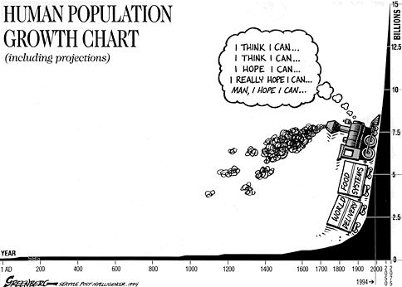
Notes:
Black plague – 1350 up to the 18 century (1700s)Killed 75-200 million people

Slide 22
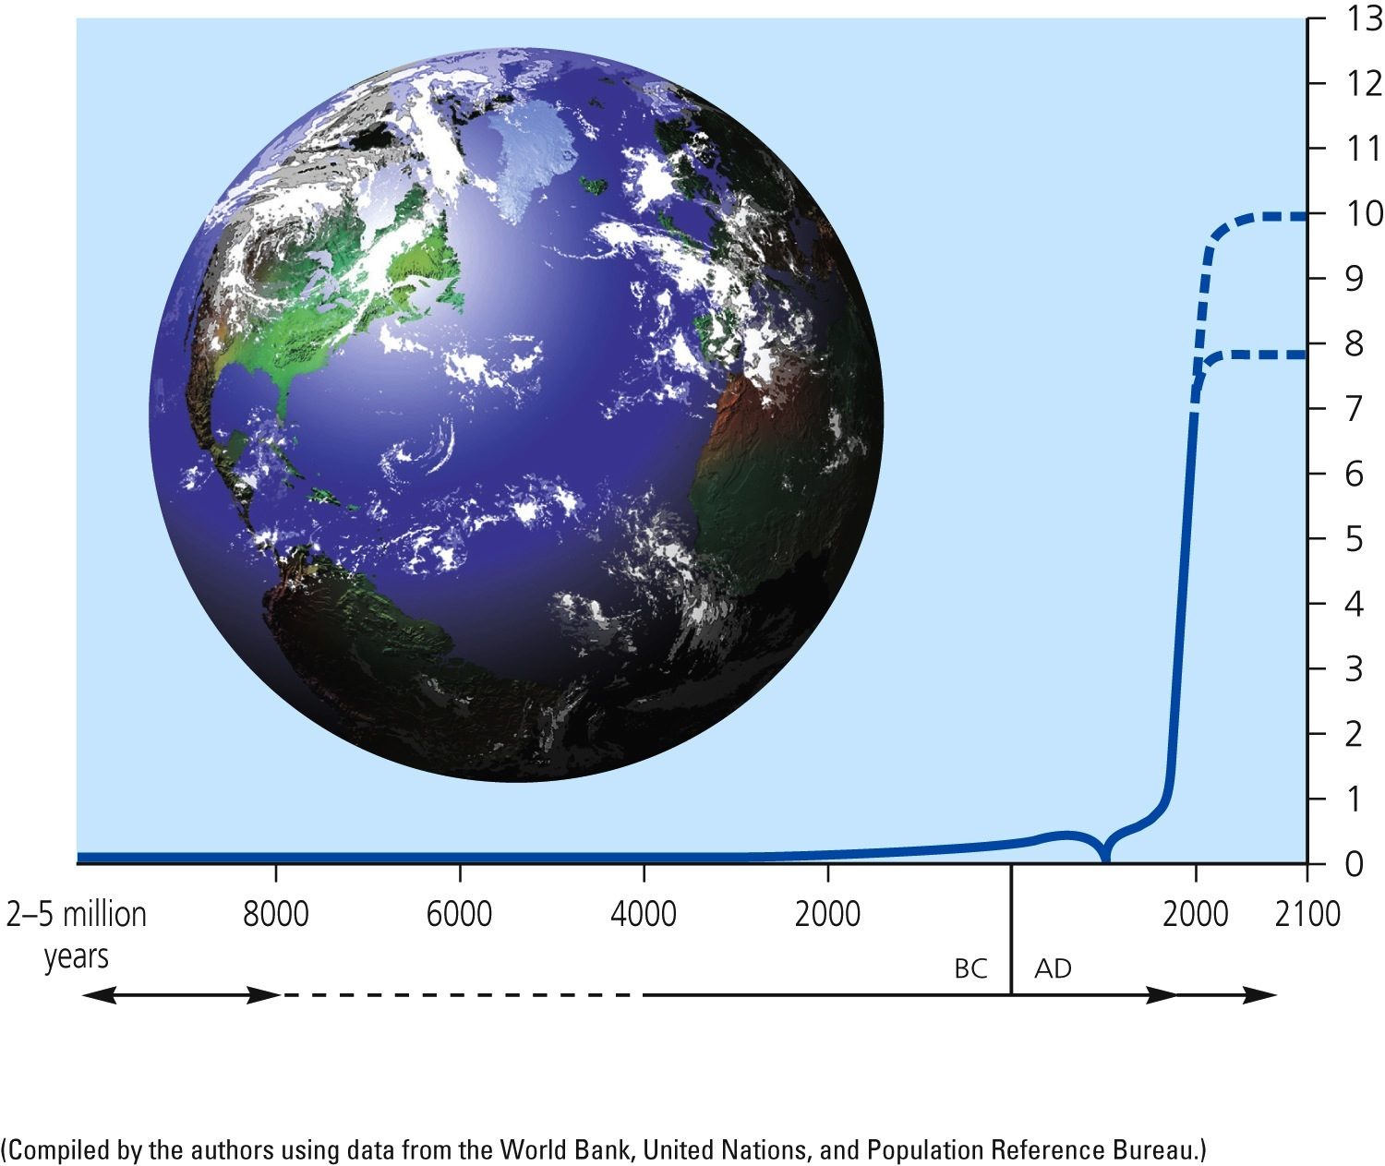
Exponential Growth of Human Population
?
Billions of people
Industrial revolution
Black Death—the Plague
Time
Hunting and gathering
Agricultural revolution
Industrial revolution
Fig. 1-16, p. 17
Notes:
Figure 1.16 Exponential growth: The J-shaped Industrial revolution Black Death—the Plague curve represents past exponential world population growth, with projections to 2100 showing possible population stabilization as the J-shaped curve of growth changes to an S-shaped curve. (This figure is not to scale.)

Slide 23
World Population Reached
1 billion in 1804
2 billion in 1927 (123 years later)
3 billion in 1960 (33 years later)
4 billion in 1974 (14 years later)
5 billion in 1987 (13 years later)
6 billion in 1999 (12 years later)
World Population May Reach
7 billion in 2013 (14 years later)
8 billion in 2028 (15 years later)
9 billion in 2050 (22 years later)

Slide 24
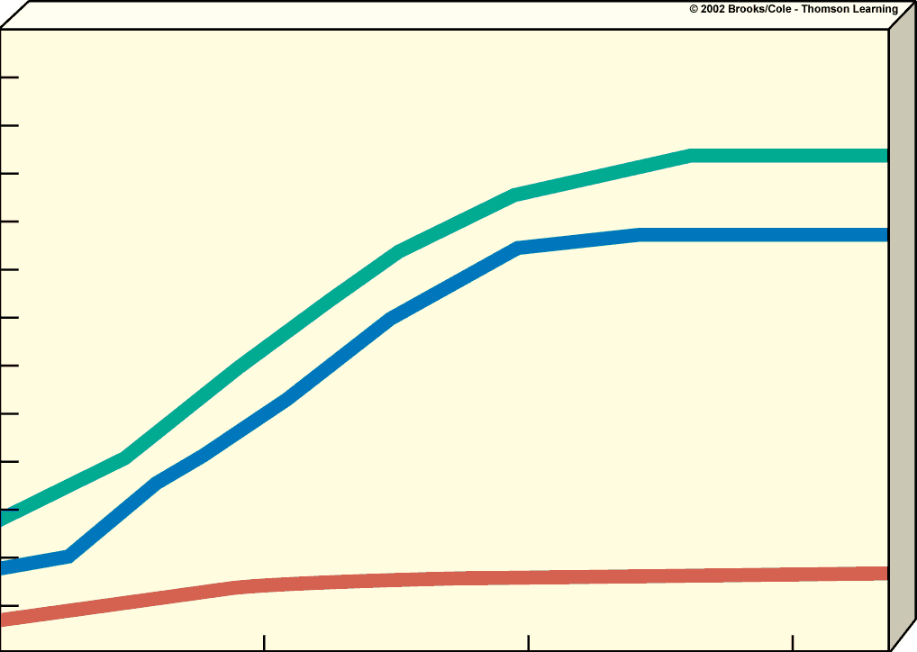
12
11
10
World total
9
8
Developing
countries
7
Population (billions)
6
5
4
3
Developed
countries
2
1
2000
2050
2100
1950
Year

Slide 25
How does Economy relate to Environment?
Uses resources
World economy – emits fossil fuels
Cannot afford a budget to “go green” if in crisis
Can offer incentives to encourage businesses to go green “subsidies”
Gross national product (GNP)
Gross domestic product (GDP)
Total value of all goods and services produced within a nation in a year plus income earned by citizens
measures economic condition of country
higher GNP→higher quality of living
Per capita – per person
**United Nations classifies the countries as:
Economically developed-US, Canada, Japan, Australia, New Zealand, Europe
Economically developing-Africa, Asia, Latin America
Economic Growth?
an increase in the capacity to provide people with goods and services
Notes:
Economic growth can help prevent extinctions because as people become richer, their interests begin to extend beyond necessities towards luxuries, such as expensive shoes or a day bird-watching. Green pressure groups begin to lean on government and pass laws to constrain companies form damaging the environment

Slide 26
Principles of Sustainability
ECONOMICS
Full-cost pricing
POLITICS
Win-win results
ETHICS
Responsibility to
future generations
Fig. 1-5, p. 9
Notes:
Figure 1.5 Three social science principles of sustainability can help us make a transition to a more environmentally and economically sustainable future.

Slide 27
Environmental Problems

Slide 28
Doubling Time
#of years it takes for a population growing at a specified rate to double it’s size
Rule of 70:
DOUBLING TIME in YEARS =
70/Percentage Growth Rate
Ex – 2002 – population grew by 1.4%
70/1.4 = 50 years (will double in this amount of time)
What year?
2052
Can also determine number of people added by using growth rate
Ex – 6 billion in 2002
6 x 10⁹ x .014 = 84 million
Notes:
70/1.4 = 50 years
Answer to problem = .084 x 109 = 84 million

Slide 29
What is Percent Increase
Population 2016 – 7.32 Population 2015 - 7.24
1st need to figure out percent increase? How do we do?
7.32-7.24 = .08
.08/7.24 = .011 x 100
1.1 %
Doubling time?
= 70/1.1 = 63.63 years
How to figure out how many people increased by?
Population in 2015 = 7.24 Billion
7.24 B x .011 = .0796 x 109 = 80 million p

Slide 30
Percent Increase
Example 2 Billion – 10 Billion
Find difference 1st
10-2 = 8
Take difference and divide by original number
8/2 = 4
Multiply by 100 = 400%

Slide 31
Annual Rate of increase
Total # of increase/total time
Ex City A
150,000 year 2005
180,000 year 2008
(180,000-150,000)/(2008-2005)
30,000/3 = 10,000 people per year
What about per month?
30,000/(3x12) = 833.33

Slide 32
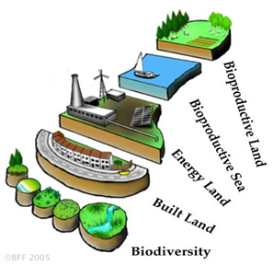
Ecological Footprint
amount of land needed to produce the resources needed by an average person in a country
developed countries – large
developing countries – smaller
total world Ecological Footprint is 2.7 global hectares per person per year. (1 hectare – ha = 2.47 acres )
average biocapacity 2.1 global ha/p (ecological deficit 0.6)
Notes:
2.7 x 2.47 = 6.669

Slide 33
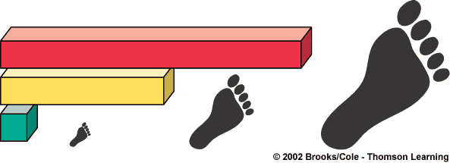
Country
Per Capita Ecological Footprint
(Hectares of land per person)
10.9
United States
5.9
The Netherlands
1.0
India

Slide 34
Total Ecological Footprint
(Hectares)
Country
United States
3 billion
hectares
The Netherlands
94 million hectares
India
1 billion
hectares

Slide 35
http://www.earthday.org/footprint-calculator - can do at home

Slide 36
Tragedy of the Commons
exploitation or overuse of common property resources
Read excerpt
http://www.youtube.com/watch?v=L8gAMFTAt2M (Garrett Hardin interview -1915-2003)

Slide 37
Tragedy of the Commons

Slide 38
How can we reduce our environmental impact?
slow population
decrease resource use and waste
use more environmentally beneficial technologies
use less environmentally harmful technologies

Slide 39
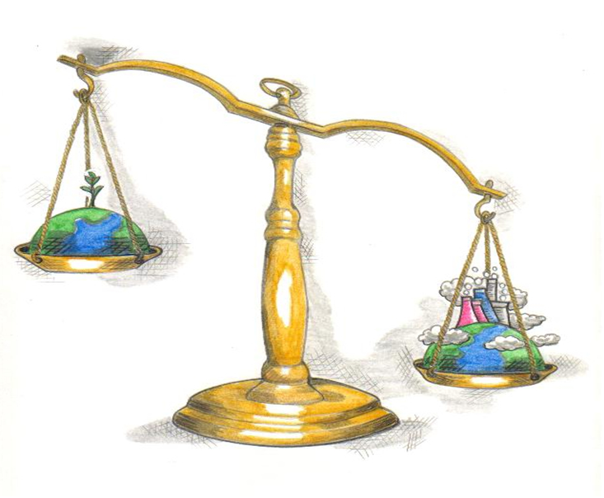
Solutions: Living more Sustainably
Be environmentally educated:
Go Green
1) Respect life and try to live more simply
2) Understand our environment and use knowledge to be involved
3) Learn the positive and negative consequences of things we do in life and others do
4) “I know, I care, I’ll do something”
5) Conserve and Preserve

