Slide 1
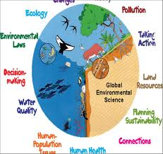
AP Environmental Science Timeline

Slide 3
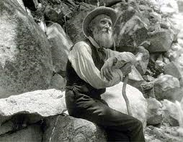
John Muir
Naturalist that wanted to preserve wilderness in US. Founded Sierra Club
“Father of the National Parks
Notes:
“

Slide 8
Prohibits trade in wildlife, fish, and plants that have been illegally taken, transported or sold

Slide 10
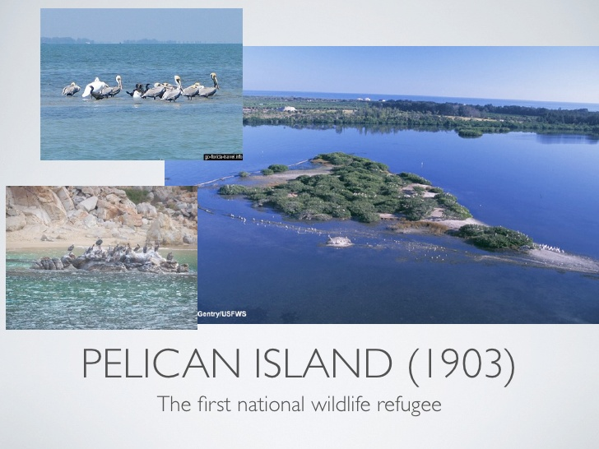

Slide 12
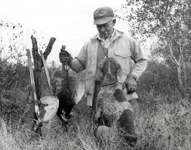
Aldo Leopold
Founder of the science of wildlife management

Slide 13
US National Park Service Founded

Slide 14
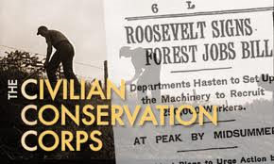
Civilian Conservation (CCC) founded by FDR to conserve and develop natural resources.
Planted 3 billion trees to reforest America and constructed 800 parks nationwide

Slide 21
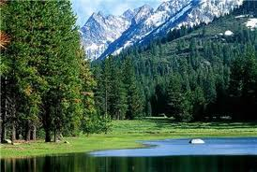
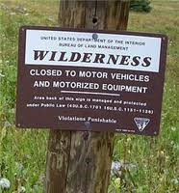
Wilderness Act

Slide 26
Environmental Impact Statement

Slide 27
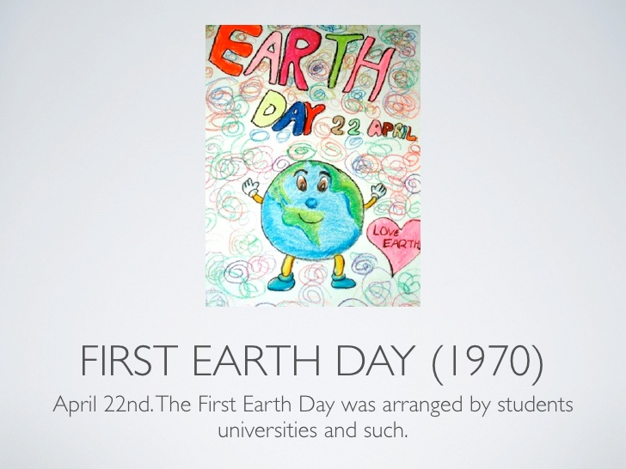

Slide 29
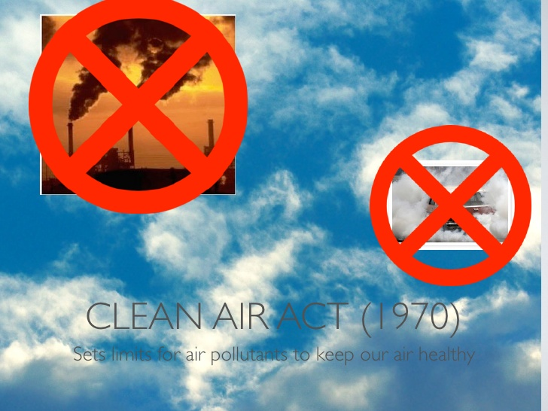

Slide 31
Endangered Species Act -1973
Conservation of species that are endangered or threatened

Slide 32
FIFRA – Federal Insecticide, Fungicide, and Rodenticide Control Act
federal control of pesticide distribution, sale, and use

Slide 34
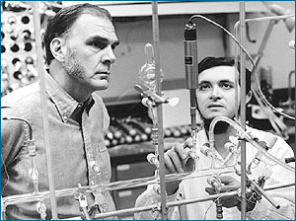
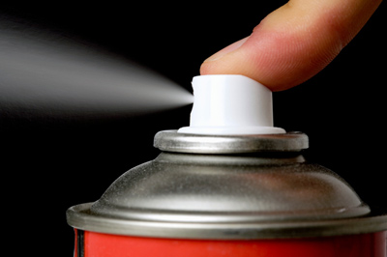
A 1970s photo of F. Sherwood Rowland (left)
and Mario Molina in the lab.
1974 Roland and Molina announce CFC’s culprit in ozone layer

Slide 35
Safe Drinking Water Act

Slide 36
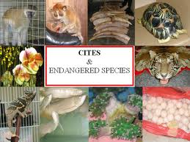
CITES – protect wildlife against exploitation

Slide 37
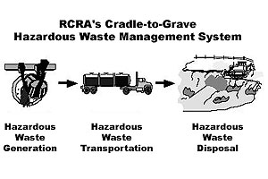
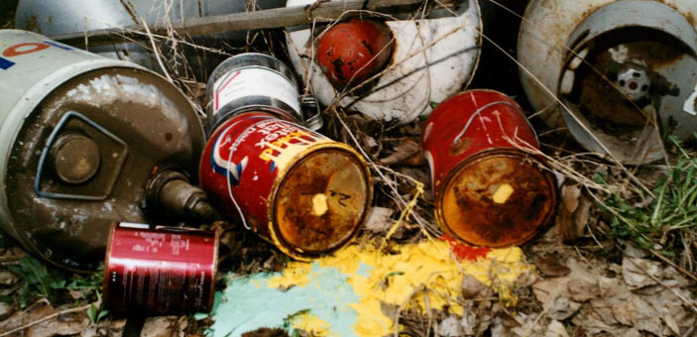
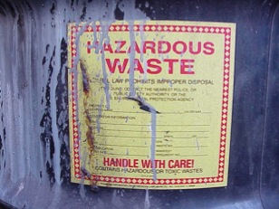
RCRA Resource Conservation and Recovery Act
disposal of solid waste and hazardous waste
“cradle to grave”

Slide 38
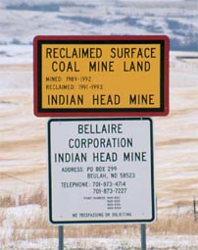
Surface Mining Control and Reclamation Act

Slide 41
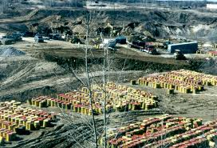
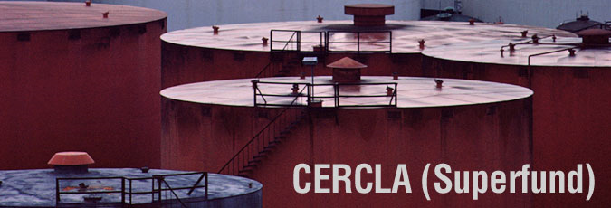
CERCLA – 1980 “Superfund Act”
clean up sites contaminated with hazardous substances

Slide 46
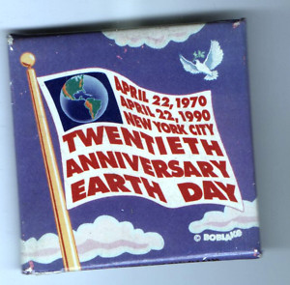
20th Anniversary of Earth Day

Slide 47
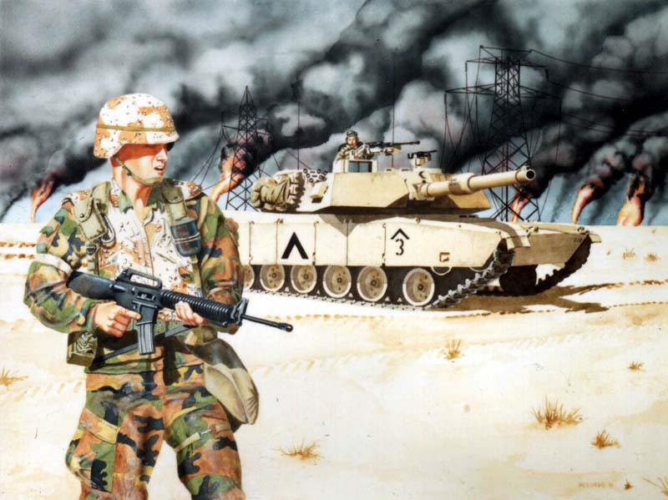
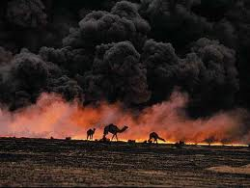
Persian Gulf War

Slide 48
Energy Policy Act
energy efficiency, energy conservation and energy management

Slide 49
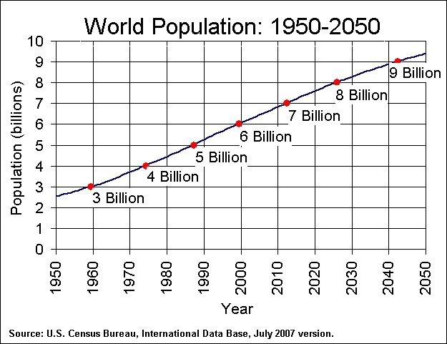
World Population Hits 6 billion

Slide 51
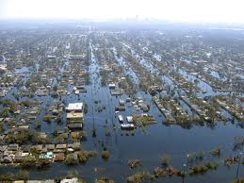
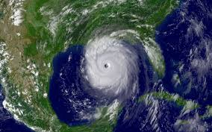
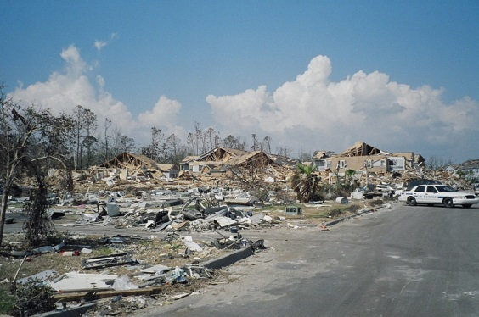
Hurricane Katrina – one of strongest storms to impact US in past 100 years, 125 mile winds
Impacted Gulf Coast – New Orleans, LA, Al

Slide 52
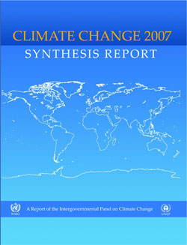
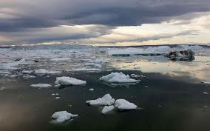
IPCC Report on Climate Change (1990, 1992, 1995, 2001, 2007)

Slide 55
World Population Hit 7 Billion
Oct 31, 2011

Slide 56
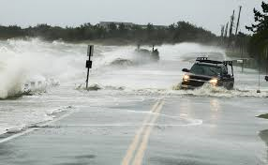
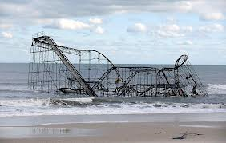
2012
Hurricane Sandy

Slide 57
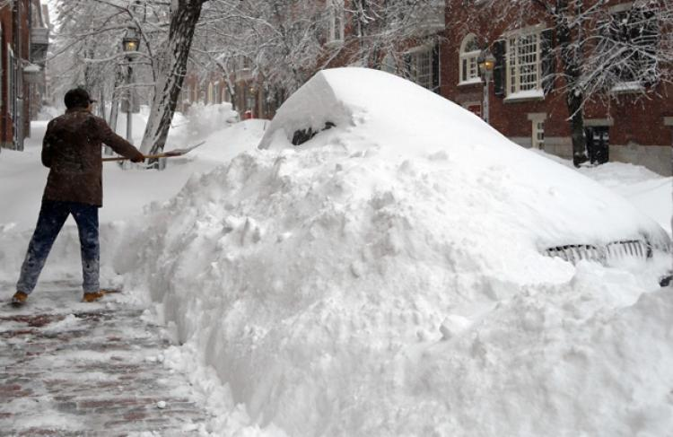
2013
Boston Massachusetts,
Winter Storm Nemo dumped up to three feet of snow across parts of the Northeast

Slide 58
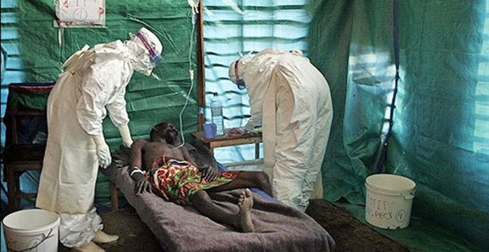
Ebola Outbreak - 2014
The Ebola outbreak that began in West Africa in worst outbreak of this virus in history.
Guinea, Sierra Leone and Liberia
70 percent of the infected people died

Slide 59
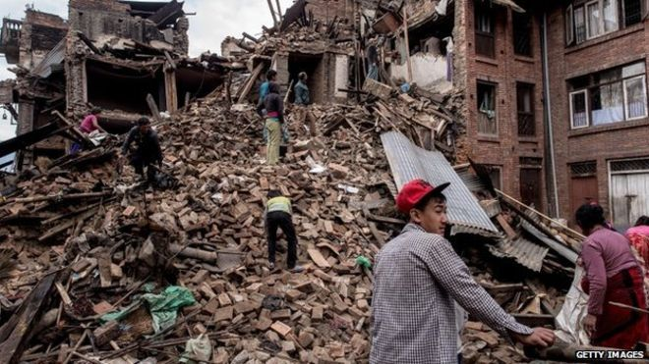
Earthquake Nepal 2015
7.8 magnitude earthquake
kills more than 8,800 people.
900,000 buildings destroyed

Slide 60
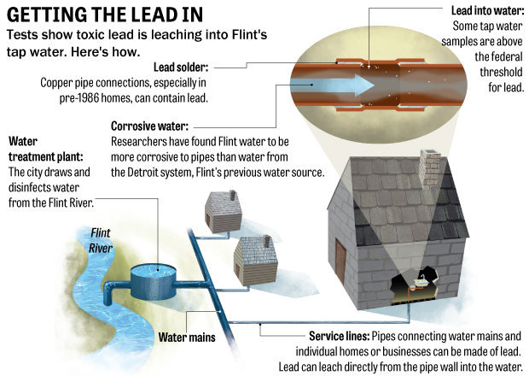
Flint Water Crisis 2016

Slide 61
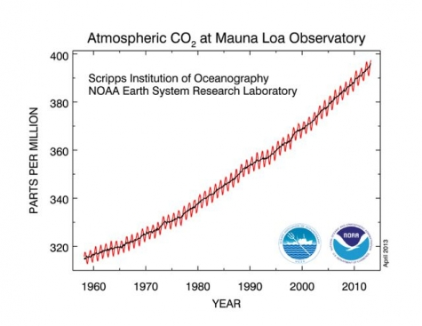
CO2 levels cross 400ppm 2016

Slide 62
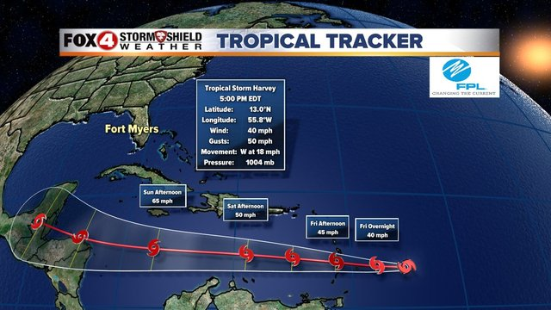
Hurricane Harvey/Hurricane Irma 2017

