Slide 1
Environmental History

Slide 2
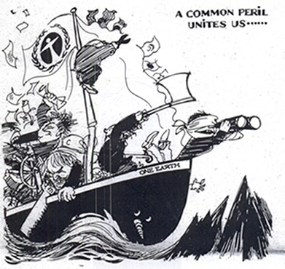
What has happened throughout history that has shaped our current environmental worldview?

Slide 3
Cultural changes and the environment

Slide 4
1) Hunter-Gatherers
Homo Sapiens only lived here about 60,000 years
Before 12,000 years ago – HG’s
Survived by simple life, moved about and hunted for food to survive
Least environmental impact
http://www.youtube.com/watch?v=Pro6X_Kc5wA

Slide 5
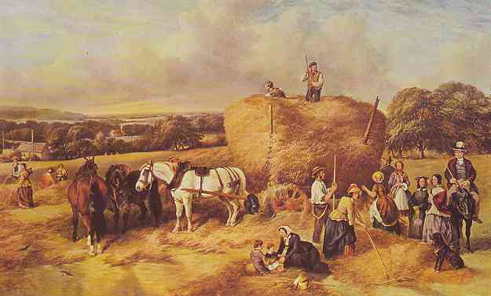
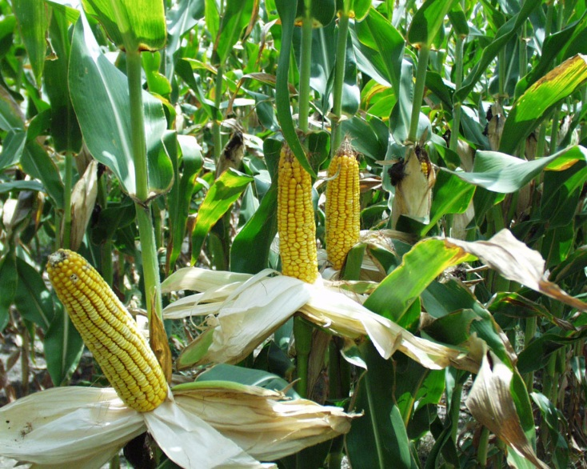
2)Agricultural Revolution
10-12,000 years ago (Neolithic – 1st AR)
Farming, slash and burn cultivation (ash-fertile)
Cultivated plants and domesticated wild animals
Destroyed habitats of plants and animals
Still little impact
http://www.youtube.com/watch?v=yVFDEGdYVro

Slide 6
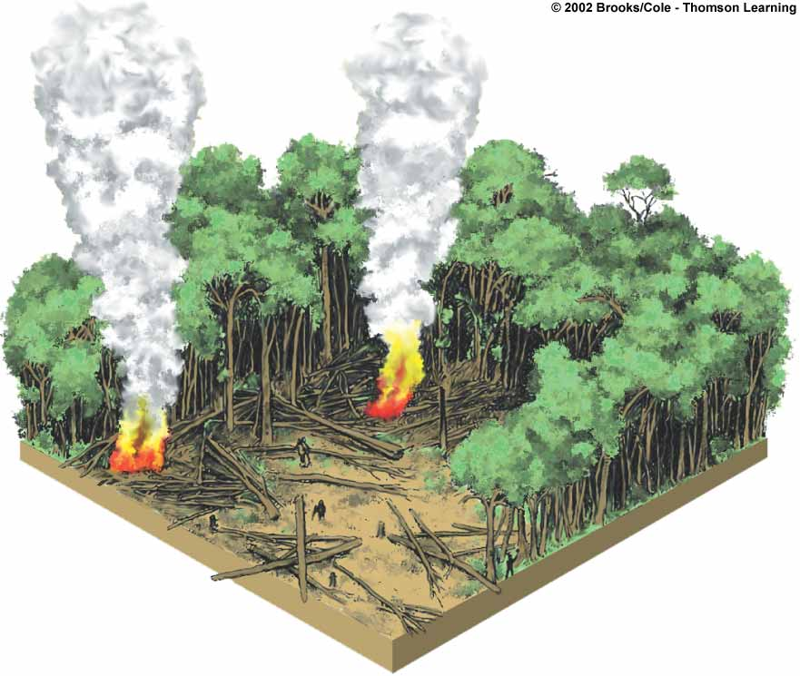
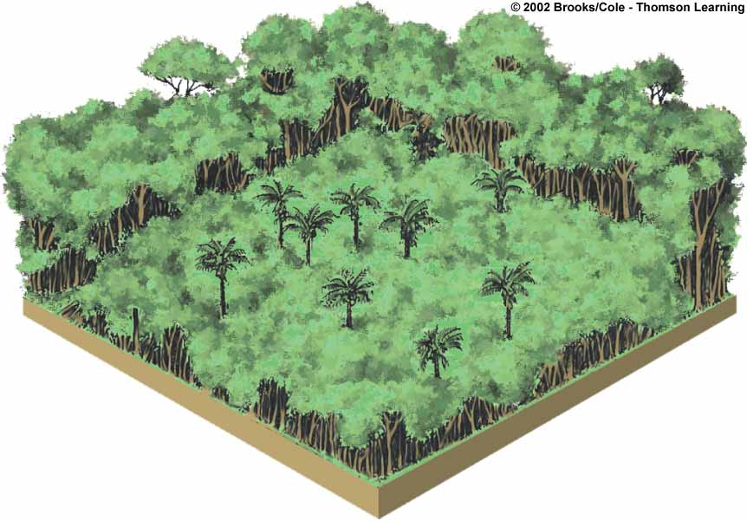
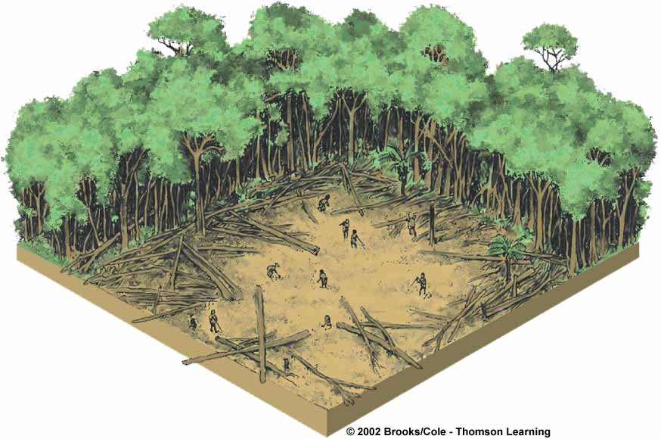
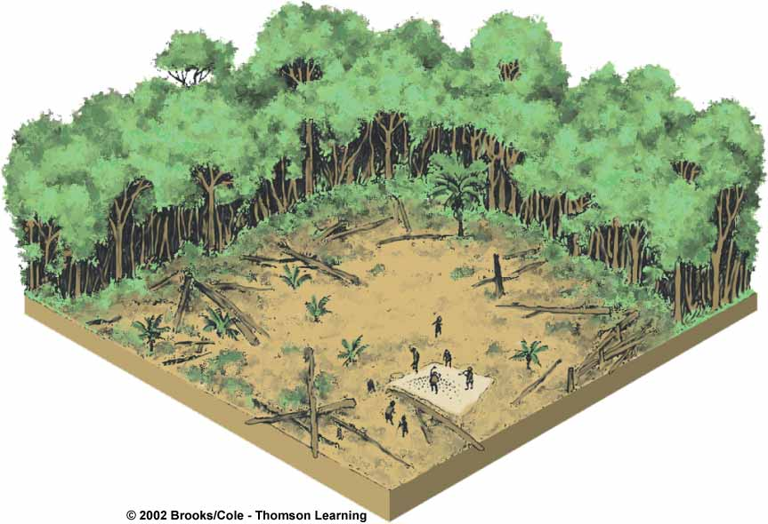
1
Clearing
and burning
vegetation
Allowing
to revegetate
10 to 30 years
4
2
3
Planting
Harvesting for
2 to 5 years

Slide 7
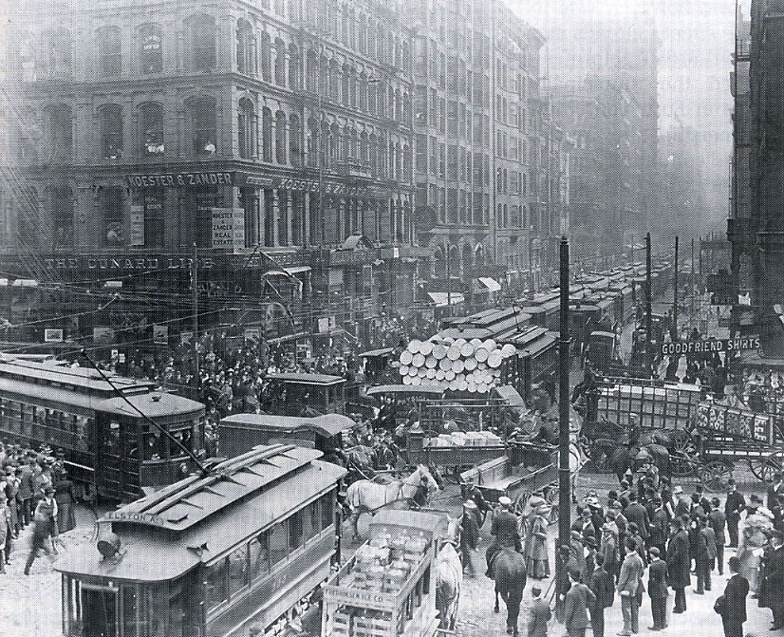
3)Industrial Revolution
England -middle 1700’s
US -1800’s.
Shift from renewable (wood) to nonrenewable (fossil fuelsl)
Machines run on coal and later oil and natural gas
Rapid expansion of production, trade, and distribution of goods
Increase in population
More impact on environment
http://www.history.com/videos/the-industrial-revolition#the-industrial-revolition

Slide 8
4) Information/Globalization Revolution
50 years ago- telephone, radio, TV, computer, Internet, satellites
Globalization-change that leads to an integrated world
Help us understand environmental problems better
Increase environmental degradation

Slide 9
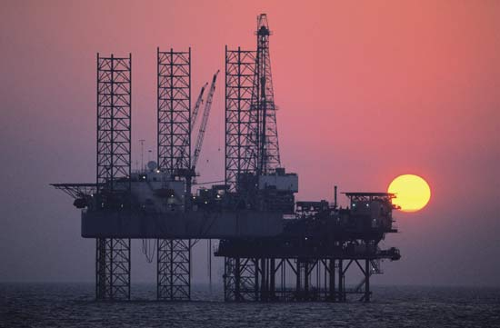
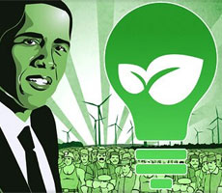
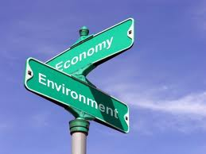
Which presidents influenced environment?
TEDDY ROOSEVELT
Golden Age of Conservation
created first federal wildlife refuges and national parks
FDR
set up CCC (Civilian Conservation Corps) – gave 2 million unemployed people to work by planting trees and building dams
JFK
investigate pesticides (after Rachel Carson published book –Silent Spring).
RICHARD NIXON
formed EPA, 1st Earth Day (4/22/1970)
JIMMY CARTER
interest in environment, put solar water heaters in WH
RONALD REAGAN
against environment movement
BILL CLINTON
set aside 58 million acres of forest and wilderness.
regulated air pollution emissions from cars
GEORGE W. BUSH
not a strong proponent (traditional energy sources)
BARACK OBAMA

