Slide 1
Chapter 9 – Population Dynamics, Carrying Capacity, and Conservation Biology

Slide 2
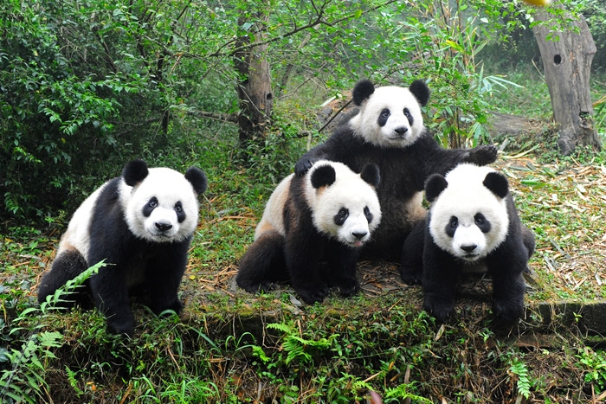
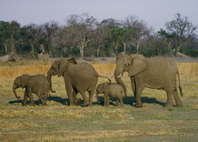
Population Dynamics
response of a population to change due to environmental stresses
Ex-size (# of individuals)
density (# of individuals in a certain space)
age distribution (different ages)
dispersion -how they form a pattern
a)clumping-patches/most common
b)uniform
c)random

Slide 3
Population Dispersion
Fig. 9-2 p. 191

Slide 4
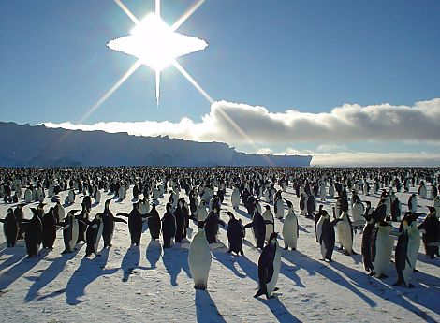
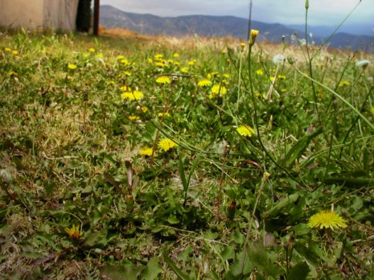
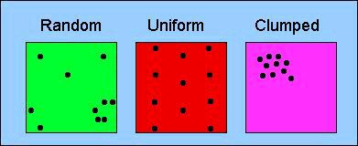
3 Patterns of Dispersion
Uniform
Clumped
Random

Slide 5
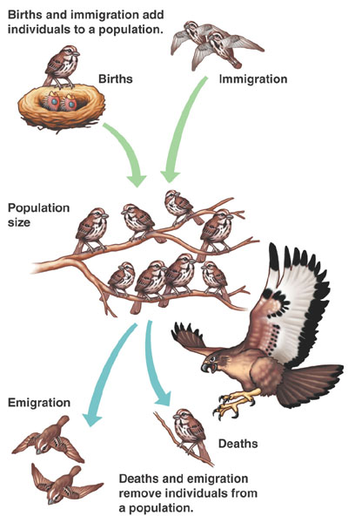
Population Change :
Birth (crude birth b/1000)
Death (crude death d/1000)
Immigration
Emigration
Population Change =
[Birth + Immigration] (–) [Death + Emigration]
What if
B+I>D+E?
B+I<D+E?
Population?
Problems
If a city population of 5,000 experiences 80 births, 30 deaths, 20 immigrants and 40 emigrants, what is the net annual percent growth rate?
30/5000 = .006 x 100 = .6%
2) The annual birth and death rate in a country per 1000 are 39 and 19 respectively . What is the number of years that the population will double assuming there is no emigration or immigration?
1st need to figure our Annual Rate of Increase = 39-19 = 20
20/1000 = .02 x 100 = 2%
70/2 = 35
Notes:
Crude Birth Rate - CBR = Births/Population x 1000
Crude Death Rate - CDR = Deaths/Population x 1000

Slide 6
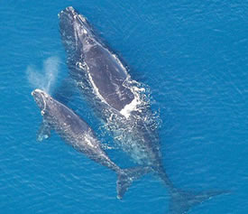
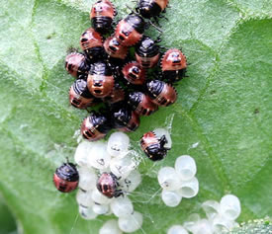
Population size affected 2 factors:
1)Biotic Potential
Populations capacity for growth
Ex fruit flies
Intrinsic Rate of increase (r)
rate a population would grow if unlimited resources
2)Environmental Resistance
limit the growth of a population
Carrying Capacity = the number of individuals that can be sustained in a given space (K)
Carrying Capacity =
Biotic Potential + Environmental Resistance
Which species has a greater
Biotic Potential?
Notes:
Environmental resistance is the same as limiting factors.

Slide 8
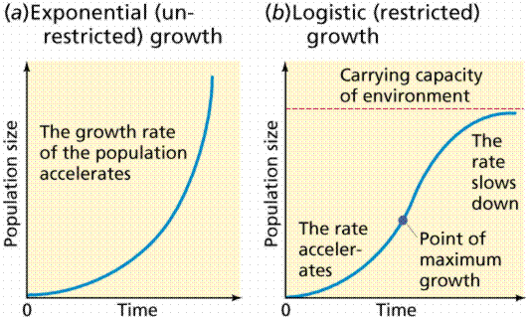
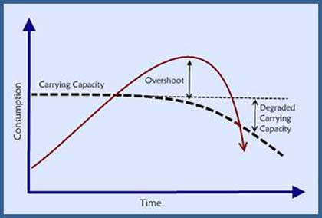
Exponential Growth
J-shaped curve
Logistic growth
S-shaped curve
→ Overshoots
When carrying capacity exceeded
due to Reproductive time lag
dieback or crash
***We have extended our earth’s carrying capacity for the human species How long can we live exponentially?
Notes:
Reproductive time lag is period needed for birth date to fall and death rate to rise, can be a dieback or crash unless use resources differently

Slide 9
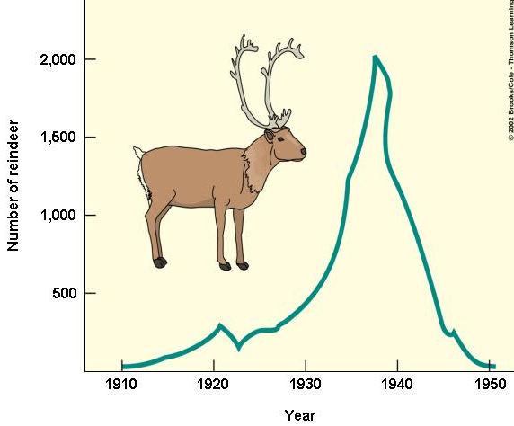
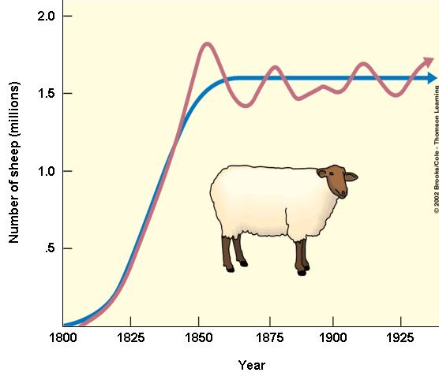
Exponential and Logistic Growth

Slide 10
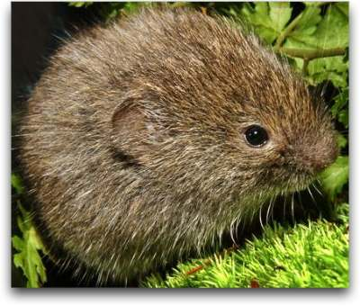
Population fluctuations
1)stable
2)irruptive
Explodes or erupts to a high peak
returns to stable
due to carrying capacity increasing
more food, better weather, fewer predators
3)chaotic (irregular)
no pattern
4)cyclic fluctuations
Boom and bust
changes every few years
Lemming - cyclical

Slide 11
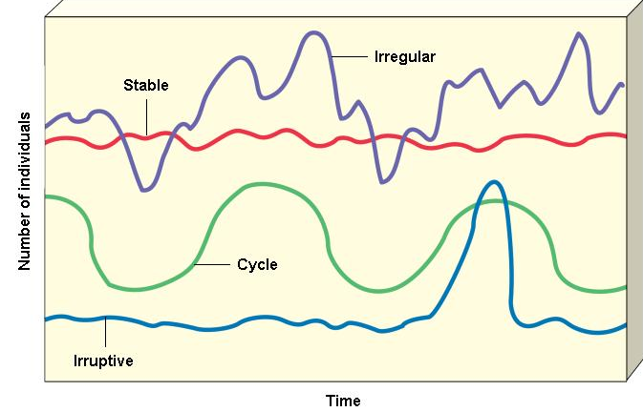
Natural Population Curves

Slide 12
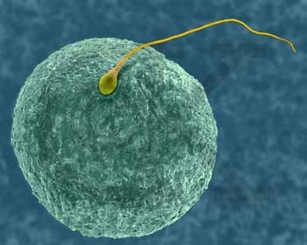
Species Reproduction:
Asexual vs Sexual (97%)
2 Reproductive Patterns
r-selected species (opportunist) – high intrinsic rate of increase
Ex-plants, fishes, bacteria
k-selected species – population size near carrying capacity
Ex-elephants & humans

Slide 13
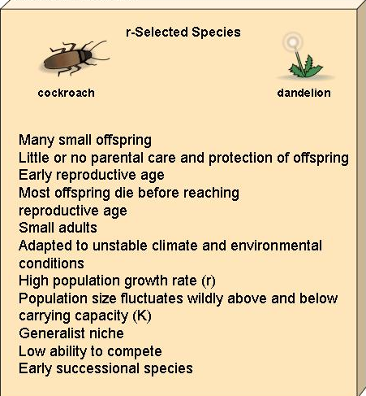
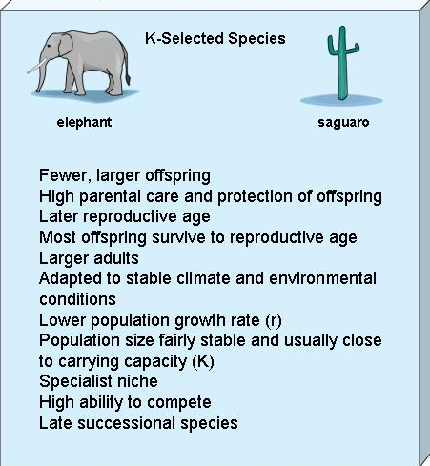
Reproductive Patterns and Survival
Asexual reproduction
r-selected species
Sexual reproduction
K-selected species
Fig. 9-10 p. 196

Slide 15
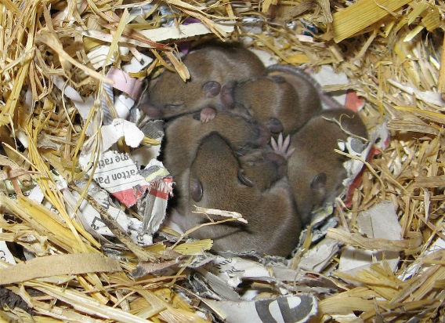
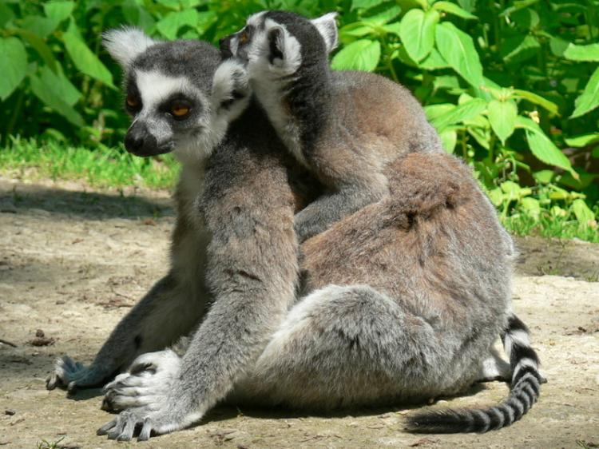
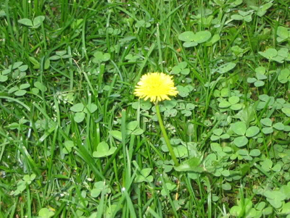
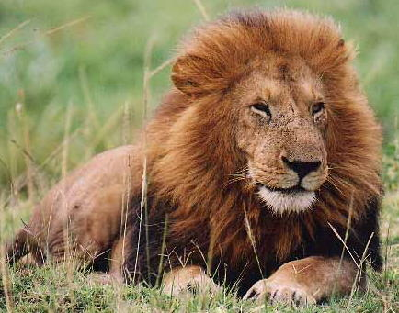
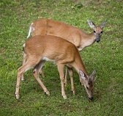
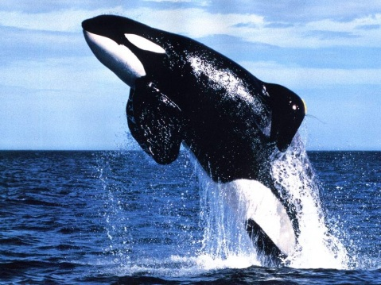
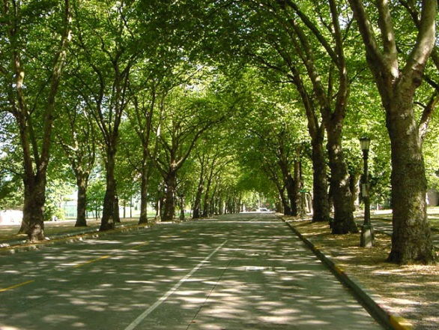
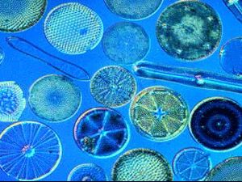
R or K Selected
Whales
Mice
Weeds
Lion
Deer
Diatoms
Trees
Humans
Bamboo Lemur

Slide 16
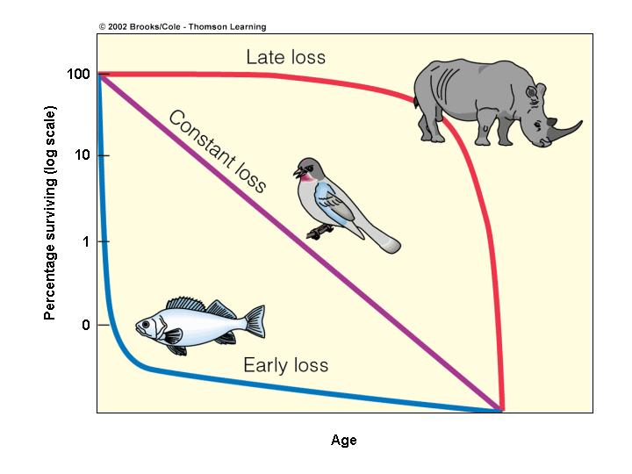
Survivorship Curves
age structure of population
# of survivors each age group
1)Late Loss Curves(I)
produce few young
long time care
reduce juvenile mortality
k-selected
2)Constant Loss Curve (II)- intermediate
3)Early Loss Curves(III)
produce many offspring
high juvenile mortality
r-selected

Slide 17
Survivorship Curves

