Slide 1

Air Pollution
Climate Change
Ozone Loss

Slide 2
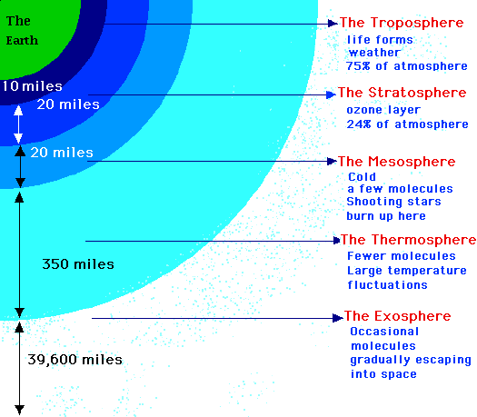
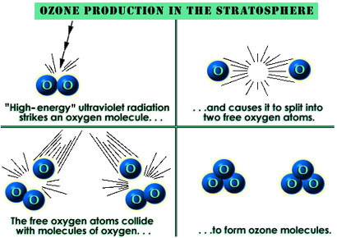

The ATMOSPHERE
Troposphere
weather patterns
nitrogen (78%) and oxygen (21%)
Stratosphere
Good ozone O₃
Some H₂O vapor
keeps out 95% UV
allows organisms to live
Bad Ozone - Trophospheric ozone – photochemical ozone (combo of sun, NO_{2,} VOCs)
Notes:
Airplanes fly just above the trophophere (to avoid turbulence) in beginning of stratosphere
Volatile organic compounds – cleaners, paints, fuel oil and gasoline
The ozone hole, however, is not the mechanism of global warming. Ultraviolet radiation represents less than one percent of the energy from the sun—not enough to be the cause of the excess heat from human activities. Global warming is caused primarily from putting too much carbon into the atmosphere when coal, gas, and oil are burned to generate electricity or to run our cars. These gases spread around the planet like a blanket, capturing the solar heat that would otherwise be radiated out into space. (For more detail on the basic mechanism of global warming, see carbon dioxide FAQ.)
Both of these environmental problems do, however, have a common cause—human activities that release gases into and alter the atmosphere. Ozone depletion occurs when chlorofluorocarbons (CFCs)—formerly found in aerosol spray cans and refrigerants—are released into the atmosphere. These gases, through several chemical reactions, cause the ozone molecules to break down, reducing ozone's ultraviolet (UV) radiation-absorbing capacity.

Slide 3
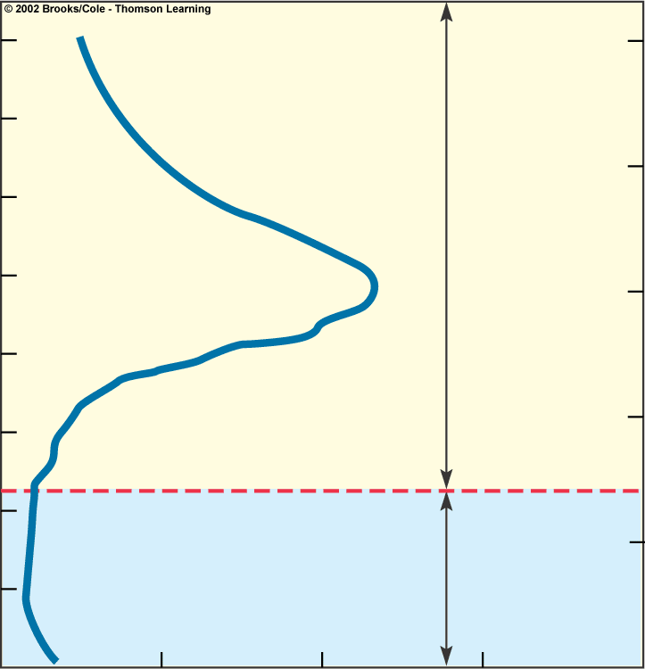
40
25
35
Stratosphere
20
30
25
Stratospheric ozone
15
Altitude (kilometers)
Altitude (miles)
20
10
15
10
Troposphere
5
5
Photochemical ozone
0
0
0
5
10
15
20
Ozone concentration (ppm)

Slide 4
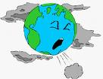


Air Pollution caused by:
1)Natural sources volcanoes, emissions from trees, forest fires
rarely reach harmful levels
2) Anthropogenic sources – human
Stationary source vs Mobile source
fossil fuels & cars
reach harmful levels
Primary Pollutants – emitted directly into the atmosphere
Ex-CO, lead
Secondary Pollutants- when primary react with one another
Ex – sulfuric acid H₂SO₄, Ozone O₃
Causes smog
What has more pollution – urban vs rural?
What effect does wind have?
https://www.cbsnews.com/pictures/top-10-smoggiest-cities-in-us/2/
https://www.cbsnews.com/pictures/the-most-polluted-cities-in-the-world-ranked/

Slide 5
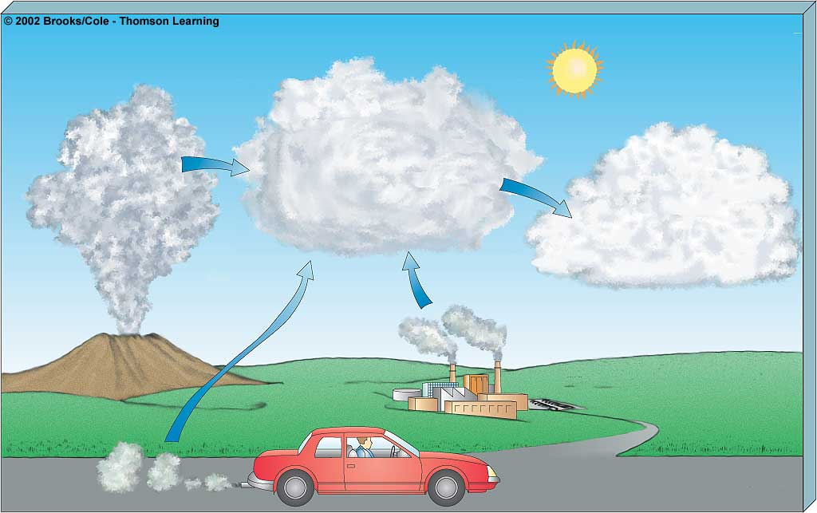
Primary Pollutants
CO
CO₂
SO₂
NO
NO₂
Secondary Pollutants
SO₃
Most hydrocarbons
HNO₃
H₂SO₄
Most suspended
particles
H₂O₂
O₃
PANs
₂
Most
NO₃
and
SO₄
–
salts
–
Natural
Sources
Stationary
Mobile
SULFATE AEROSOLS
microscopic particles – dust, sea salt, volcaonoes
fossil fuel and biomass combustion
acid rain, haze, lung irritation & albedo (seed clouds)
Global Dimming
Notes:
SO3 sulfur trioxide
HNO3 nitric acid
H2SO4 sulfuric acid
H2O2 hydrogen peroxide
PANS - peroxyacyl nitrates
An aerosol is a suspension of very fine particles of a solid, or of droplets of a liquid, in a gaseous medium. Fog, smoke, and volcanic dust are naturally occurring examples of aerosols. Sulfates are salts that contain a charged group of sulfur and oxygen atoms: SO, the basic constituent of sulfuric acid. The sulfate particles in the atmosphere are about 0.1 to 1.0 micrometer (a millionth of a meter) in diameter and are particularly concentrated over industrial areas. They contribute to acid rain, cause lung irritation, and have been a main culprit in causing the haze that obscures a clear view of the Grand Canyon.
Global dimming is the phenomena of an observed reduction (about 1-2% per decade since ~1960) of sunlight reaching the surface of the Earth caused by air pollution (aerosols – small particles) and cloud changes. Some of this solar energy is reflected back out to space and this cooling effect is believed to have counteracted part of the greenhouse gas warming - See more at: http://www.realclimate.org/index.php/archives/2006/04/global-dimming-and-climate-models/#sthash.PVYMPxAP.dpuf

Slide 6
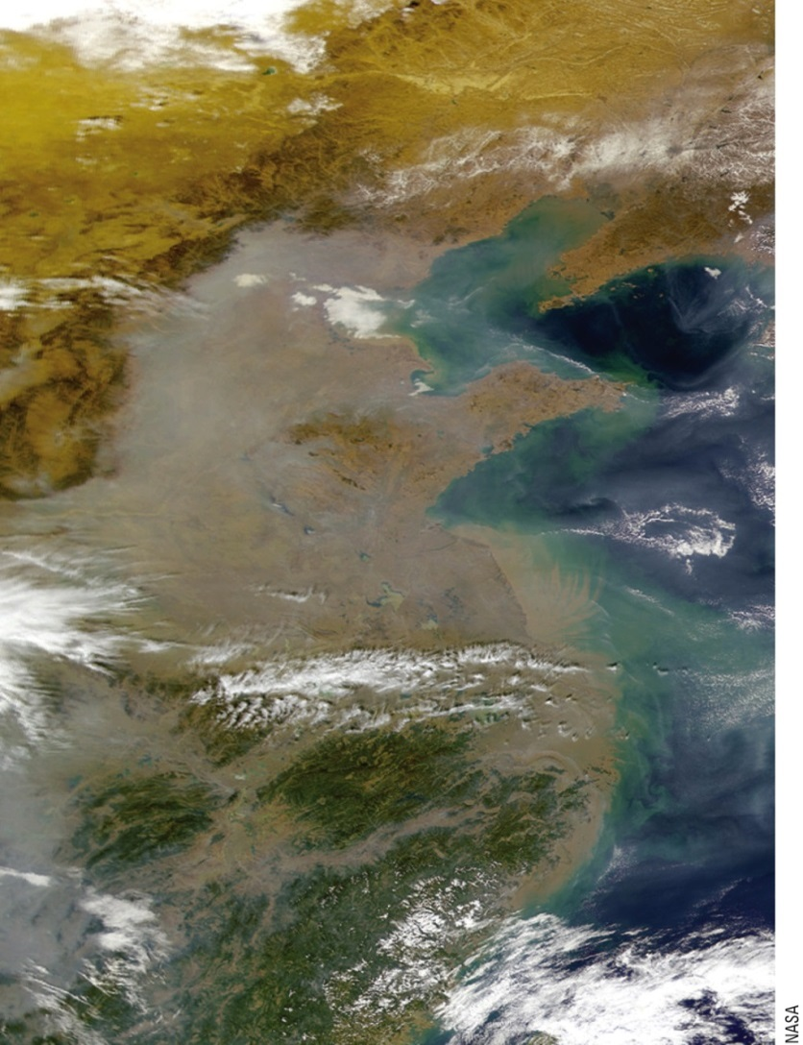
The South Asia's Brown Clouds (cont'd.)
Location: India, Bangledesh, China
Size of US
Dust, smoke, ash
Drought I& deforestation & soot (diesel),
Emissions from PP, cars
Fig. 18-1a, p. 474
Notes:
Figure 18.1: The South Asian Brown Clouds are gigantic clouds of dust, smoke, soot, and other pollutants that stretch over much of South Asia. One is visible here over eastern China.

Slide 7
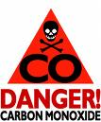


Outdoor Air Pollution
Common criteria Air Pollutants in US
have set maximum levels for 6 criteria pollutants
1)Carbon monoxide (CO)– motor vehicle exhaust, gas stoves, wood burning, tobacco
2)Nitrogen dioxide (NO₂₎ – motor vehicles and industrial plants, ground level ozone
3)Sulfur dioxide (SO₂₎ – coal burning power plants
4)Suspended particulate matter (SPM)
5)Ozone – floating around, mainly from motor vehicle exhaust
6)Lead – paint
http://www.epa.gov/ttn/naaqs/

Slide 8
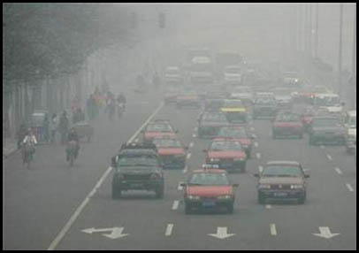
Photochemical Smog
Summer Smog/Los Angeles smog
Most common
Problem in warm dry climates
reaction of hydrocarbons and nitrogen oxides/influence of sunlight
Nitrogen based
Primary: Nitrogen Oxides
Secondary: Ozone & PANS
White/yellow/brownish haze
Sulfurous/Industrial Smog
Winter Smog/London Smog
consists mostly of SO₂ and smoke
Sulfur based/Very thick
Primary: Sulfur oxides
Secondary SO₃, H₂SO₄
Gray
What does Smog Do to People?
Severe Respiratory Problems
What does Smog Do to Environment?
Prevents sufficient photosynthesis
Loss of soil fertility/Reduces crops
Photochemical Smog
Los Angeles
Mexico City
Industrial Smog
Beijing
London
Hong Kong

Slide 9
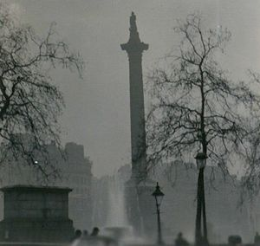
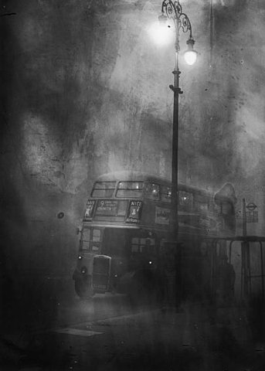
London Smog of Dec 5-9 1952
5 days of continuous smog
Caused mainly from use of coal
Responsible for 4000 deaths

Slide 10
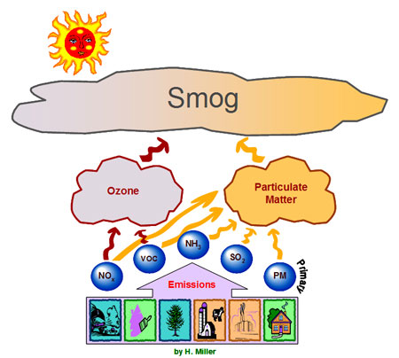
What Increases Smog?
1)Motor vehicles/factories
2)Climate - high temps, dry, sunny
3)Urban Buildings
4)Hills and Mountains
pollutants build up in valleys below them
5)Temp Inversions – occurs during day (instead of night)
layer of warm air lies atop a layer of cooler air(which is denser)
pollutants concentrate in this cooler air (cannot disperse)
Decreases
1)Rain and Snow
2)Salty Sea Spray from oceans
3)Winds
4)Smokestacks
http://www.youtube.com/watch?v=A_mJqZB0Ts4 Actual Temp Inversion
http://www.youtube.com/watch?v=LPvn9qhVFbM
Steve Spangler Temp inversion
http://www.youtube.com/watch?v=qb0MH6Z4IWs
Bejing heavy smog
Notes:
Urban Buildings/Hills and Mountains – slows winds and pollutants cannot disperse
Typically through convection, the warm air rises during the day and becomes cooler and denser and sinks – so a mixing
When temps start to drop at night, cool air can end of settling near earth and create a temp inversion. Occurs often in winter months when winters longer

Slide 11
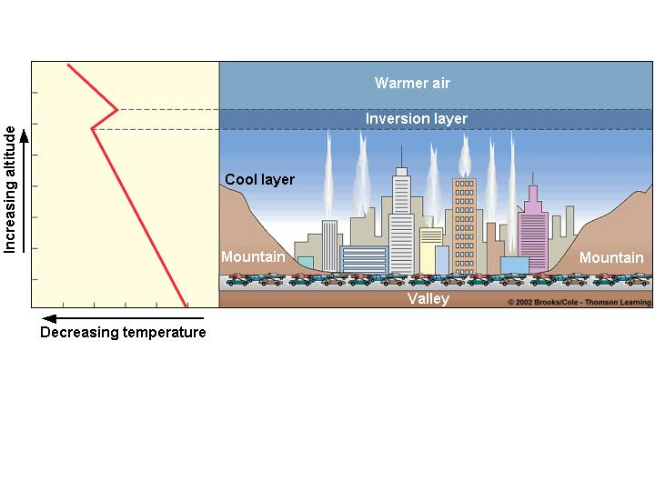
Fig. 17-9 p. 427

Slide 12
Some Chemical Reactions Happening with Smog
PHOTOCHEMICAL SMOG
Net result
NO + VOCs + O₂ +UV O₃ + PANs (peroxyacyl nitrates)
NO₂ + VOCs increase from cars
Increased sun – breaks down NO₂ (nitrogen dioxide)
into NO (nitric oxide) and 0
O combines with O₂ O₃
NO₂ + VOCs PANS (peroxyacyl nitrates)
INDUSTRIAL SMOG
C + O₂ CO₂ (#1 GG) or CO (Incomplete Combustion)
S + O₂ SO₂ SO3 or H2SO4

Slide 13
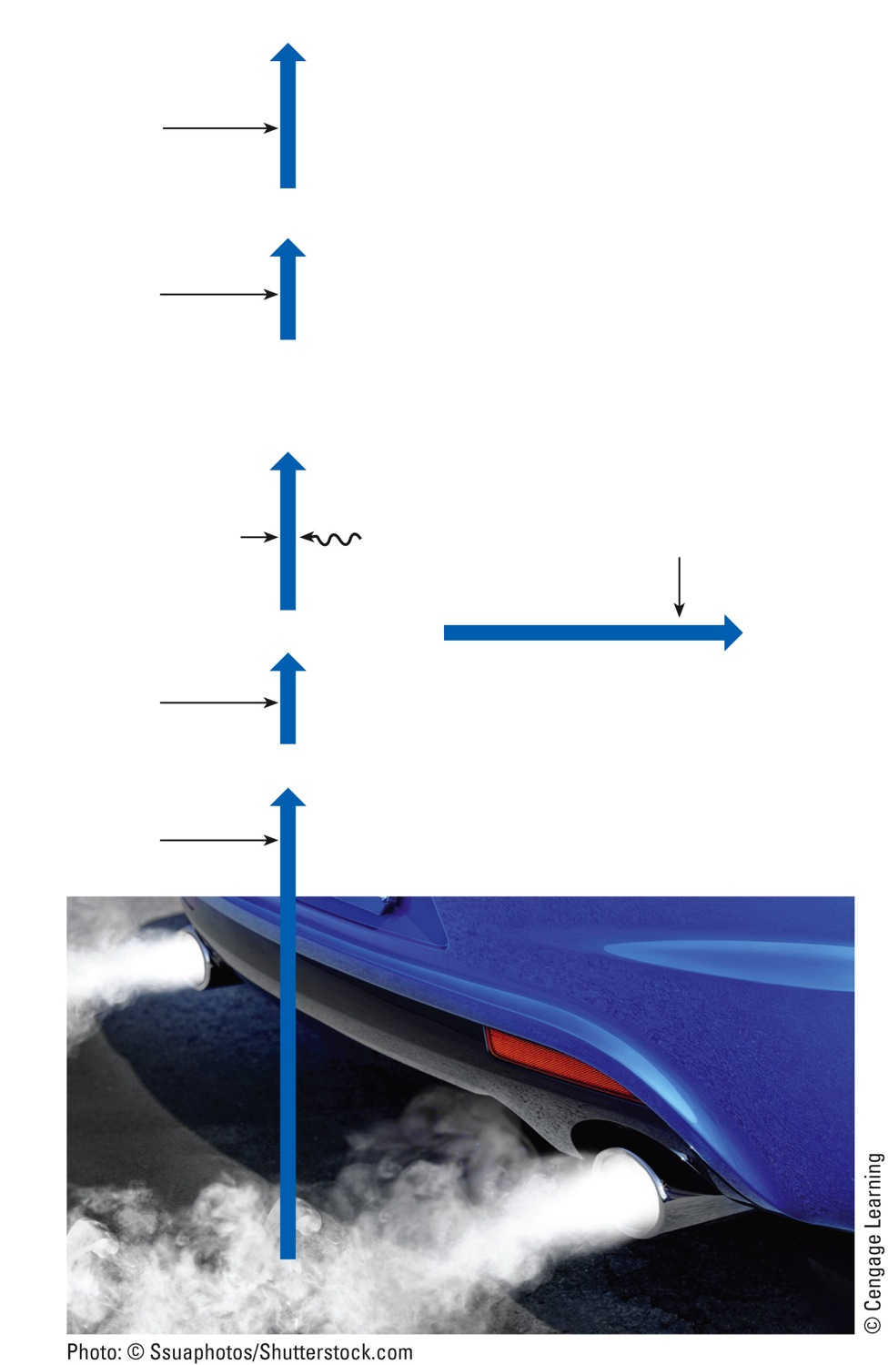
Photochemical Smog
PANS and other pollutants
Volatile organic compounds (VOCs)
Ozone (O₃)
Oxygen (O₂)
Nitric oxide (NO) + Oxygen atom (O)
Water vapor (H₂O)
UV radiation
Hydrocarbons
Peroxyacyl nitrates (PANs)
Nitrogen dioxide (NO₂)
Oxygen (O₂)
Nitric oxide (NO)
Oxygen (O₂)
Burning fossil fuels
Nitrogen (N) in fossil fuel
Fig. 18-9, p. 483
Notes:
Figure 18.9: A greatly simplified model of how the pollutants that make up photochemical smog are formed.

Slide 14
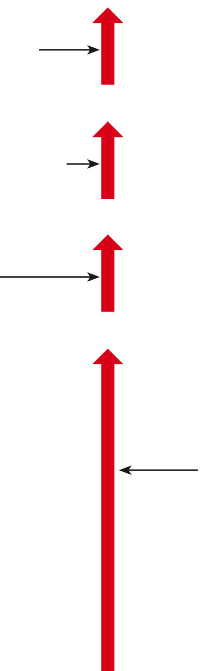

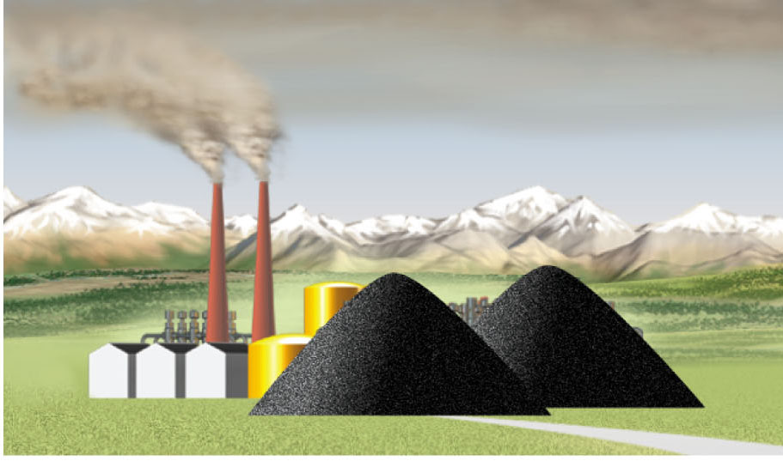
Ammonium sulfate [(NH₄)₂SO₄]
Ammonia (NH₃)
Sulfuric acid (H₂SO₄)
Water vapor (H₂O)
Carbon monoxide (CO) and
carbon dioxide (CO₂)
Sulfur trioxide (SO 3 )
Oxygen (O₂)
Sulfur dioxide (SO₂)
Burning coal and oil
Oxygen (O₂)
Sulfur (S) in coal and oil
Carbon (C) in coal and oil
Stepped Art
Fig. 18-8, p. 481
Notes:
Note: This is a carry-over animation from 17e. No modifications have been made to the animation itself; we have simply updating the figure number and page number in the lower-right corner.
Figure 18.8: This is a greatly simplified model of how pollutants are formed when coal and oil are burned. The result is industrial smog.

Slide 15
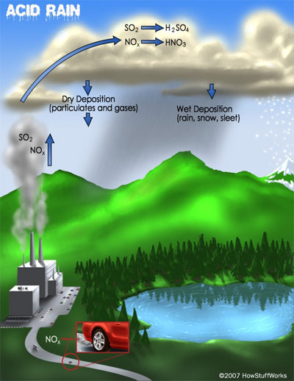
Acid Deposition
SO2 and NOx emissions
Motor vehicles,powerplants
NY/NJ – comes from Midwest (westerly winds bring down east)
SO₂ + H₂O H₂SO₃ (Sulfurous Acid)
reacts with O H₂SO₄
NOx + O NO₂ + H₂O
nitrous (HNO₂) and nitric acids (HNO₃)
Notes:
Acid Deposition – affects NY and PA a lot. Can further move to Canada and affect environment
1)wet deposition (acidic rain, snow, fog, and cloud vapor
pH less than 5.6 Acid rain 4.2-4.7
more distant downwind area (4-14 days)
2)dry deposition (air borne particulates
near emission source (2-3 days)

Slide 16
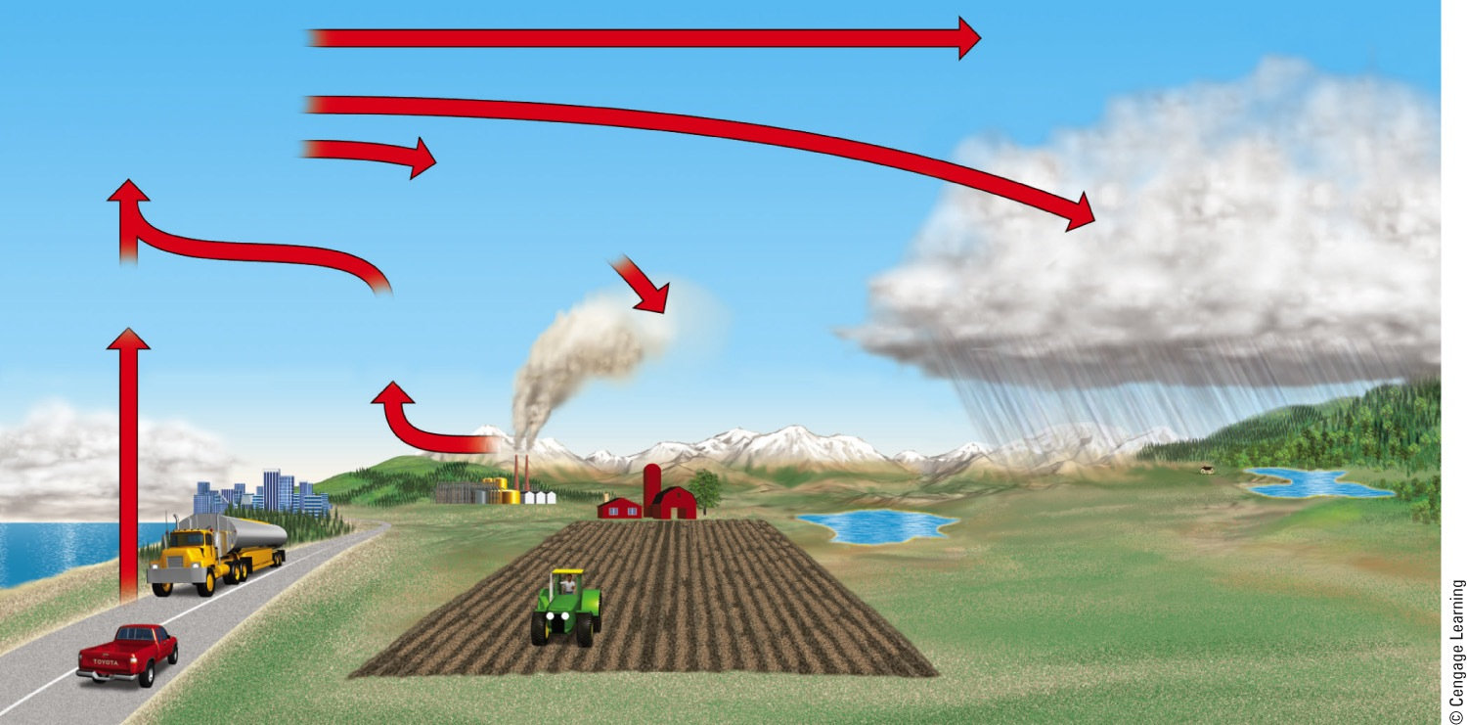
Natural Capital Degradation: Acid Deposition
Wind
Transformation to sulfuric acid (H₂SO₄) and nitric acid (HNO₃)
Windborne ammonia gas
and some soil particles partially neutralize acids and form dry sulfate and nitrate salts
Wet acid deposition (droplets of H₂SO₄ and HNO₃ dissolved
in rain and snow)
Nitric oxide (NO)
Sulfur dioxide (SO₂) and NO
Dry acid deposition (sulfur dioxide gas and particles of sulfate and nitrate salts)
Acid fog
Lakes in shallow
soil low in limestone become acidic
Lakes in deep soil high in limestone are buffered
Fig. 18-12, p. 485
Notes:
Figure 18.12: Natural capital degradation.
Acid deposition, which consists of rain, snow, dust, or gas with a pH lower than 5.6, is commonly called acid rain. Soils and lakes vary in their ability to neutralize excess acidity.

Slide 17
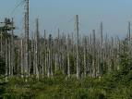

Harmful Effects:
human respiratory disease – asthma, bronchitis
damage statues, buildings & cars
decreases atmospheric visibility
lowers fish populations (pH drops-6 or 5)
releasing Al, Pb, Hg from soils into lakes and streams
leaching of plant nutrients (Ca & Mg) from soils – damages soil
Ways to Reduce Acid Deposition:
prevention
National Acid Precipitation Assessment Program (NAPAP)- studies acid deposition
Clean Air Act – amended 1990
limestone/lime (CaCO₃ –base) neutralize lakes/soil
Full-cost pricing, Scrubbers
http://www.youtube.com/watch?v=RP-sU8i2edo

Slide 18
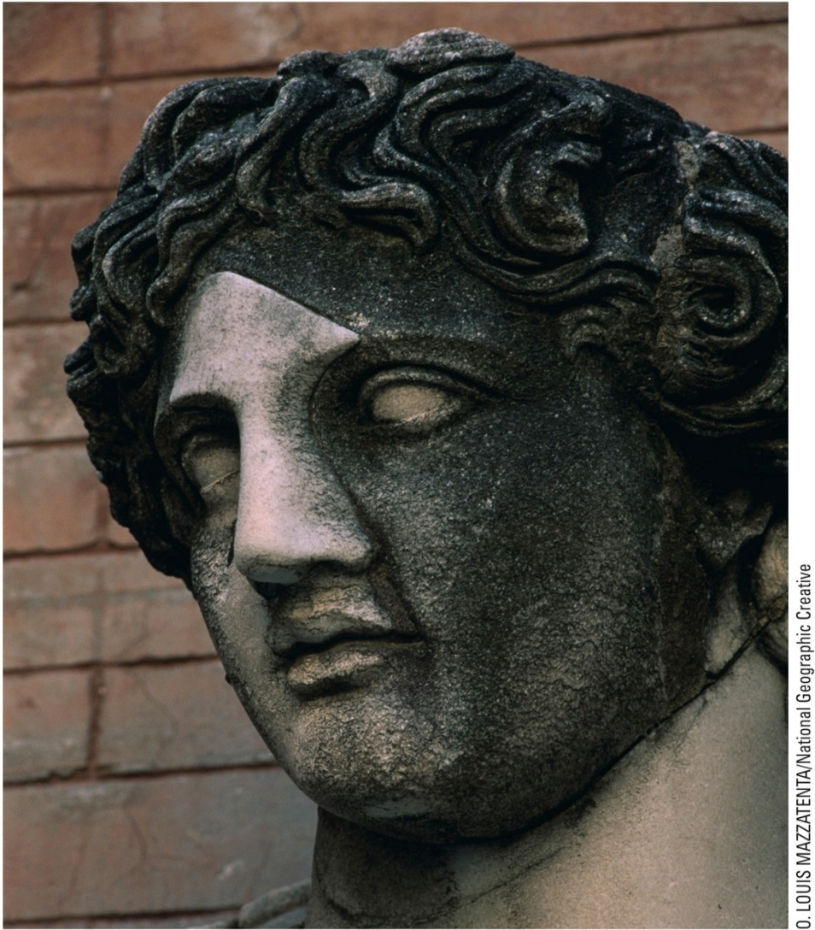
Acid Deposition
Figure 18.4: Acid deposition and other forms of air pollution have damaged this statue in Rome, Italy. The nose and part of the forehead have been restored
Fig. 18-4, p. 478
Notes:
Figure 18.4: Acid deposition and other forms of air pollution have damaged this statue in Rome, Italy. The nose and part of the forehead have been restored.

Slide 19
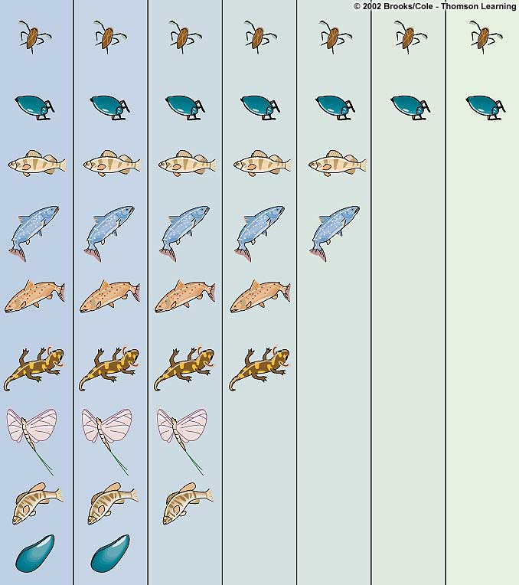
Water
boatman
Whirligig
Yellow perch
Lake trout
Brown trout
Salamander
(embryonic)
Mayfly
Smallmouth
bass
Mussel
6.5
6.0
5.5
5.0
4.5
4.0
3.5
pH

Slide 20
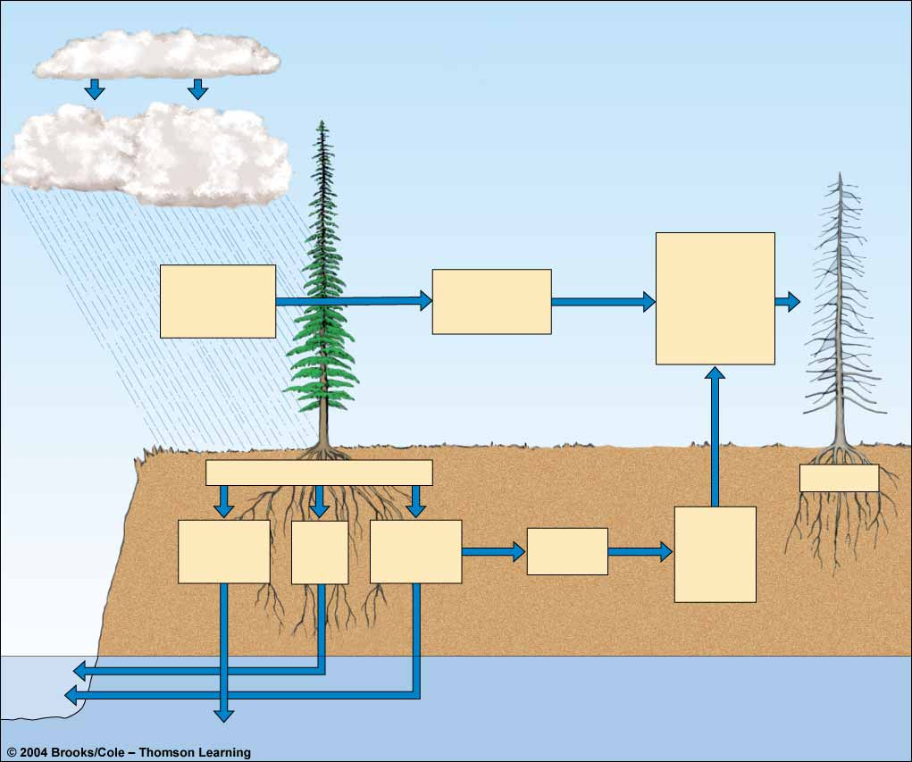
Figure 17-15
Page 432
Emission
Acid
deposition
SO₂
H₂O₂
PANs
NO_{X}
O₃
Others
Increased
Susceptibility
to drought,
extreme cold,
insects, mosses,
and disease
organisms
Direct damage
to leaves
and bark
Reduced
photosynthesis
and growth
Soil acidification
Tree death
Reduced
nutrient
and
water
uptake
Leaching of
soil
nutrients
Release of
toxic
metal icons
Root
damage
Acid

Slide 21

Ways to Clean Air in Industrial Plants

Slide 22
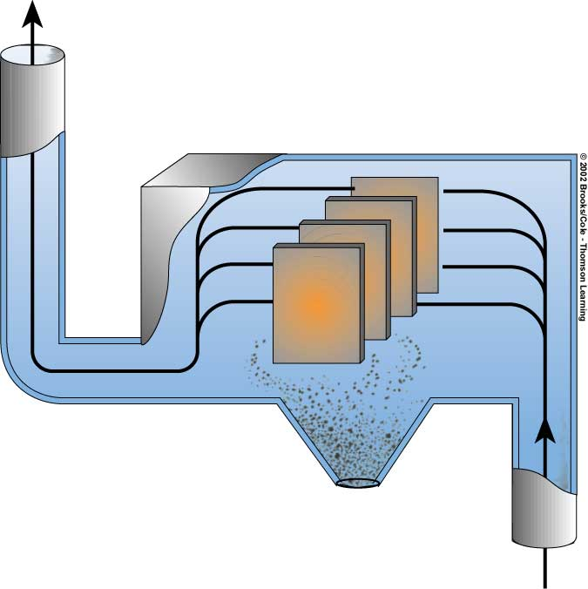
Remove particulates
from industrial plants (dust & smoke)
Cleaned gas
Electrodes
Dust discharge
Dirty gas
Electrostatic Precipitator

Slide 23
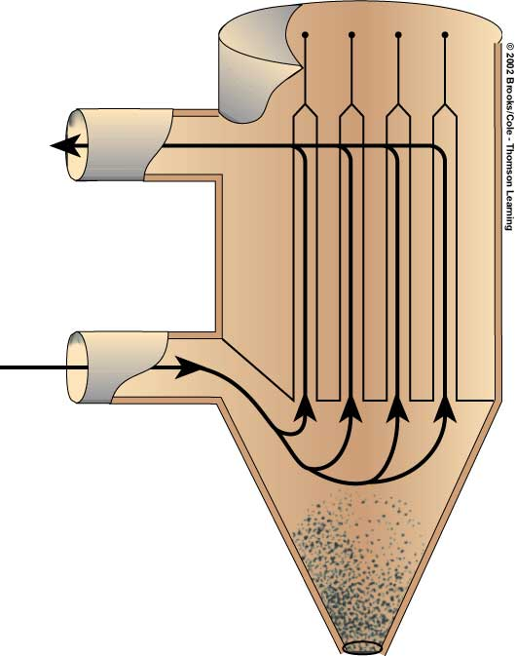
Bags
Remove more of the
Hazardous fine particles
(dioxins & furans)
Cleaned gas
Dirty gas
Baghouse Filter
Dust discharge

Slide 24
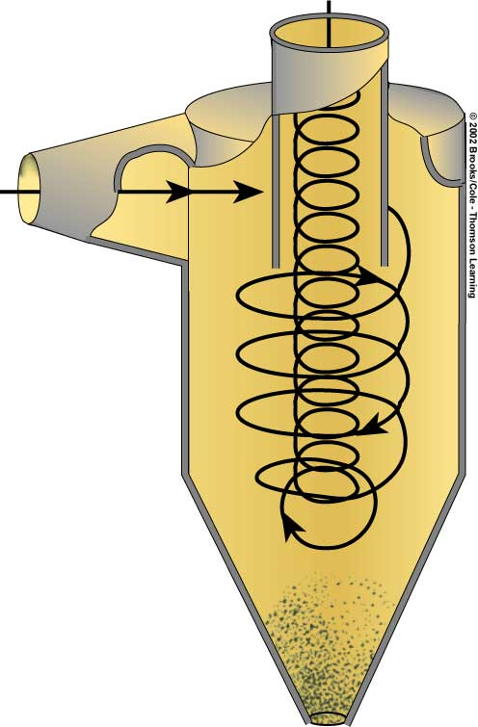
Cleaned gas
Dirty gas
Cheapest solution to
Removing particulates
Cyclone Separator
Dust discharge

Slide 25
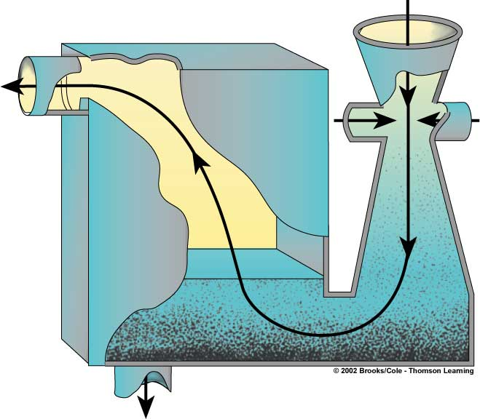
Cleaned gas
Dirty gas
Clean
water
Wet
gas
Dirty water
Can also reduce sulfur
dioxide emissions
Wet Scrubber

Slide 26
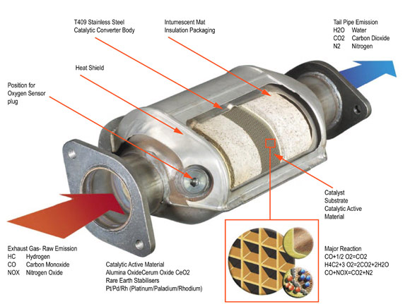
What is a Catalytic Convertor?
Designed to take harmful emissions
and release less harmful substances
http://auto.howstuffworks.com/catalytic-converter.htm

Slide 27
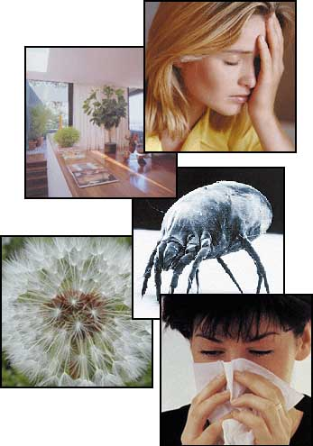
Indoor Air Pollution
more indoor than outdoor
4 most dangerous pollutants:
1)Cigarette smoke
2)Formaldehyde – colorless, extremely irritating gas,
chronic breathing problems, sinus/eye irritation, and nausea.
Ex – plywood, high-gloss wood in floors and furniture, drapes, adhesives in carpeting,
3)Radon-222 gas – natural gas
Radioactive decay of uranium
cannot see, taste, or smell
cracks in foundations/walls, openings in sump pumps. .
radon exhausts
www.epa.gov/iaq/radon
4)fine particles/ultrafine particles
asbestos/fiberglass
**negative effects of humans
Who is affected most?
EPA Studies have found that common pollutants can be 2-5 time higher inside than outside
http://www.youtube.com/watch?v=gciSp5X40t0
Notes:
Who is affected most – elderly people, children, children with compromised immune system, fac

Slide 28
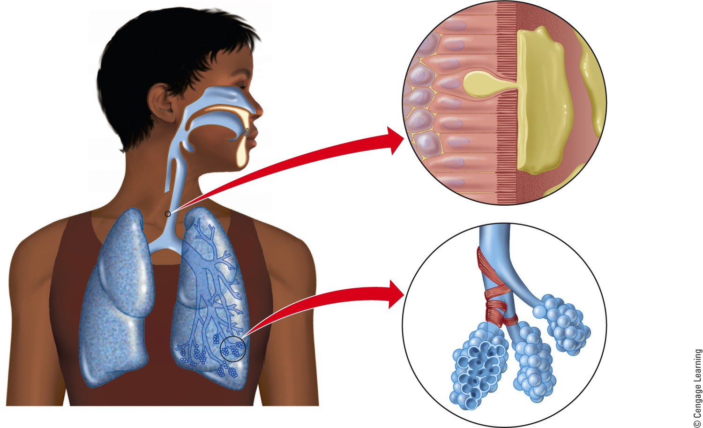
Major Components of the Human Respiratory System
Epithelial cell
Nasal cavity
Cilia
Oral cavity
Goblet cell (secreting mucus)
Pharynx (throat)
Trachea (windpipe)
Mucus
Bronchus
Bronchioles
Right lung
Alveolar duct
Bronchioles
Alveolar sac (sectioned)
Alveoli
Fig. 18-21, p. 492
Notes:
Figure 18.21: Major components of the human respiratory system can help to protect you from air pollution, but these defenses can be overwhelmed or breached.

Slide 29
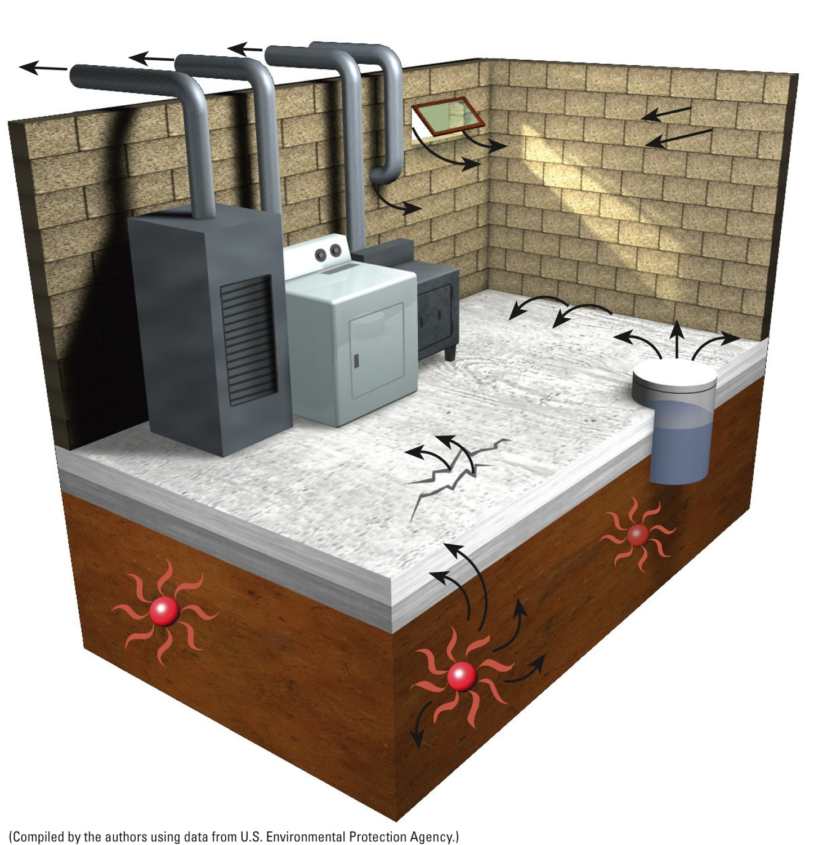
Case Study: Radioactive Radon Gas (cont’d.)
Outlet vents for furnace, dryer, and woodstove
Open window
Cracks in wall
Openings around pipes
Slab joints
Wood stove
Clothes dryer
Cracks in floor
Sump pump
Furnace
Slab
Radon-222 gas
Uranium-238
Soil
Fig. 18-19, p. 491
Notes:
Figure 18.19: There are a number of ways that radon-222 gas can enter homes and other buildings. Question: Have you tested the indoor air where you live for radon-222?

Slide 30
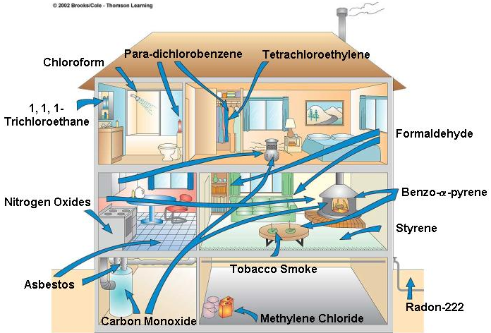
Indoor Air Pollution/Sick Building Syndrome
Fig. 17-17
p. 434

Slide 31
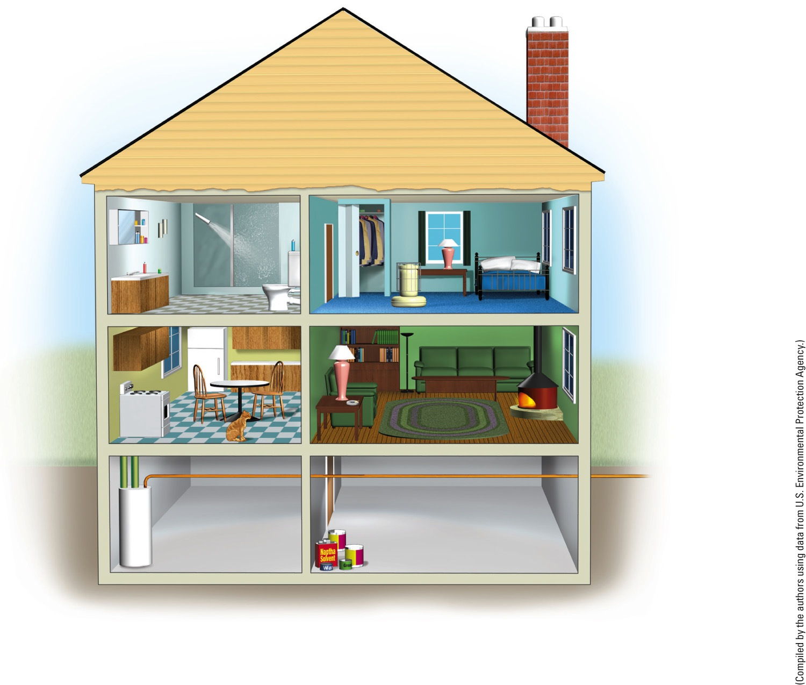
Chloroform Source: Chlorine-treated water in hot showers
Possible threat: Cancer
Para-dichlorobenzene Source: Air fresheners, mothball crystals
Threat: Cancer
Tetrachloroethylene Source: Dry-cleaning fluid fumes on clothes Threat: Nerve disorders, damage to liver and kidneys, possible cancer
Formaldehyde
Source: Furniture stuffing, paneling, particleboard, foam insulation
Threat: Irritation of eyes, throat, skin, and lungs; nausea; dizziness
1,1,1-Trichloroethane Source: Aerosol sprays Threat: Dizziness, irregular breathing
Styrene
Source: Carpets, plastic products
Threat: Kidney and liver damage
Nitrogen oxides Source: Unvented gas stoves and kerosene heaters, woodstoves Threat: Irritated lungs, children's colds, headaches
Benzo-α-pyrene Source: Tobacco smoke, woodstoves Threat: Lung cancer
Particulates
Source: Pollen, pet dander, dust mites, cooking smoke particles
Threat: Irritated lungs, asthma attacks, itchy eyes, runny nose, lung disease
Radon-222
Source: Radioactive soil and rock surrounding foundation, water supply
Threat: Lung cancer
Tobacco smoke
Source: Cigarettes Threat: Lung cancer, respiratory ailments, heart disease
Asbestos
Source: Pipe insulation, vinyl ceiling and floor tiles
Threat: Lung disease, lung cancer
Carbon monoxide
Source: Faulty furnaces, unvented gas stoves and kerosene heaters, woodstoves Threat: Headaches, drowsiness, irregular heartbeat, death
Methylene chloride Source: Paint strippers and thinners
Threat: Nerve disorders, diabetes
Fig. 18-17, p. 489
Notes:
Figure 18-17 Numerous indoor air pollutants are found in most modern homes. Question: To which of these pollutants are you exposed?

Slide 32
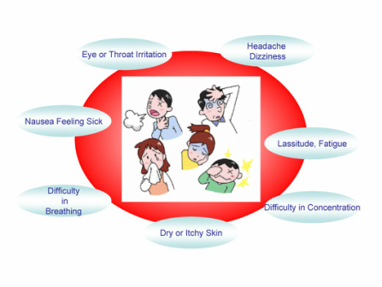
Sick Building Syndrome

Slide 33
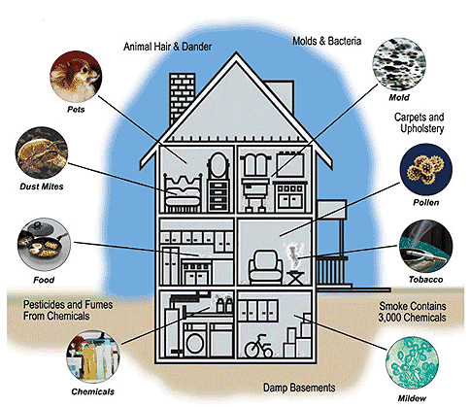

Slide 34

Solutions
Prevention before cleanup
Fuel-efficiency for cars
Clean Air Acts – US
air pollution regulations –city & state
“National ambient air quality standards”
use “cap and trade market approach”
Ex – clean air act established a cap and trade for SO2
Notes:
Cap:
-a cap is a limit placed on the amount of emissions allowed
-cap will decrease over time to try and reduce amount of emissions in long run
power plant is given a certain # of pollution credits or rights that allow it to emit a certain amount of SO₂/Carbon/etc
-TRADE
-they can sell excess credits if they do not use (possibly if they are more ecofriendly in their corporation) to other companies and make lots of money (billions).
trade

Slide 35
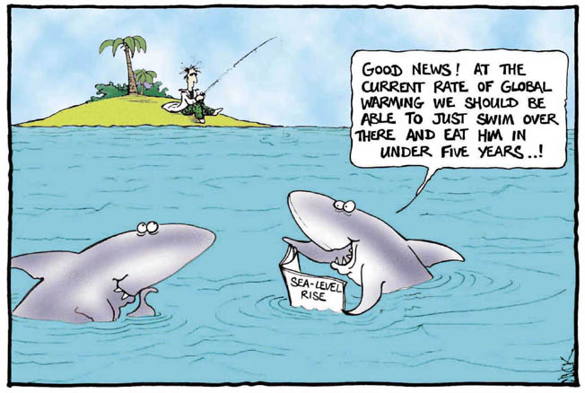
Climate Change and Ozone Loss

Slide 36
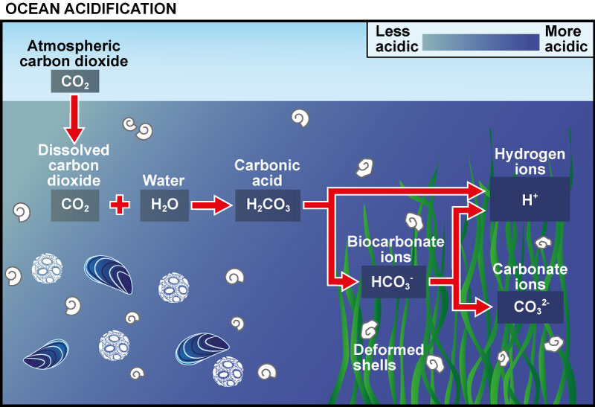
Ocean Acidification

Slide 37
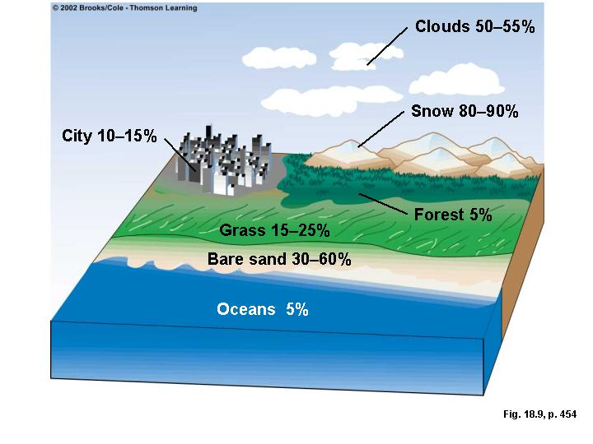

Factors Affecting Earth’s Temperature
Fig. 18-13 p. 458
1)Solar Output
how much sun will hit the earth
can warm or cool.
seasons
2)Earth’s Reflectivity/ALBEDO
Ex -snow and sand reflect light better
Ex-sulfate aerosols – reflect
Ex-soot - absorb
3)Oceans
moderate climate by removing excess CO₂
Carbon sink
absorb heat and store it in ocean.
gigantic conveyor belt to transfer heat
4)Cloud formation
Warming or cooling
5)Air Pollution
Notes:
Atmosphere warms – ice shrinks – less reflective water (lower albedo)
Clouds – warmer temps increase evaporation (more water vapor) form more clouds, effec tcan have either warming effect – absorbs heat or cooling effect– reflecting sunlight
Sea ice reflects 80% of incoming solar radiation
Water absorbs 80% of radiation - warmer

Slide 38
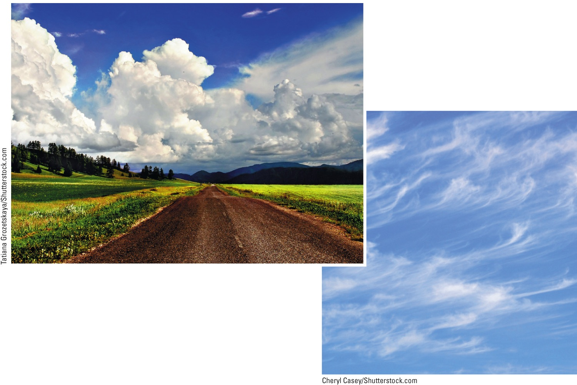
Figure 19-10: Cumulus clouds (left) are thick, relatively low-lying clouds that tend to decrease surface warming by reflecting some incoming solar radiation back into space. Cirrus clouds (right) are thin and float at high altitudes; they tend to warm the earth’s surface by preventing some heat from flowing into space.
Fig. 19-10, p. 513
Notes:
Figure 19-10: Cumulus clouds (left) are thick, relatively low-lying clouds that tend to decrease surface warming by reflecting some incoming solar radiation back into space. Cirrus clouds (right) are thin and float at high altitudes; they tend to warm the earth’s surface by preventing some heat from flowing into space.

Slide 39
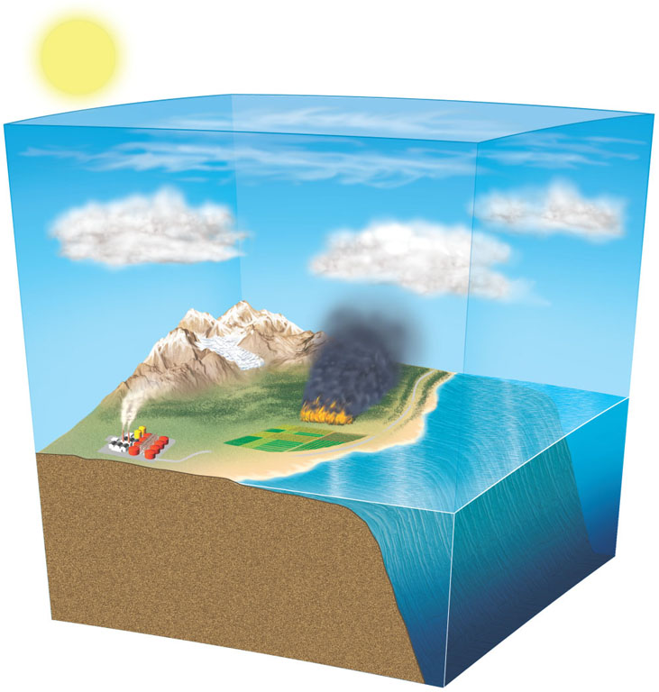
Sun
Troposphere
CO₂ removal by plants and soil organisms
Greenhouse
gases
Cooling from increase
Heat and
CO₂ removal
Warming
from
decrease
CO₂ emissions from land cleaning, fires, and decay
Aerosols
Heat and
CO₂ emissions
Ice and snow cover
Shallow ocean
Land and soil biotoa
Long-term
storage
Natural and human emissions
Deep ocean
Stepped Art
Fig. 20-6, p. 469
Notes:
Ocean can absorb and then slowly release heat and co2 emissions

Slide 40
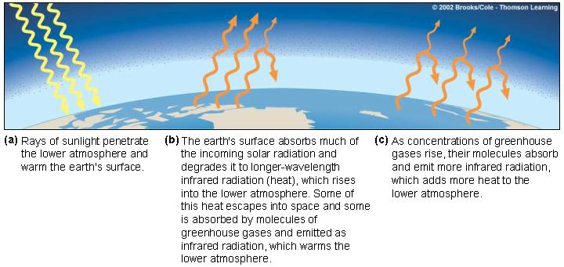
The Natural Greenhouse Effect
Greenhouse effect
Greenhouse gases
(Refer to Table 18-1 p. 448)
Fig. 6-13 p. 128

Slide 41
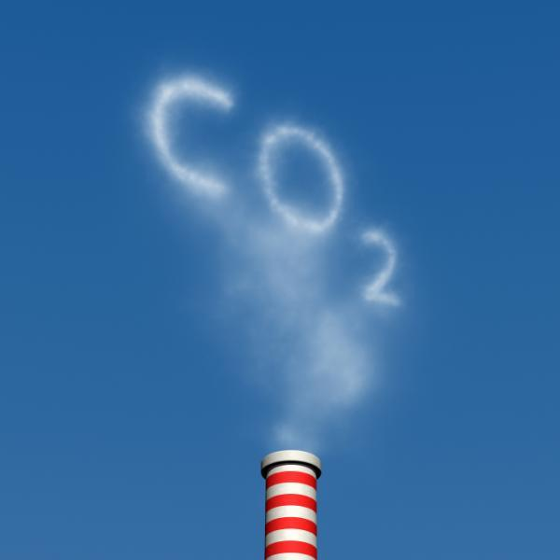
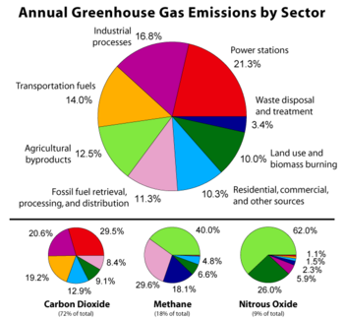
What are greenhouse gases?
https://www.epa.gov/ghgemissions/sources-greenhouse-gas-emissions
water vapor
carbon dioxide
methane
nitrous oxide
chlorofluorocarbons
Ozone
(In order from most to least”)
Natural vs Anthropogenic
Notes:
Water vapor accounts for 95% of greenhouse gas. Creates a positive feed back loop. Temperature is correlated with water vapor – increase in temp causes an increase in water vapor (such as from more carbon dioxide in atmosphere). When water evaporates and forms water vapor, causes more warming
Ozone occurs natural in trophosphere at low levels

Slide 42
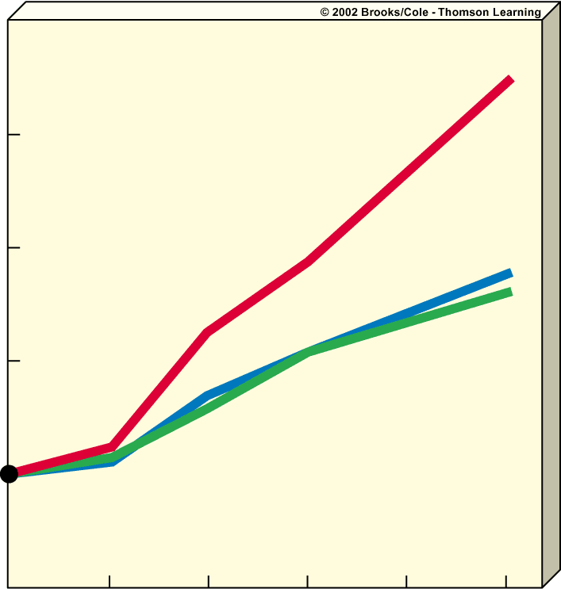
Carbon dioxide
Methane
250
Nitrous oxide
200
Index (1900 = 100)
150
100
1990
2000
2025
2050
2075
2100
Year

Slide 43
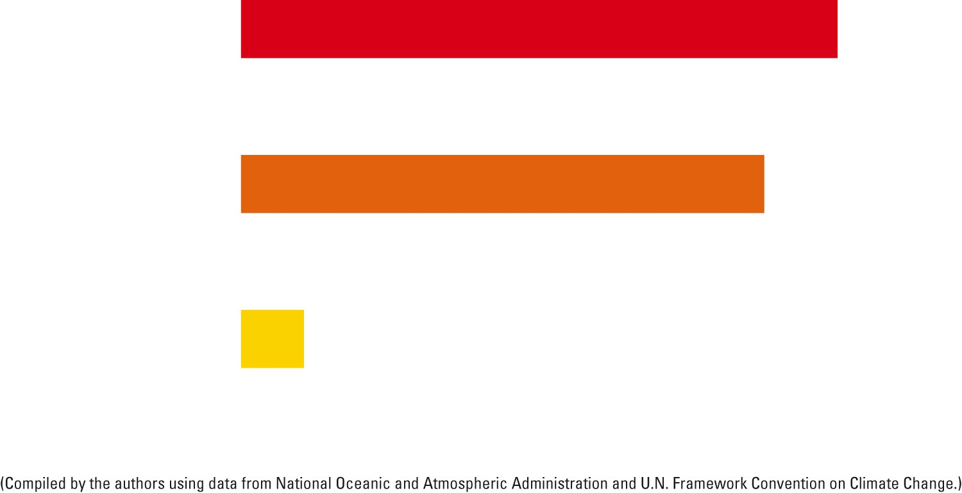
Atmospheric lifetime
Nitrous oxide (N₂O)
114 yrs
Carbon dioxide (CO₂)
100 yrs
(varies 50–200 yrs)
Although water vapor accounts for
66% if earth’s greenhouse effect, only
Stays for 1-3 weeks (short residence time)
Methane (CH₄)
12 yrs
Figure 19.6 Atmospheric lifetimes
Fig. 19-6a, p. 510
Notes:
Figure 19.6 Atmospheric lifetimes and warming potentials for three major greenhouse gases.

Slide 44
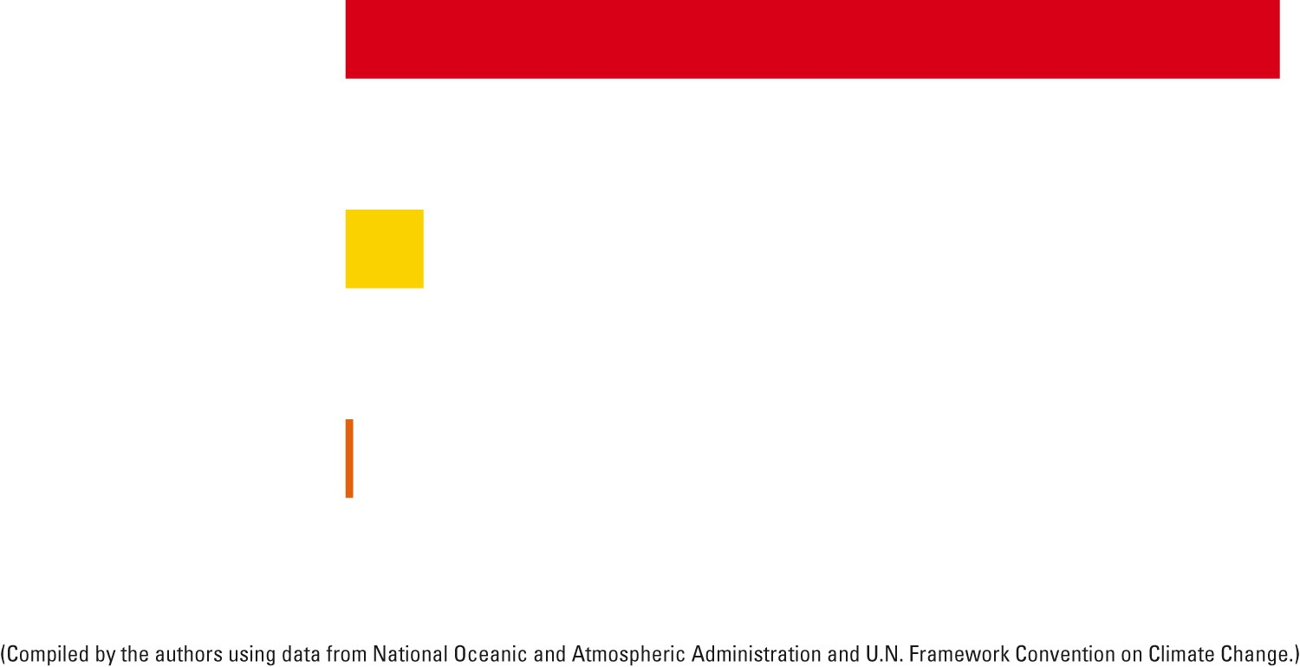
Atmospheric Warming Potential
(over 100 years, as multiples of CO2 warming potential)
Nitrous oxide (N₂O)
300
Methane (CH₄)
25
Carbon dioxide (CO₂)
Figure 19.6 Atmospheric lifetimes warming potentials for three major greenhouse gases.
1
Fig. 19-6b, p. 510
Notes:
Figure 19.6 Atmospheric lifetimes and warming potentials for three major greenhouse gases.

Slide 45
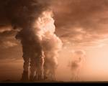


Global Warming:
temperature increases higher over land than oceans
greater by poles than equator
water expands slightly when heated (thermal expansion)
Water becomes more acidic (CO2 gets dissolved in H₂O and forms carbonic acid – H₂CO₃)
Enhanced Greenhouse Effect
What human activities cause:
1) fossil fuels - CO₂ and CH₄
***2 largest emissions
coal burning plants & motor vehicles
2) deforestation and burning of crops CO₂ and N₂O – nitrous oxide
3) inorganic fertilizers - release N₂O
Notes:
Trees breathe and take in carbon dioxide and release oxygen. They store carbon in their trunks. Because trees live such a long time, there are amazing carbon sinks. They sequester carbon dioxide. Cutting down trees inevitably alters carbon storage, and releases carbon dioxide into the air as the wood decays. Also burning trees releases carbon dioxide.

Slide 46
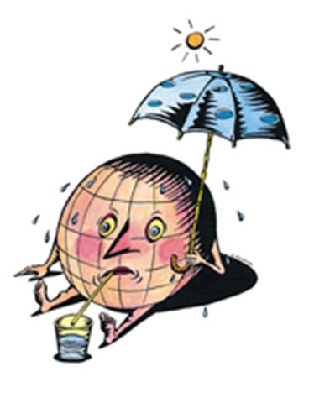

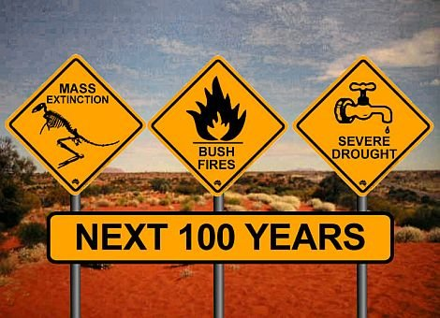
Are we definitely experiencing global warming?
*** 10 of the hottest years have come from 1998
2017 – hottest
History of Atmosphere
Earth – 4.7 billion years old
average temp has been changing throughout history
periods of global cooling and global warming
past 10,000 years, fairly stable climate and average global temperature

Slide 48
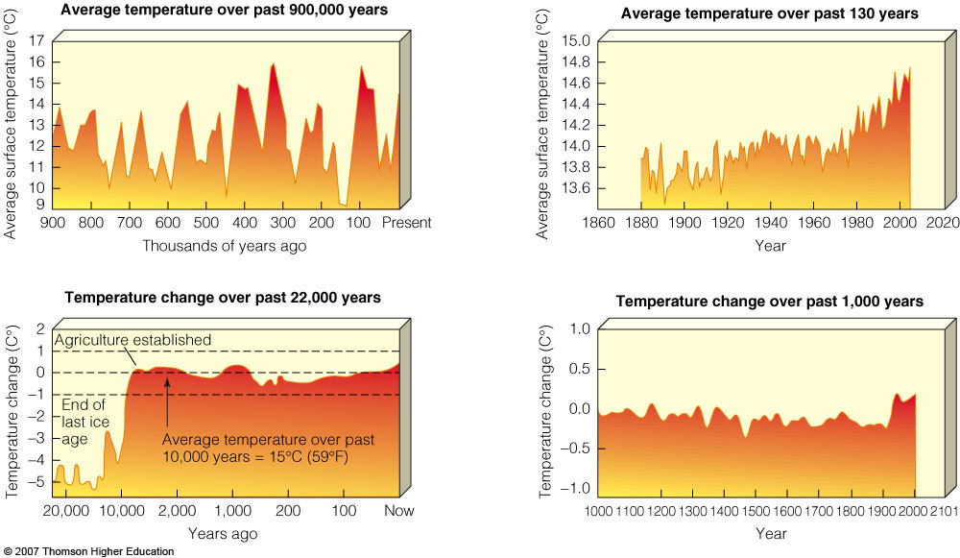
PAST CLIMATE AND THE GREENHOUSE EFFECT
Figure 20-2

Slide 49
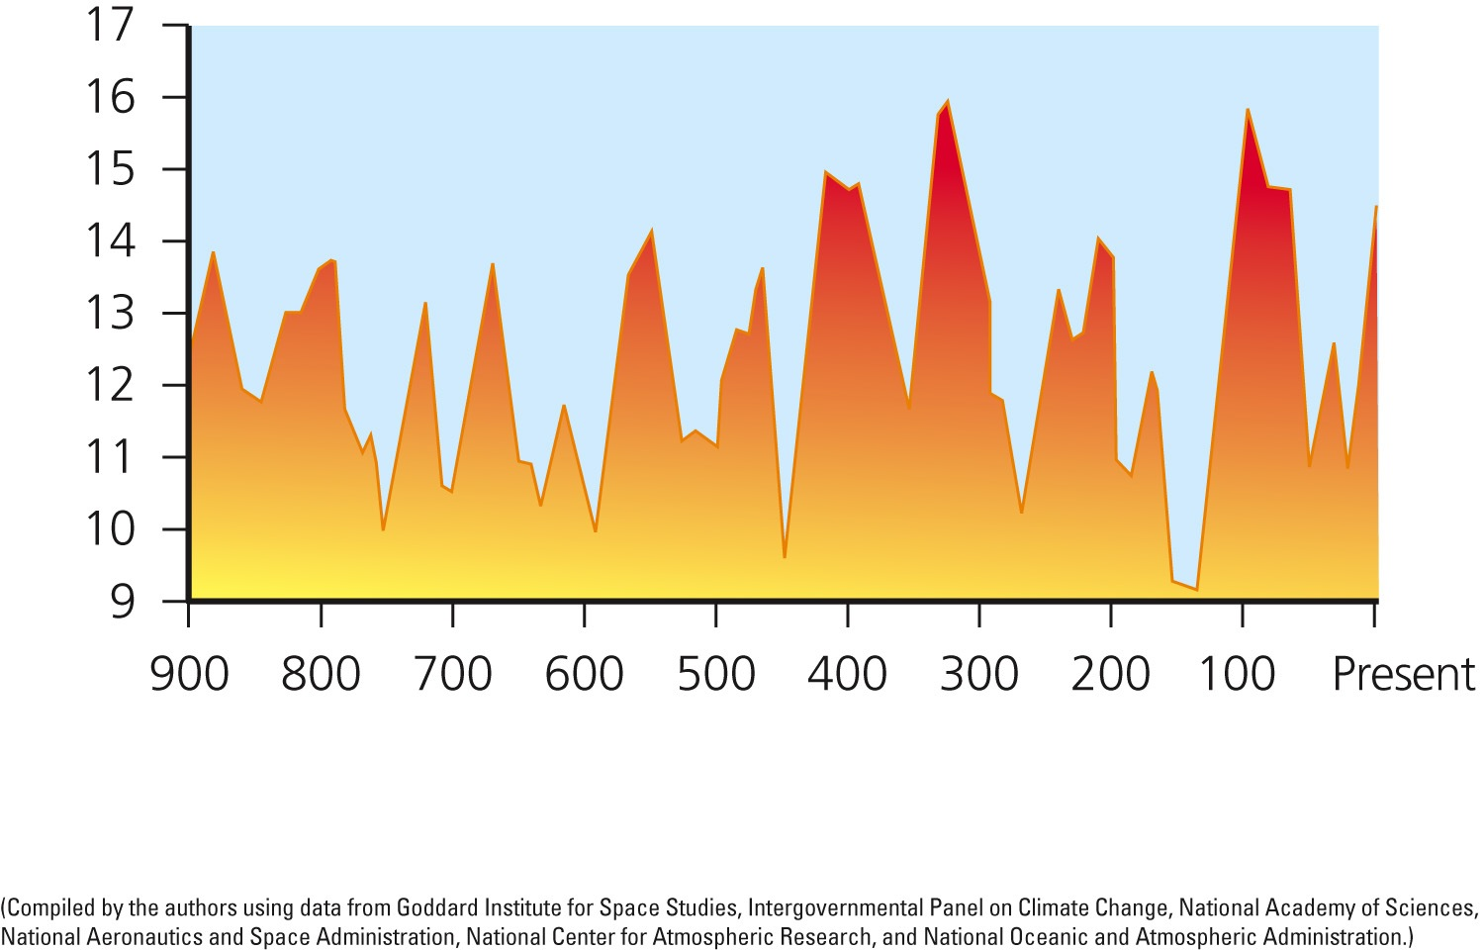
AVERAGE TEMPERATURE (over past 900,000 years)
Average surface temperature (°C)
Thousands of years ago
Fig. 19-2, p. 507
Notes:
Figure 19-2: Over the past 900,000 years, the average global temperature of the atmosphere near the earth’s surface has fluctuated widely. This graph is based on a body of scientific evidence that contains gaps, but the data clearly indicate general trends. Question: What are two conclusions you can draw from this graph?

Slide 50
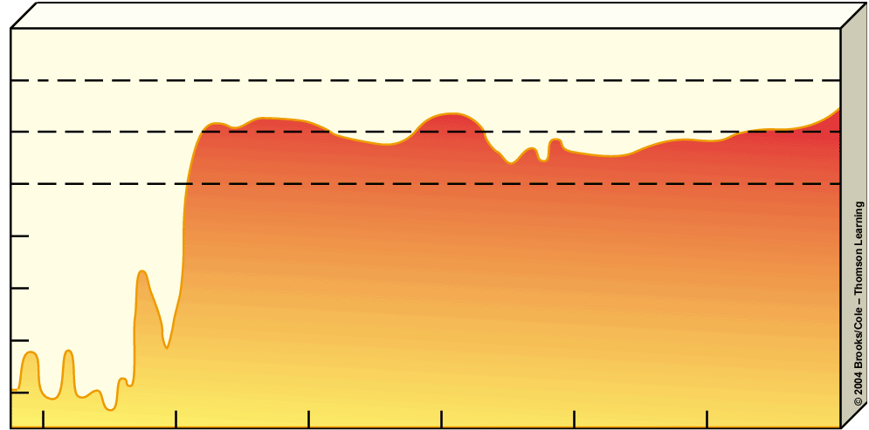
Temperature change over past 22,000 years
2
Agriculture established
1
0
-1
End of
last ice
age
Temperature change (°C)
-2
-3
Average temperature over past
10,000 years = 15°C (59°F)
-4
-5
20,000
10,000
2,000
1,000
200
100
Now
Years ago

Slide 51

Temperature change over past 1,000 years
1.0
0.5
0.0
Temperature change (°C)
-0.5
-1.0
1000
1100
1200
1300
1400
1500
1600
1700
1800
1900
2000
2101
Year

Slide 52

AVERAGE TEMPERATURE (over past 130 years)
Average surface temperature (°C)
Year
Fig. 19-3, p. 507
Notes:
Figure 19-3: Atmospheric warming has trended upward since 1975 with a slight slowing of this trend between 2002 and 2012. Question: What are two conclusions you can draw from this graph?

Slide 53

How Do We Know What Temperatures Were in the Past?
Figure 19-4: Ice cores are extracted by drilling deep holes into ancient glaciers at various sites such as this one near the South Pole in Antarctica. Analysis of ice cores (tiny bubbles are found that have ancient air trapped inside) yields information about the past composition of the lower atmosphere, temperature trends, solar activity, snowfall, and forest fire frequency.
(Can also look at radioisotopes in rocks, fossils, and ocean sediments, pollen at bottom of lakes and bogs, tree rings, temperatures taken since 1861)
http://earthobservatory.nasa.gov/Features/Paleoclimatology_IceCores/
Fig. 19-4, p. 507
Notes:
Figure 19-4: Ice cores are extracted by drilling deep holes into ancient glaciers at various sites such as this one near the South Pole in Antarctica. Analysis of ice cores yields information about the past composition of the lower atmosphere, temperature trends such as those shown in Figure 19-2, solar activity, snowfall, and forest fire frequency.

Slide 54

Fig. 19-8, p. 511
Notes:
Figure 19-8: Comparison of atmospheric concentrations of carbon dioxide (CO₂) and the atmosphere’s average temperature for the period 1880–2011. Temperature data show the fluctuating seasonal average temperatures (orange curve) as well as the mean, or average of these data (red curve). While the data show an apparent relationship between the mean temperature and CO₂ concentrations, they do not establish that these two variables are related.

Slide 55

The Scientific Consensus about Future Climate Change
Measured and projected changes in the average temperature of the atmosphere.
Figure 20-7

Slide 56
Fig. 20-7, p. 470
Notes:
Figure 20.7
Natural capital degradation: comparison of measured changes in the average temperature of the atmosphere at the earth’s surface between 1875 and 2005 and the projected range of temperature increase during the rest of this century. QUESTION: If these projections are valid, list three ways this will affect your lifestyle. (Data from U.S. National Academy of Sciences, National Center for Atmospheric Research, and Intergovernmental Panel on Climate Change, Hadley Center for Climate Prediction and Research)

Slide 57



History of Climate Change
http://www.cnn.com/video/data/2.0/video/tech/2009/12/06/coren.kyoto.backgrounder.cnn.htmlKYOTO TREATY CNN
1972 (Sweden)
UN Conference on the Human Environment in Stockholm-(first major conference on environmental issues International – 113 )
1992 (Brazil)
Earth Summit in Rio de Janeiro (UNFCCC)
“United Nations Framework Convention on Climate Change”
1997 (Japan)
Kyoto Treaty
2009 (Copenhagan) Summit on Climate Change (UNFCCC)
2012 (Qatar)UN Climate Change Conference –Qatar
2013 Warsaw, Poland
2014 Lima, Peru
2015 Paris, France
2016 Morocco
2017 Bonn, Germany
2018 Poland
Notes:
http://www.nature.com/news/the-kyoto-protocol-hot-air-1.11882
Kyoto Treaty
Tried to cut greenhouse emissions to an average of about 5.2% below 1990 levels by 2012 (38 Developed- US pulled out in 2005)
The seeds of Kyoto's problems were planted long before the treaty took shape. Many go back to June 1992, when negotiators at the Earth Summit in Rio de Janeiro, Brazil, were hammering out the United Nations Framework Convention on Climate Change (UNFCCC), the umbrella treaty that would encompass the Kyoto Protocol.
In Copenhagen in 2009, nations failed to produce a follow-on treaty to the Kyoto Protocol. However, in Durban, South Africa, last year, countries including China and the United States agreed to negotiate a new climate treaty by 2015. If the past is any indication, the final details of that pact will not emerge until the sleep-deprived delegates have reached the deadline of the final negotiating session.
The 2014 Summit in NYwill come one year before countries aim to conclude a global climate agreement in 2015 through the United Nations Framework Convention on Climate Change. Although the 2014 Climate Summit is not part of the negotiating process, countries have recognized the value of the Summit, including by welcoming the Secretary-General’s efforts in a Decision of the Doha climate conference in 2012

Slide 58



Evidence of Global Warming
http://www.globalgreen.org/articles/global/95
Areas of Sea level rise
1)increased temperature
2)melting of ice caps/glaciers
3)sea level rise (average global 10-20 cms (4-8 in) over past 100 years
4)northward migration of fish, birds, butterflies
5)early spring/late fall
Possible Effects
patterns of crop growth (increase/decrease food production)
Change biomes
Change ocean currents
availability of water (some areas more/some less)
disrupt marine wildlife
increased flooding/drought
more destructive storms (hurricanes, tornadoes)
Insect borne diseases
death and illness (or maybe fewer if warmer weather)
http://dsc.discovery.com/convergence/globalwarming/interactive/interactive.html
Shows Effects
Notes:
US top areas of sea level rise:
NY, Virginia Beach, Miami, New Orleans
Antartica – ice increasing
Arctic – ice decreasing

Slide 59

Fig. 19-1, p. 506
Notes:
Figure 19-1: The total area of Greenland’s glacial ice that melted by July 8, 2012 (red area in right image) was much greater than the amount that melted during the summer of 1982 (left).

Slide 60

Average minimum ice cover, 1979–2010
Minimum ice cover, September 16, 2012
Fig. 19-11a, p. 517
Notes:
Figure 19.11 The big melt: Rising average atmospheric and ocean temperatures have caused more and more arctic sea ice to melt during the summer months. The yellow line added to this satellite image (left) shows the average summer minimum area of ice during the period 1979–2010, in contrast to the white, ice-covered summer minimum in 2012. The graphs (right) show that the sea ice melt has been accelerating. Question: Which is declining faster, the summer sea ice area, or the summer sea ice volume?

Slide 61

Agriculture
Water Resources
Forests
Shifts in food-growing areas
Changes in crop yields
Increased irrigation demands
Increased pests, crop diseases, and weeds in warmer areas
Changes in water supply
Decreased water quality
Increased drought
Increased flooding
Changes in forest composition and locations
Disappearance of some forests
Increased fires from drying
Loss of wildlife habitat and species
Biodiversity
Sea Level and Coastal Areas
Extinction of some plant and animal species
Loss of habitats
Disruption of aquatic life
Rising sea levels
Flooding of low-lying islands and coastal cities
Flooding of coastal estuaries, wetlands, and coral reefs
Beach erosion
Disruption of coastal fisheries
Contamination of coastal aquifiers with salt water
Weather Extremes
Human Health
Prolonged heat waves and droughts
Increased flooding from more frequent, intense, and heavy rainfall in some areas
Human Population
Increased deaths from heat and disease
Disruption of food and water supplies
Spread of tropical diseases to temperate areas
Increased respiratory disease and pollen allergies
Increased water pollution from coastal flooding
Increased deaths
More environmental refugees
Increased migration

Slide 62

EFFECTS OF GLOBAL WARMING
Between 1979 and 2005, average Arctic sea ice dropped 20% (as shown in blue hues above).
Figure 20-8

Slide 63

Russia
*
North
pole
Greenland
Alaska (U.S.)
Canada
Fig. 20-8, p. 474
Notes:
Figure 20.8
Science: satellite data showing Arctic sea ice between 1979 and 2005. The white area shows a moving average of Arctic sea ice between 2003 and 2005. The darker blue surrounding the white area is the moving average for the sea ice between 1979 and 1981. Between 1979 and 2005, average Arctic sea ice dropped 20%—a loss in area about the size of the U.S. state of Texas. The decrease in light-colored ice reflects less incoming solar energy back into space and can heat the troposphere. This in turn can cause more ice to melt and raise temperatures more in a runaway positive feedback cycle. QUESTION: List three impacts that this and continued melting of Arctic sea ice might have on your lifestyle. (Goddard Space Flight Center, NASA)

Slide 64

Rising Sea Levels
During this century rising seas levels are projected to flood low-lying urban areas, coastal estuaries, wetlands, coral reefs, and barrier islands and beaches.
Figure 20-10

Slide 65

Rising Sea Levels
Changes in average sea level over the past 250,000 years based on data from ocean cores.
Figure 20-9

Slide 66

Rising Sea Levels
If seas levels rise by 9-88cm during this century, most of the Maldives islands and their coral reefs will be flooded.
Figure 20-11

Slide 67

Fig. 19-14, p. 520
Notes:
Figure 19-14: If the average sea level rises by 1 meter (3.3 feet), the areas shown here in red in the U.S. state of Florida will be flooded.

Slide 68

Changing Ocean Currents
Global warming could alter ocean currents and cause both excessive warming and severe cooling.
Figure 20-12

Slide 69
Food Production Could Face an Overall Decline
Regions of farming may shift
  Decrease in tropical and subtropical areas
  Increase in northern latitudes
    Less productivity – soil not as fertile
Hundreds of millions of people could face starvation and malnutrition

Slide 70

Solutions
prevention/reduce energy waste
nonrenewable to renewable energy sources
planting trees to remove CO₂
CO₂ increase could → increase photosynthesis naturally? (reduce global warming)
http://video.nationalgeographic.com/video/environment/global-warming-environment/global-warming-101/
Global Warming Review
http://environment.nationalgeographic.com/environment/global-warming/gw-effects/
National Geographic Global Warming Effects & Quiz

Slide 71

Solutions
Slowing Climate Disruption
Prevention
Cleanup
Cut fossil fuel use (especially coal)
Sequester CO₂ by planting trees and preserving forests and wetlands
Shift from coal to natural gas
Repair leaky natural gas pipelines and facilities
Sequester carbon in soil using biochar
Improve energy efficiency
Sequester CO₂ deep underground (with no leaks allowed)
Shift to renewable energy resources
Reduce deforestation
Sequester CO₂ in the deep ocean (with no leaks allowed)
Use more sustainable agriculture and forestry
Remove CO₂ from smokestack and vehicle emissions
Put a price on greenhouse gas emissions
Fig. 19-22, p. 528
Notes:
Figure 19-22: Some ways to slow atmospheric warming and the resulting projected climate disruption during this century (Concept 19-3). Questions: Which five of these solutions do you think are the best ones? Why?

Slide 72

Removing CO₂ From the Atmosphere
Tree
plantation
Coal
power plant
Tanker delivers
CO₂ from plant
to rig
Oil rig
Abandoned
oil field
CO₂ is
pumped down
from rig for
Deep ocean
disposal
CO₂ is pumped
down to reservoir
through abandoned oil field
Crop field
Switchgrass
field
Spent oil reservoir is
used for CO₂ deposit
Fig. 18-21
p. 467
= CO₂ deposit
= CO₂ pumping

Slide 73

Orbiting Satellite Space Shield
Stratospheric Reflective Aerosol Dispersal Using High-altitude Balloons
Stratospheric Reflective Aerosol Dispersal Using Jet Aircraft
Genetically Modified
Trees Absorb More Carbon
Cloud Brightening with Seawater
Iron Fertilization
Promotes Carbon-Absorbing Marine Organisms
Fig. 19-23, p. 529
Notes:
Figure 19-23: Geoengineering schemes include ways to reflect more sunlight, and some carbon sequestration approaches (Figure 19-D) can also be thought of as geoengineering. Questions: Of the approaches shown here, which three do you think are the most workable? Why?

Slide 74

Ozone Depletion
lower stratosphere
thinning over Antarctica & Arctic – overall thinning everywhere but tropics
CFC’s biggest reason for ozone depletion (chlorofluorocarbons “Freons”)
stable, odorless, nonflammable, nontoxic, noncorrosive, cheap
dream chemicals
spray cans/coolants/sterilants
other chemicals such as halons and carbon tetrachloride can also deplete
Notes:
http://www.theozonehole.com/ozoneholehistory.htm
“Why ozone hole greatest over Antartica”
Stratosphere - Filters out all UVC (most dangerous), most UVB, and some UVA shines through
Polar Stratospheric Clouds (ice clouds) form in Antarctica – many reactions occur inside that destroy ozone
Also, variation in solar radiation greatest over the Antarctica, with 3 continuous months of dark - -80C (-112F), very strong winds – Polar Vortex

Slide 75

Ultraviolet light hits a chlorofluorocarbon
(CFC) molecule, such as CFCl₃, breaking
off a chlorine atom and
leaving CFCl₂.
Sun
Cl
Once free, the chlorine atom is off
to attack another ozone molecule
and begin the cycle again.
UV radiation
A free oxygen atom pulls
the oxygen atom off
the chlorine monoxide
molecule to form O₂.
The chlorine atom attacks
an ozone (O3) molecule,
pulling an oxygen atom off
it and leaving an oxygen
molecule (O2).
The chlorine atom
and the oxygen atom
join to form a chlorine monoxide molecule (ClO).
Summary of Reactions
CCl₃F + UV Cl + CCl₂F
Cl + O₃ ClO + O₂
Cl + O Cl + O2
Repeated
many times
Fig. 20-18, p. 486
Notes:
Figure 20.18
Natural capital degradation: simplified summary of how chlorofluorocarbons (CFCs) and other chlorine-containing compounds can destroy ozone in the stratosphere faster than it is formed. Note that chlorine atoms are continuously regenerated as they react with ozone. Thus, they act as catalysts, chemicals that speed up chemical reactions without being used up by the reaction. Bromine atoms released from bromine-containing compounds that reach the stratosphere also destroy ozone by a similar mechanism.

Slide 76















Ultraviolet light hits a chlorofluorocarbon (CFC) molecule, such as CFCl₃, breaking off a chlorine atom and leaving CFCl₂.
Once free, the chlorine atom is off to attack another ozone molecule
and begin the cycle again.
Sun
Cl
Cl
C
Cl
F
UV radiation
Cl
Cl
O
O
The chlorine atom attacks an ozone (O₃) molecule, pulling an oxygen atom off it and leaving an oxygen
molecule (O₂).
A free oxygen atom pulls
the oxygen atom off
the chlorine monoxide
molecule to form O2.
Cl
O
Cl
O
O
O
O
Cl
The chlorine atom and
the oxygen atom join to
form a chlorine monoxide
molecule (ClO).
O
O
Stepped Art
O
Fig. 20-18, p. 486

Slide 77

Ozone Degradation
Figure 18-30: Natural Capital Degradation: These colorized satellite images show ozone thinning over Antarctica during September of 1980 (left), 2000 (center), and 2011 (right). Ozone depletion of 50% or more occurred in the dark blue and purple areas
Fig. 18-30, p. 498
Notes:
Figure 18-30: Natural Capital Degradation: These colorized satellite images show ozone thinning over Antarctica during September of 1980 (left), 2000 (center), and 2011 (right). Ozone depletion of 50% or more occurred in the dark blue and purple areas.

Slide 78

Problems with Ozone Depletion
UV rays
Filters out all UVC (most dangerous), most UVB, and UVA shines through (95%)
sunburns, skin cancer, eye cataracts
decrease in phytoplankton
decreased photosynthesis,
reduced yields of crops
CFCs act as greenhouse gases (warm earth)
Solutions
try to stop producing all ozone-depleting chemicals (ODCs)
many substitutes available
Montreal Protocol (signed by 177 countries) -1987
Rowland & Molina
Notes:
UVA – longest wavelength, normally penetrates and shines through ozone, can penetrate skin and cause skin aging and cancer, penetrates skin more deeply than UVB, used in tanning booths, can penetrate glass
UVB – shorter rays, most does not shine through ozone, causes skin reddening and burning, cannot penetrate glass, worst from April to October (10AM-4PM)
UVC – shortest rays, do not penetrate ozone layer and reach earth, most damaging if did

Slide 79

Ultraviolet A
Ultraviolet B
Thin layer of
dead cells
Hair
Epidermis
Squamous
cells
Basal
layer
Sweat
gland
Melanocyte
cells
Dermis
Basal
membrane
Blood
vessels
Squamous Cell Carcinoma
Basal Cell Carcinoma
Melanoma
Notes:
Basal cell – most common type
Squamous cell –worse
Melanoma - worst

Slide 80

Natural Capital Degradation
Effects of Ozone Depletion
Human Health
• Worse sunburn
• More eye cataracts
• More skin cancers
• Immune system suppression
Food and Forests
• Reduced yields for some crops
• Reduced seafood supplies from reduced phytoplankton
• Decreased forest productivity for UV-sensitive tree species
Wildlife
• Increased eye cataracts in some species
• Decreased population of aquatic species sensitive to UV radiation
• Reduced population of surface phytoplankton
• Disrupted aquatic food webs from reduced phytoplankton
Air Pollution and Materials
• Increased acid deposition
• Increased photochemical smog
• Degradation of outdoor paints and plastics
Fig. 20-21, p. 488
Global Warming
• Accelerated warming because of decreased ocean uptake of CO2 from atmosphere by phytoplankton and CFCs acting as greenhouse gases
Notes:
Figure 20.21
Natural capital degradation: expected effects of decreased levels of ozone in the stratosphere. QUESTION: Which five of these effects do you think are the most important?

Slide 81

OZONE DEPLETION IN THE STRATOSPHERE
During four months (mid August-late November)
half of the ozone in the stratosphere over Antarctica and a smaller amount over the Artic is depleted.
September/October worst
http://www.theozonehole.com/ozoneholehistory.htm
Figure 20-19

Slide 82

OZONE DEPLETION IN THE STRATOSPHERE
Since 1976, in Antarctica, ozone levels have markedly decreased during October and November.
Figure 20-20

Slide 83

What Can You Do?
Reducing Exposure to UV Radiation
• Stay out of the sun, especially between 10 A.M. and 3 P.M.
• Do not use tanning parlors or sunlamps.
• When in the sun, wear protective clothing and sun–
glasses that protect against UV-A and UV-B radiation.
• Be aware that overcast skies do not protect you.
• Do not expose yourself to the sun if you are taking
antibiotics or birth control pills.
• Use a sunscreen with a protection factor of 15 or 30
anytime you are in the sun if you have light skin.
• Examine your skin and scalp at least once a month for
moles or warts that change in size, shape, or color or
sores that keep oozing, bleeding, and crusting over. If
you observe any of these signs, consult a doctor
immediately.
Fig. 20-23, p. 490
Notes:
Figure 20.23
Individuals matter: ways to reduce your exposure to harmful UV radiation. QUESTION: Which three of these actions do you think are the most important? Which ones do you do?

